Slide 1

eCATS -
SUPPLIER EXTERNAL
USER GUIDE

Slide 2
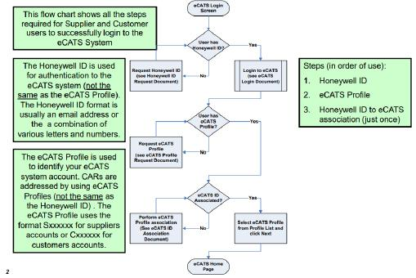
HONEYWELL ECATS
SUPPLIERS ACCOUNT
eCATS Login Process- Supplier / Customer Users
Follow the flow chart step(s) 1 and 2
As illustrated in next 2 slides
PROCESS FOR SUPPLIERS TO REQUEST AN ACCOUNT AND ID TO USE ECATS

Slide 3
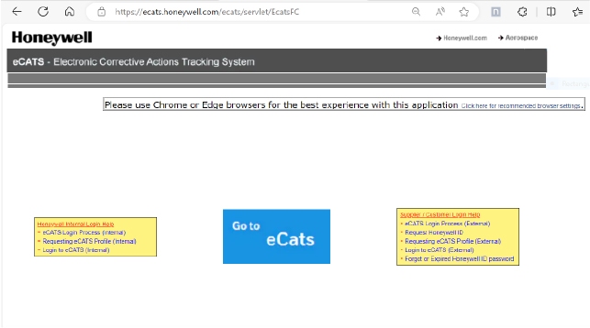
HONEYWELL ECATS
SUPPLIERS ACCOUNT
Go to
https://ecats.honeywell.com
Select Request Honeywell ID Link click embedded pdf icon for instructions
SUPPLIER REQUESTS UNIQUE USER ID (TYPICALLY 3 - 5 BUSINESS DAYS)

Slide 4
HONEYWELL ECATS
SUPPLIERS ACCOUNT
Go to
https://ecats.honeywell.com
Select Requesting eCATS Profile (External) Link click embedded pdf icon for instructions
SUPPLIER SETS UP USER PROFILE AFTER SUPPLIER ID IS RECEIVED

Slide 5
HONEYWELL ECATS
SUPPLIERS ACCOUNT
Go to
https://ecats.honeywell.com
The eCATS profile password is only used to associate an existing eCATS Profile to a new Honeywell ID. Newly created profiles have the association already completed and the password is not needed. If the eCATS profile password needs to be reset, contact an eCATS administrator for assistance.
Select Forgot or Expired
Honeywell ID password Link
SUPPLIER NEEDS PASSWORD RESET

Slide 6




ROLES /
RESPONSIBILITIES
OWNER
The person at the supplier that is responsible for answering the finding to the CAR at the Owner Response Phase. Then responsible for implementing those responses at Owner Implementation Phase prior to Follow up Review.
SPOC (Single Point of Contact)
The Honeywell person that interfaces with the supplier to ensure that root cause and corrective CAR responses meet Honeywell requirements, managing the corrective / preventive actions for an individual event. The SPOC has the responsibility to work directly with the Owner/supplier of the CAR to help answer the findings using the 5 Why CAMP tool and any other 8D methodology.
LEAD
The Honeywell person that represents the Requester’s interest in the CAR process.
REQUESTER
The Honeywell person requesting a corrective/preventive action to be implemented using eCATS due to an external customer event caused by the supplier or a finding during a Honeywell Audit.
OWNER & SPOC TOGETHER PLAY A KEY ROLE IN THE SUCCESS AND TIMELY CLOSURE OF THE CAR

Slide 7
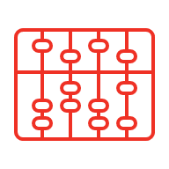




DEFINITIONS
CAMP (CAUSE ANALYSIS AND MISTAKE PROOFING)
Is a process for finding the root causes of an event and facilitating corrective/preventive actions through mistake proofing.
RCCA
Root Cause Corrective Action
NATURAL TEAM
A group of people at the supplier having vested ownership of the problem to solve the reason for the CAR. This should include Quality, manufacturing, and management at the supplier and any other function needing to be part of the team. Should also include Honeywell SPOC and FQE (if different than the SQE) and the Honeywell SDE.
QUALIFIED TEAM
The natural team, including other individuals (i.e. Honeywell) who can provide necessary resources to understand the problem or can help in the cause analysis and mistake proofing process (SME).
CAR/SCAR
(Supplier) Corrective Action Request is the record that documents the corrective action process.
SUPPLIER NEEDS TO ESTABLISH A STRONG NATURAL TEAM. THE QUALIFIED TEAM SUPPORTS NATURAL TEAM

Slide 8




DEFINITIONS
(CONT)
EVENT
An occurrence resulting in a nonconformity, product failure, process failure, customer complaint, customer escape, audit finding(s), failure mode, accident, or other potential or detected problems.
CAUSE CHAIN
Diagram showing the causes linked in a sequence from the event question to the root cause for why made and missed.
ERROR PROOFING
A process that provides a structure for designing a failure mode out of a Product or process (performed with cause analysis).
CAUSES
Direct - The cause that directly resulted in an event.
Contributing - The cause that contributed to an event but, by itself, would not have caused the event. There can be several contributing causes to a finding.
Root - The last cause in the chain (Why Made and Why Missed).
CORRECTIVE ACTIONS MUST BE DRIVEN FROM ROOT CAUSE(S)

Slide 9

DEFINITIONS
(CONT)
ACTIONS:
Specific Action/Containment - Actions taken to correct the direct cause. Corrects or improves the detected event, by changing the direct cause, or the direct cause and the effect. Also, may be referred to as remedial action
Corrective Action - Actions taken to address the root and/orcontributing causes to prevent recurrence of the detected event
Preventive / Systemic Action - Actions taken to ensure that the detected event does not occur in other areas/locations or prevent from occurring
NFF / CID:
NFF (No Fault Found) - Artifacts should include original manufacturing test data and as returned test data proving passing results before and after shipment to the customer
CID (Customer Induced Damage) - Artifacts should include objective evidence that feature or damaged component was checked for conformity prior to shipment to Honeywell
CAR ACTIONS D5 – D7 MUST BE DRIVEN TO CORRECT ROOT CAUSE

Slide 10
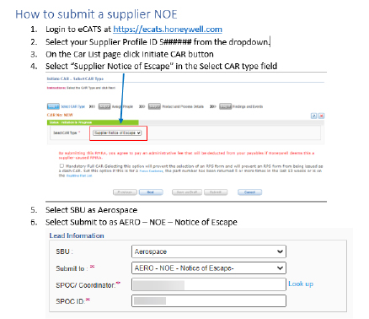
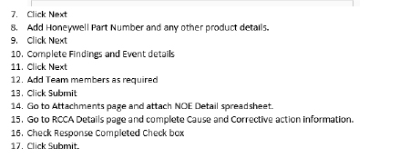
SUPPLIER DISCLOSURE
TO HONEYWELL
Honeywell QA will then review for containment and issue a CAR to the supplier.
COMMUNICATION TO HONEYWELL ON NEW NON CONFORMANCE

Slide 11
CAR COMPLETION
PROCESS FLOW MAP
Initiate CAR
Containment D0 and D3 within 2 days
Holding for Hardware
Owner Response (including D0 and D3 containment) to be completed by supplier within 21 days.
2 Part Approval after Owner Response
Response aging on pause. Timing metrics will resume when supplier receives the part.
SPOC/Lead (Honeywell)
Owner (Supplier)
Owner Response Phase (30 days from initiation of CAR)
Owner Implementation to be completed by supplier
Follow-up Review to be completed after supplier objective evidence has been attached
Owner (Supplier)
Follow-up reviewer (Honeywell)
Owner Implementation includes all Specific, Corrective and Preventive actions are finished
Gray = Honeywell
Yellow = Supplier
Effectiveness Review
Effectiveness Reviewer (Honeywell)
OWNER RESPONSIBILITIES IN ORANGE. ACTIONS ARE TO BE COMPLETED BEFORE DUE DATES

Slide 12
D2 -
UNDERSTANDING THE PROBLEM
What to look for in the Event Definition.
Careful definition of the problem is worth the effort
Use data to define more than just the nonconformance:
  Where was it discovered?
  When was it discovered?
  What does the customer see? Can it be measured?
  Exactly what is affected? Can the population be bound?
  Pictures, drawings, and facts.
ASK SQE OR HONEYWELL FOR ADDITIONAL DETAILS TO DEFINE THE EVENT

Slide 13
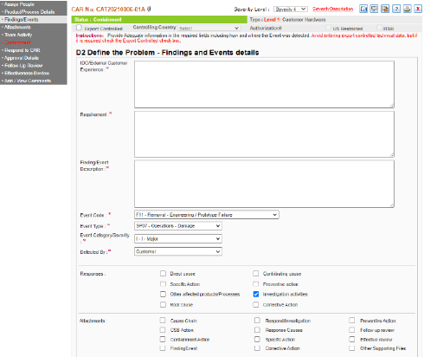
D2 -
DEFINE THE PROBLEM
In eCATS the problem is defined on the Findings/Events page.
IDO/External Customer Experience
Describe what the customer experienced
Requirement
Describe the requirement that was not met. Do not use a generic statement such as “Unit must comply with all applicable parameters and specifications”.
Finding/Event Description
Describe the event or the finding in as detailed terms as possible.
Event Code, Event Type, Even Category, and Detected by drop downs are required. Select the most appropriate available option for each.

Slide 14


CONTAINMENT
CONTAINMENT – PRODUCT
The process whereby actions are taken to assure that additional product with similar fault is identified so that corrective actions can be applied and allow additional shipments to the customer prior to CA implementation.
CONTAINMENT – PROCESS
The comprehensive series of containment activities undertaken on other similar product families, similar or common processing steps employed by other product families and any and all common processing equipment or facilities in order to ensure system-wide containment of the non-conformance event.
Containment actions may be documented in multiple places within the CAR
When the CAR includes an active Containment Tab (flashing red), containment actions (D0 and D3) will be documented there
Containment actions may also be recorded in the Specific Actions or Corrective Actions on the “Respond to CAR” page. If no containment is needed populate comments stating “no containment needed” with reason why containment is not necessary
Part not received is not an acceptable reason for no containment - there are containment steps that can be implemented prior to receipt of part and then refined once part arrives
CONTAINMENT D0 AND D3 MUST BE ADDRESSED ON ALL CARS

Slide 15
D0 -
IMPLEMENT IMMEDIATE CONTAINMENT
Stop the potential for any further occurrences of the event, defect, injury “Protect the customer”
  Lockout machine, stop shipping, stop the line.
  Contain parts already produced (stores, WIP, shipping, customer stores), account for every part
  Look at the entire pipeline including suppliers
  Goal is for containment within 2 Days (AS13100 calls for 48 hours)
Define what parts have the symptom-the issue the customer sees
URGENCY IS THE KEY TO MITIGATING ADDITIONAL CUSTOMER EVENTS

Slide 16
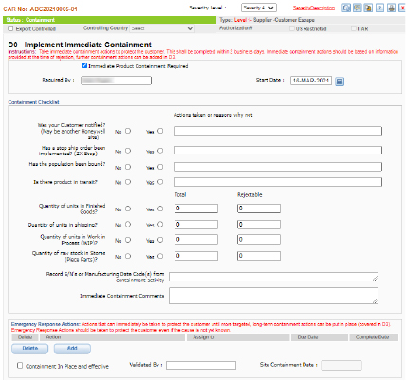
EMERGENCY
CONTAINMENT
The D0 portion of containment is required to be completed as part of the Containment phase of answering the CAR.
You will need to answer each question with a Yes, No, or N/A as applicable and provide some text explanation in the text fields to the right of each question.
The Immediate Containment Action Comments are not required but give you a space to record any additional comments you may have related to the D0 Containment activities.
An error message pop-up may occur when submitting
containment for completion which indicates missing
information somewhere on the containment page.

Slide 17
CONTAINMENT CHECKLIST –
PART 1
Was your Customer notified? (May be another Honeywell site)? Did you notify your customer of this event and that these defects occurred? Answer Yes or No and add explanation in field.
Has a stop ship order been implemented? (ZX Stop)? Did your facility issue a stop ship order on the affected parts and processes to prevent any further defects from shipping? Answer Yes or No and add explanation in field.
Has the population been bound? Do you know the population of parts that could potentially be affected by this defect or issue? Answer Yes or No and add explanation in field.
Is there product in transit? Is there any potentially affected product in transit to Honeywell or to one of Honeywell’s customers? Answer Yes or No and add explanation in field.

Slide 18
CONTAINMENT CHECKLIST –
PART 2
Each of the following questions relates to the population of the defect and whether or not the population in each category is known. If it is not known the answer is No and the quantity fields are 0. If it is known the answer is yes and the quantities are entered. All WIP and inventory locations at your facility and at your applicable sub-tiers' facilities.
Quantity of units in Finished Goods? How many potentially affected parts are in your finished inventory (Total) and of that total how many are known to have the defect (Rejectable)?
Quantity of units in shipping? How many potentially affected parts are in your shipping area (Total) and of that total how many are known to have the defect (Rejectable)?
Quantity of units in Work in Process (WIP)? How many potentially affected parts are in the process of being produced (Total) and of that total how many are known to have the defect (Rejectable)?
Quantity of raw stock in Stores (Piece Parts)? If this is a raw material issue, how many potentially affected pieces of raw material are in your inventory (Total) and of that total how many are known to have the defect (Rejectable)?
Record S/N's or Manufacturing Date Code(s) from containment activity. Record any serial numbers or manufacturing date codes that would identify affected material.
Immediate Containment Comments - Add any additional comments if needed.

Slide 19
EMERGENCY
CONTAINMENT ACTIONS
Completion of the D0 Containment section requires the addition of at least one Emergency Response Action.
These actions are taken to immediately stop the symptoms from affecting the customer until the problem can be resolved permanently.
There always has to be at least “one” Emergency Response Action entered and saved.
To add an action, click the “Add” button.

Slide 20
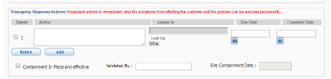

EMERGENCY
CONTAINMENT ACTIONS
The action line item will expand and allow data entry.
Type the description of the action.
Use the “Look Up” Link under the Assign to field to search for and select the user to whom the action will be assigned.
Select a Due Date and save the CAR.
Once the action has been completed, select a Completion date for each action and then check the “Containment In Place and effective” check box. This should auto populate the Validated By and Site Containment Date fields.
Next click the Submit button at the bottom of the screen.
This will move the CAR forward to the Waiting Owner Response Status.
An error message pop-up may occur when submitting
Containment for completion which indicates missing
information somewhere on the containment page.

Slide 21
D3 -
DEVELOP CONTAINMENT ACTIONS
Immediate containment (D0) refers to parts already produced
In house
Stock
WIP
Shipment
D3 Containment actions allow us to continue delivery until corrective actions are implemented
We must implement actions to immediately stop the symptoms from affecting the customer until the problem can be resolved permanently
Examples include special Inspections, Zero Escape Benches, SAP MIC’s…
Keep proper records and make notifications as required by the customer
D3 ALLOWS PRODUCTION TO RESUME ON EXISTING OR NEW BUILDS

Slide 22
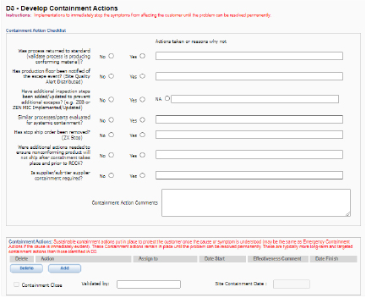
CONTAINMENT -
RESPONSE PHASE
The D3 portion of containment is required to be completed as part of the Owner Response phase of answering the CAR.
You will need to answer each question with a Yes, No, or N/A as applicable and provide some text explanation in the text fields to the right of each question.
The Containment Action Comments are not required but give you a space to record any additional comments you may have related to the D3 Containment activities.

Slide 23
CONTAINMENT -
RESPONSE PHASE
Was process returned to standard (validate process is producing conforming material)? Have you validated that the actions you have taken to allow you to ship conforming material are working? Answer Yes or No and add explanation in field.
Has production floor been notified of the escape event? (Site Quality Alert Distributed)? Have you distributed a notification describing the defect/event and what is being done to contain it to your shop floor technicians where the product is being made? Answer Yes or No and add explanation in field.
Have additional inspection steps been added/updated to prevent additional escapes? (e.g. Zero Escape Bench or Work Instruction Implemented/Updated)? Have you implemented a special extra inspection station or updated controls to inspect every unit with standard work to ensure there are zero escapes? Answer Yes or No and add explanation in field.
Similar processes/parts evaluated for systemic containment? Have you evaluated other similar product and processes at your facility to see if they require containment on similar issues? Answer Yes or No and add explanation in field.
Has stop ship order been removed? If a stop ship order was put in place during D0 at your facility, has it been removed? Answer Yes or No and add explanation in field.
Were additional actions needed to ensure nonconforming product will not ship after containment takes place and prior to RCCA? Answer Yes or No and add explanation in field.
Is supplier/sub-tier supplier containment required? Is containment required at a sub-tier supplier to the owner of the CAR? Answer Yes or No and add explanation in field.

Slide 24
CONTAINMENT
ACTIONS
Completion of the D3 Containment section requires the addition of at least one Containment Action.
These actions are taken to immediately stop the symptoms from affecting the customer until the problem can be resolved permanently.
There always has to be at least “one” Emergency Response Action entered and saved.
To add an action, click the “Add” button.

Slide 25
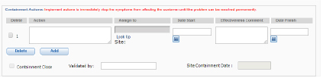
CONTAINMENT
ACTIONS
The action line item will expand and allow data entry.
Type the description of the action.
Use the “Look Up” Link under the Assign to field to search for and select the user to whom the action will be assigned.
Select a Due Date and save the CAR.
Once the action has been completed, type a comment on the effectiveness of the action taken, select a Completion date for each action and then check the “Containment Close” check box. This should auto populate the Validated By and Site Containment Date fields.
There always has to be at least “one” D3 Containment Action entered and saved.
Next click the Save button at the bottom of the screen and navigate to the Respond to CAR Page to continue with the CAR Response.

Slide 26
OWNER RESPONSE
PHASE
D1 - Team Member Expectations
Determining Team Members:
  Chose members of the Natural and Qualified Teams to assist in determining cause and corrective action plan (should be minimum of 2 people)
Supplier to gather and verify data:
Work with Honeywell SPOC and Natural Team to perform root cause and corrective actions to develop a Cause Chain that includes “5Y” methodology per CAMP training (Cause Analysis and Mistake Proofing). Cause Chain should be populated with brief statements. Ensure D2 (Finding) is understood, specific and enough information to initiate containment / investigation. Work with Honeywell (site or SQE) if additional information is needed.
WHEN CREATING A NATURAL TEAM, YOU SHOULD INCLUDE THE SPOC AND LEAD OF THE CAR

Slide 27
OWNER RESPONSE
PHASE (CONT)
Owner shall Create:
A why question that is robust enough to start the 5 why analysis.
Use problem solving tools to identify all direct causes, contributing causes and root cause
Specific Actions, Corrective Actions and Preventative Actions that will answer how the findings will be addressed. These actions must also include Systemic Actions
Owner shall set dates for task/action completion
*Note: There may be multiple sub-actions created and assigned for all 3 action types
Objective evidence will need to be provided when developing your corrective action plans
Embedded Cause Chains are not required for level 2 suppliers CARs as long as the Response Section of the CAR is robust enough to meets the 5 Why process for both Why Made and Why Missed
NO CORRECTIVE ACTIONS SHOULD BE IMPLEMENTED UNTIL OWNER RESPONSE PHASE HAVE BEEN APPROVED BY THE SPOC AND LEAD

Slide 28
CAUSE TYPES
EVENT
There are three types of causes:
DIRECT - the immediate cause of the event
CONTRIBUTING - contribute to the event
ROOT - fundamental cause of an event
All three types are used to construct cause analysis
* Remember there can be more than one contributing and root cause
DIRECT CAUSE
CONTRIBUTING CAUSE
ROOT CAUSE
D4 CAUSES FOR WHY MADE & WHY MISSED

Slide 29
5 WHY’S
EVENT
WHY?
One of the most natural and popular methods for finding root cause
Define an event question
Ask why the event question occurred
The answer is the direct cause
Ask why the direct cause occurred
The answer(s) are contributing causes
For each contributing cause, ask why
Continue asking why until root causes are found
DIRECT CAUSE
WHY?
WHY?
CONTRIBUTING CAUSE
CONTRIBUTING CAUSE
WHY?
WHY?
ROOT CAUSE
ROOT CAUSE
ROOT CAUSE
WHY 5? ROOT CAUSE IS TYPICALLY REACHED AT ABOUT THE FIFTH ANSWER

Slide 30

RECOGNIZING ROOT CAUSE
What does a good root cause look like?
Often:
It refers to a process rather than a person
It is under our control, or at least our organization’s
Searching for deeper causes can be unproductive
Preventing it from happening would make the issue unlikely occur again.
ROOT CAUSE SHOULD ADDRESS SYSTEMIC ISSUES

Slide 31
WHY MADE AND
WHY MISSED
EVENT
Two Separate Cause Chains for the Same Event:
WHY MADE and WHY MISSED
DIRECT CAUSE
Why was the mistake/defect made to begin with?
What in the process allowed the error to be made?
Why didn’t we catch the mistake (before it got to the customer)?
Most common example is an operations caused issue that was not caught by inspection
Often two or more groups/areas miss the error
Audit findings must have “Why Missed” analysis
  ‒ Why didn’t we catch the problem sooner?
  ‒ If a customer audit caught the problem, why didn’t we catch and repair it first?
CONTRIBUTING CAUSE
CONTRIBUTING CAUSE
D4 EXAMPLES AND KEY QUESTIONS TO DRIVE ROOT CAUSE

Slide 32
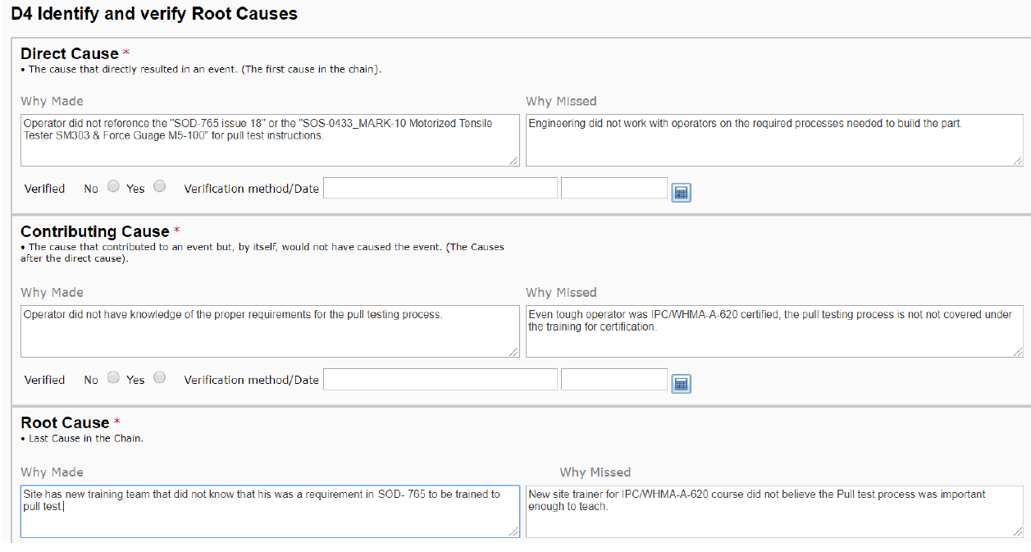
OWNER RESPOND TO
CAR CAUSES (ACCEPTABLE)
ALL CARS SHOULD REFLECT: DIRECT, CONTRIBUTING AND ROOT CAUSES

Slide 33
OWNER RESPOND TO
CAR CAUSES (UNACCEPTABLE)
N/A OR BLANK FIELD IS NOT AN ACCEPTABLE RESPONSE FOR CAUSE ANALYSIS

Slide 34

D5 - COMPARING ERRORS AND EVENTS
The best corrective actions are ones that include Error Proofing or Mistake Proofing elements.
To understand error proofing, you must understand the difference between Errors and Events!
An Error occurs and is a cause. Undetected, the Error leads to an Event or an Escape
ERROR EVENT
Forgot to stop at the store on the way home.
Proofread an email and still send the email with errors.
Dialed the wrong phone number.
After moving, went back to the old location.
Don’t have needed items for dinner.
Email recipient receives wrong information.
Speak to the wrong person.
Arrive at your old house instead of your new one.

Slide 35
D5 - KEY CORRECTIVE ACTION QUESTIONS
Do the long-term corrective actions address the root cause?
Do the corrective actions eliminate the root cause (error proofing) or do the corrective actions mitigate the root cause (mistake proofing)?
How will the corrective actions be formally implemented? Procedure change, tooling, test process change)?
Are the corrective actions specific and auditable? (They should be)
What is the plan to verify the corrective actions are effective? What data collection will be implemented?
Key Questions
Will the corrective action work if there are team changes? (It should)
Will the corrective action be in place permanently? (It should be)
Is this a short-term fix or the long-term solution (May have both)

Slide 36
SUMMARY
Supplier will work CAR to closure by using Cause Analysis (5 Why) or other 8D problem solving tools with Actions needed to address all findings to the systemic level.
Working with Honeywell SPOC and Lead, as part of the natural team, will help team to create a robust cause analysis (5 Why) that will prevent rejections during SPOC and Lead signoff.
Owner Implementation can be completed when all Specific, Corrective and Preventive actions are finished.
All objective evidence is to be attached to CAR before moving it to follow up review.

Slide 37
THANK YOU!

