Slide 1
VMI Flex implementation training
Christine Marshall
VMI Process Leader

Slide 2
agenda
Overview
VMI Purchase Order Screen
Changing Delivery Dates/Quantities
Forecasting
OTTR Calculation
VMI Management Tools
Settlement/Consumption Reporting
Recent Improvements

Slide 3
What happens during VMI implementation?
Kickoff
Outline process between Honeywell and Supplier to properly Implement VMI
VMI Team / Supplier Collaboration & Initial Training
HASP user access, PO creation, VMI management tools
Signed VMI Parts System Settings Updated
Parts are changed in SAP to function as VMI
Review Open POs for VMI Parts
Essential for seamless transition onto the program
Conduct Go-Live Meeting
Supplier led to ensure full understanding and system functionality
Training
& Review
Honeywell Aerospace Supplier Portal Training
VMI Supplier Replenishment Training
Optimize Min levels / MOQs / Lot Sizing
Implement
System settings loaded to Flex configuration
VMI PO conversions
Validation
& Sustain
Schedule Quarterly VMI Reviews
Continuous Improvement through partnered inventory and delivery optimization

Slide 4
Agreement to implement parts
Pre-planned Go-Live date during negotiation
Alignment on the Min, Max, and CRLT parameters provided via the contract amendment
This ensures alignment between HON and Supplier
Provides Supplier with Min Target 1 month prior to implementation
Settings are reviewed and adjusted as needed quarterly via the QVR process
Min levels are based on latest demand and can become “stale” after a period of time
Parameters can be reviewed ad hoc by vendor request to their respective VMI Process Leader and/or VMI Program Manager
HON / Supplier Agreement Needed Prior to Implementation

Slide 5
Standard implementation schedule
Week 1: Initial Training Meeting
Complete VMI Flex training
Review HASP user access
Review signed Flex parts
Confirm Go-Live meeting date
Weeks 2-3: System Updates
Set up parts in SAP
Review Open POs
Week 4: Go-Live Meeting
Confirm parts live in the Flex portal
Step-by-Step PO Creation
Questions/Next Steps
Confirm QVR Lite date
Confirm QVR Standard date
VMI Implementation is a 4 Week Process

Slide 6
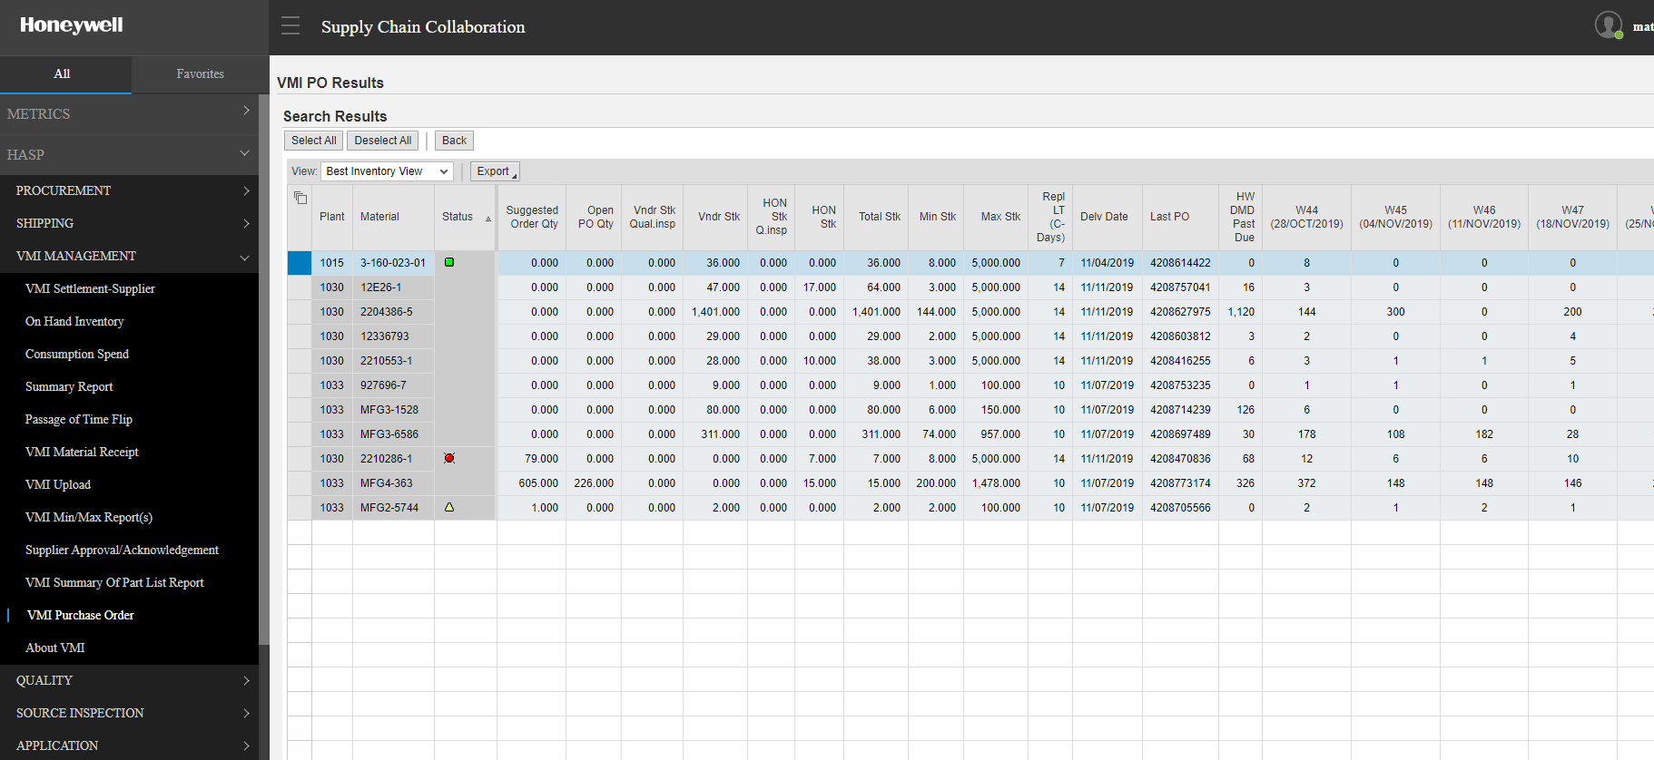
VMI purchase order screen
26 week Rolling MPS
Total Stock vs Min Stock
VMI Report Menu
Supply Health
Inventory Visibility

Slide 7
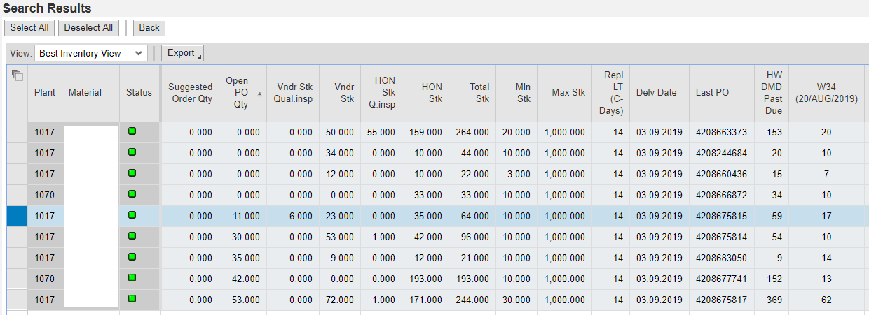
How to view VMI inventory in HASP
There are 5 inventory positions to view inventory
Open PO Qty = From PO creation to In transit to HON warehouse receipt
Vendor Stk Qual Insp = Receiving Step at Warehouse
Vndr Stk = Supplier Owned Inventory Position
HON Stk Q Insp = Quality inspection step after pull from Vndr Stk
Hon Stk = Honeywell owned Inventory Position

Slide 8
Creating a Vendor Purchase Order As easy as 1-2-3!
Create a Purchase Order
Fill in the PO quantity in the ‘Suggested Order Qty’ field
The line is already highlighted or highlight the line if you move the cursor
Click the Submit button
PO will generate with a delivery date based on the Contract Replenishment Lead Time (CRLT), typically 14 days. Recent enhancement allows selection of delivery date.
3
2
1
*Open PO Qty was 138

Slide 9
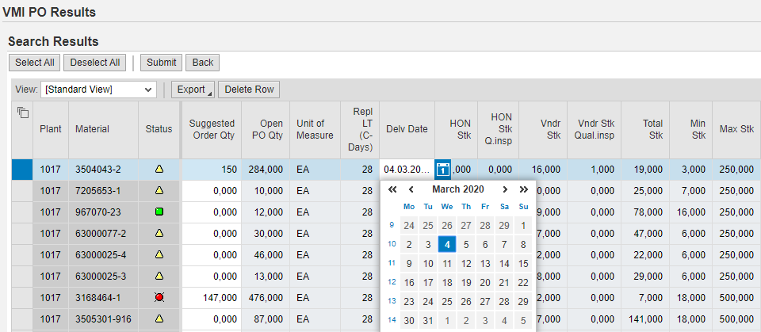
Delivery Date Selection at time of po creation
If you would like to create a VMI PO outside of your default replenishment lead time, you will need to select the appropriate date in the VMI Purchase Order screen, prior to hitting “Submit” for PO creation.
A calendar icon will display, allowing you to choose the delivery date for the PO being created. The date must be selected prior to hitting “Submit.”

Slide 10
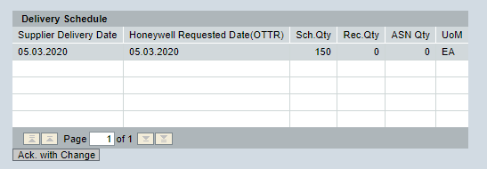
Changing Delivery date & PO quantity after po creation
To change the delivery date and/or quantity of a VMI PO, leverage the “Ack. With Change” button within the Purchase Order report.

Slide 11
Changing Delivery date & PO quantity after po creation
Select the delivery date you would like.

Slide 12
Changing Delivery date & PO quantity after po creation
Adjust the PO quantity if needed.

Slide 13
Changing Delivery date & PO quantity after po creation
Enter the Reason Text and select the applicable OTTR Miss code.

Slide 14
Changing Delivery date & PO quantity after po creation
Click submit, confirmation of change will display.

Slide 15
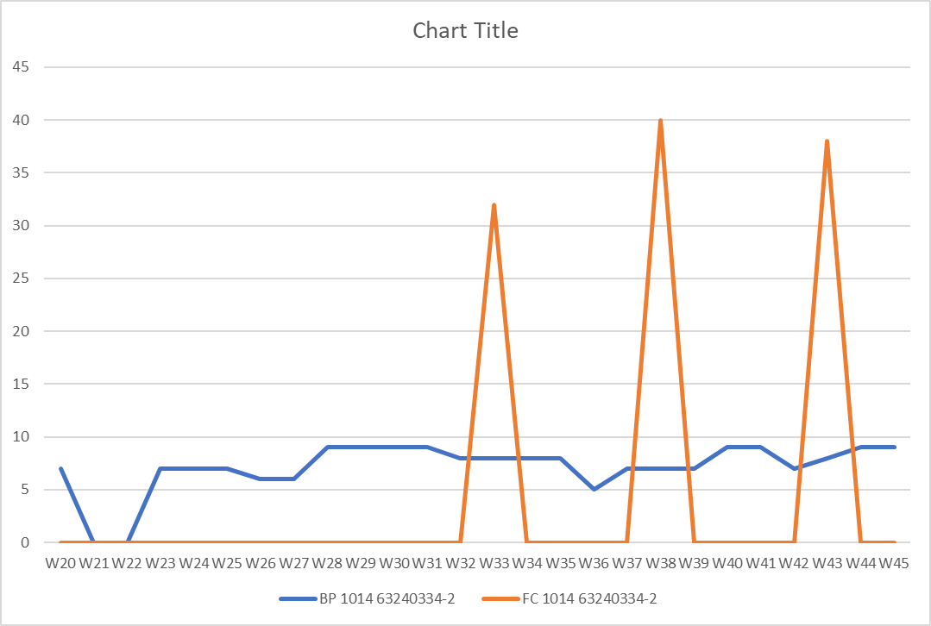
VMI Flex HASP– Two Forecasts Available
The Planning Forecast and has a 2-3 year time horizon. This forecast is more strategic and often buckets demand by month or quarter, instead of week.
Vendors are to use this forecast to build/MRP.
The MPS Forecast is Honeywell’s MRP extract, it is bucketed weekly and goes out 6 months.
Vendors typically use this forecast to ship to. Vendor can also use it build shorter lead time parts (<26 weeks build time)
These two forecasts tie out in the aggregate. If you add up 1 qtr of Planning Forecast and 1 qtr of Buildplan, the numbers will generally match. These forecast will not tie out on a week to week comparison
Vendors should use both forecasts to plan their requirements.
Planning
FC
Buildplan
MPS

Slide 16
VMI forecasting process & past due
Scenario 2
Scenario 1
Scenario 1 – Past Due is small, in this case less than 1X the Min.
HON is around 1 week past due and will be operating normally to the MPS.
Recommendation: Use MPS Demand signal guidance on when and how many to ship.
Scenario 2 – Past Due is very large, in this case 12X the Min.
HON is around 12 weeks past due and will be working hard to secure the missing parts and produce as many end items as possible. Collaborate with your buyer & VMI site focal to better understand the burndown plan.
Recommendation: Use historical Consumption Report to approximate the actual run rate and capacity of the Manufacturing Line. Use as guidance on when and how many to ship.

Slide 17
Open PO Report / PO Cancellation Process
As part of the VMI Flex implementation process, existing PO’s for the parts converting to Flex will be closed out. The VMI Process Specialist will send the supplier an Open PO Report for review the week prior to Go-Live.
Why are we doing this?
The new Flex system settings no longer match the existing PO parameters
Payment and receipt delays will occur if PO’s are not closed out
To ensure a clean Flex portal is in place for a successful Go-Live
Are there exceptions?
PO’s currently in transit can remain open
Delivery documentation and tracking numbers must already be generated
RTV PO’s must remain open
When will the PO’s be cancelled?
PO’s will be closed out once the part settings have converted to VMI Flex; this is typically the week prior to Go-Live.
What if the supplier needs to ship parts?
The supplier will now oversee the PO creation process for parts on the VMI Flex program. Once the parts have converted to Flex and the existing PO’s closed out, the supplier can create PO’s as needed in the Flex portal to fill the demand.

Slide 18
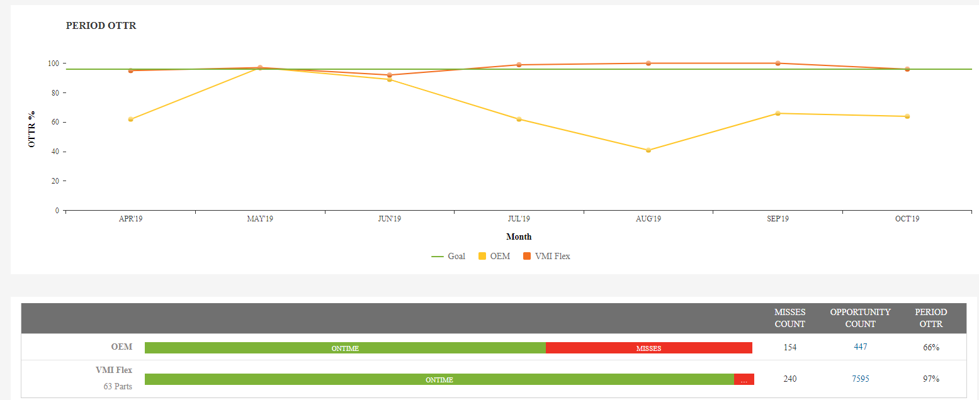
Simplified oTTr calculation
VMI Flex OTTR is not based on PO dates, but rather on the Total Stock >= Min.
Inventory Snapshot taken once per day and compared to the Min stock level
If OH Stock > Min - GOOD
If OH Stock < Min - BAD
Contract OTTR is based on support of requested PO dates
VMI Flex Success Relies on Healthy Inventory Levels

Slide 19
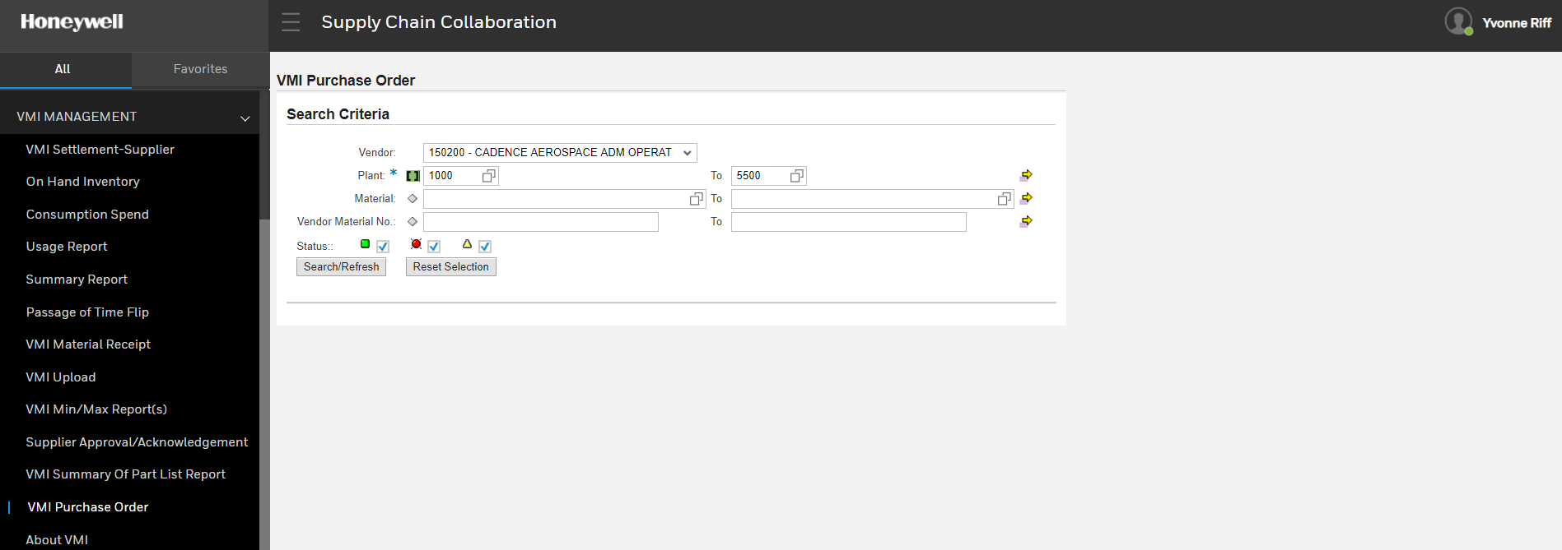
VMI MANAGEMENT TOOLS - HASP
Settlement Report – Provides consumption and payment details
On Hand Inventory – Current on hand position of VMI parts
Consumption Spend – Provides transfer of ownership data by month
Summary Report – Report of qty of parts moving in and out of VMI <180 days
Passage of Time Flip – VMI 1.0/2.0 PO flip date for transfer of ownership
VMI Material Receipt - Report of POs received within a specified timeframe
UNDER CONSTRUCTION - VMI Upload - VMI Min/Max Reports(s) – Supplier Approval/Ack
VMI Summary of Parts List – Report of part settings for VMI parts
VMI Purchase Order – PO creation Portal for VMI Flex and 2.0
About VMI – VMI Landing page with instructions and VMI Help Access

Slide 20
HASP VMI Settlement and Consumption Spend Reports
The VMI Process does not settle with supplier by PO, HON only starts payment clock when product is pull from bin.
Example:
100 unit PO received on May 1 – no payment made on $0 PO
HON pulls 10 pcs from VMI bin on May 3 – payment terms start on only 10 pcs
HON pulls 25 pcs from VMI bin on May 5 - payment terms start on only 25 pcs
Supplier can use “VMI Settlement” Report to reconcile payments.
When large HON Past Due occurs, MPS becomes clouded.
Vendor can use actual consumption to target when/how many to ship
Supplier can use VMI “Consumption Spend” Report to view at historical HON pulls

Slide 21
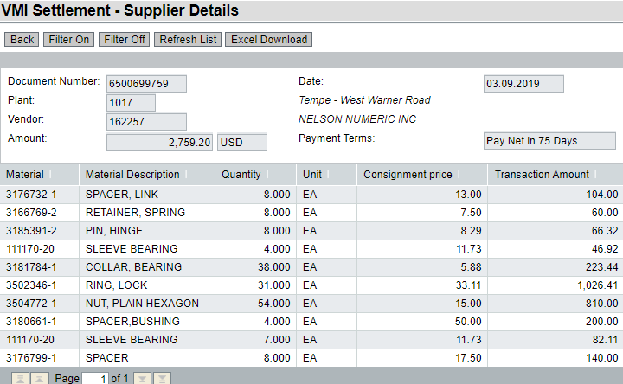
Settlement Report
Provides consumption (pull) details
Settlement runs once per day
All parts pulled are rolled up into a HW document
Part detail available

Slide 22
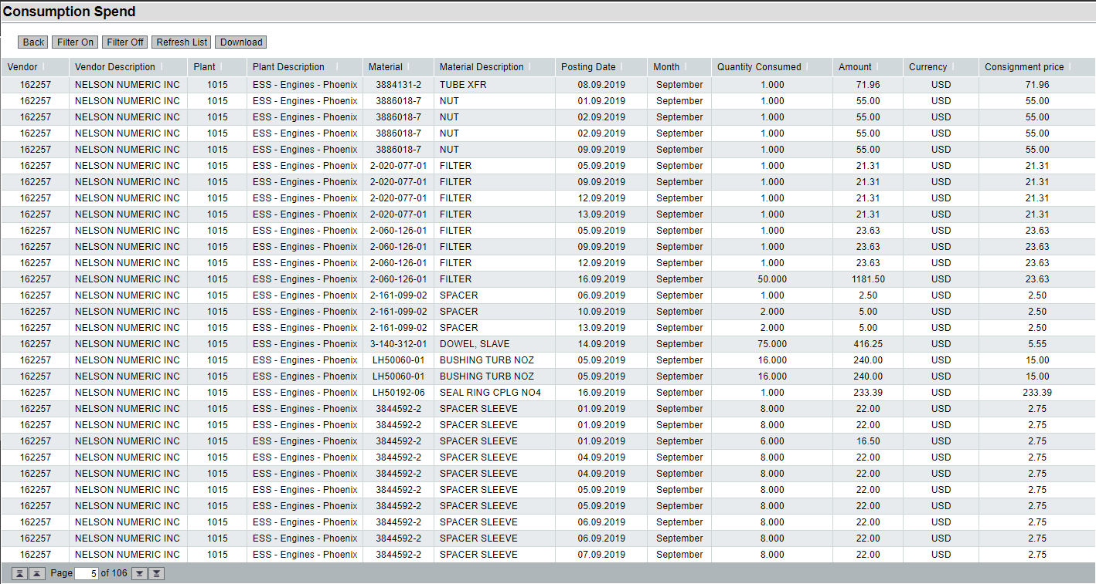
Consumption Spend Report
Provides transfer of ownership data by part number
Every pull by part number is recorded
Vendor can determine historical run rate
Same part pulled three times same day

Slide 23
QVR “Lite” (6 wks post implementation)
Questions:
Verify full implemented part portfolio is visible for supplier in HASP. Do you see any part(s) settings that are incorrect? If so, which ones and what is incorrect?
Have you generated a PO?
Have you changed a delivery date or quantity on a PO? i.e. created your own change orders
Do you know how to generate the consumption report?
Do you know how to generate the settlement report?
Do you know how to tie them together so that you understand when you will be paid?
Do you know how to read the forecast and MPS in order to schedule your manufacturing to ensure on time delivery?
Do you have any questions or need further training?
Is your Quarterly Vendor Review (QVR) scheduled?
Do you know how to use Case Management in HASP to resolve issues?
Is there any additional training or information needed?
Proactive engagement is critical to long term success

Slide 24
VMI QVR Metrics dashboard

Slide 25
Recent VMI program improvements
Case Management via HASP
Supplier can now request issue resolution directly in HASP
When a HASP case is created, it is tracked and automatically escalated if no action is taken. Automatically routed to the VMI team for resolution.
Improved PO Creation
Supplier can now control the delivery date when creating Flex POs
Supplier can now change existing Flex PO dates and quantities
Simplified Part Selection Process
Easier to understand why HON wants to add or remove VMI parts
VMI Team Reorganization
Dedicated Program Managers and Process Leaders for every supplier, from negotiation to sustainment.
Robust Quarterly VMI Review enables open communication between supplier and VMI team.
Focused on Continuous Improvement

Slide 26
Questions?
Honeywell Internal

