Slide 1
NGFMS USERS FORUM
NOV 2024
Yasutaka Miyazaki

Slide 2
AGENDA
VGP Capture Improvement
VDEV Pointer Jump
Cruise Descent vs. Early Descent
Auto Nav Preview Improvement
Arrival Procedure Removal
Status of Previously Presented Improvement Ideas
Voice of the Customer

Slide 3
VGP capture Improvement
Current Design
VGP captures when the aircraft is within 1-dot of glidepath when slowly converging to glidepath from below
1-dot on VDI scale is:
250ft when > 2nm from the FAF
75ft when < 2nm from the FAF
A significant pitch-up is observed if VGP is captured when 1-dot is 250ft
New Design (GVII Block II and after)
VGP captures when the aircraft is within 75ft of glidepath regardless of VDI scale
Negligible pitch-up upon VGP capture
VGP Glidepath
1-dot (250’)
2 nm
Descent Path with Decel Segment
FAF
1-dot (75’)
Existing VGP Capture at 250’ Below Path
Improved VGP Capture at 75’ Below Path

Slide 4
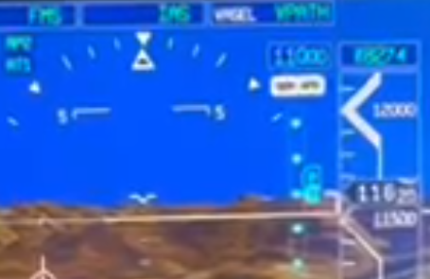
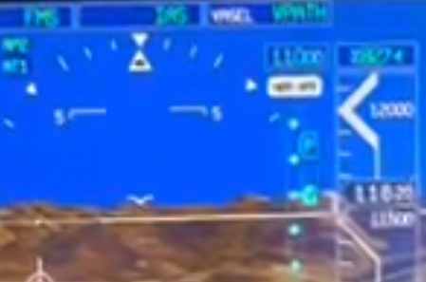
VDEV Pointer Jump
If VDEV pointer is not centered when the scale changes at 2nm from the FAF, the pointer will appear to jump
This is often seen with VGP preview pointer when aircraft slowly converges to the glidepath in VPATH mode
VGP capture logic update will increase the chance of seeing a VGP pointer jump due to delayed VGP capture
VGP Glidepath
1-dot (250’)
VDI Scale Change
Descent Path with Decel Segment
2 nm
FAF
1-dot (75’)

Slide 5
Cruise descent vs. early descent
A pilot-initiated descent from cruise altitude before the Top-Of-Descent (TOD) is classified as Cruise Descent or Early Descent based on the distance to TOD
Early Descent Region
TOD
CRZ ALT
Descent Path
Cruise Descent
Early Descent
Cruise Descent vs. Early Descent
 | Cruise Descent | Early Descent
VNAV mode if initiated with FLCH | VFLCH | VFLCH
VNAV mode if initiated with FPA or VS | VPATH @ -1000 fpm | VPATH @ -1000 fpm above 10000’ VPATH @ -500 fpm below 10000’
Cruise Altitude | Preselector Altitude | Unchanged
Flight Phase | Cruise | Descent
Early Descent Region
 | GVI Blk 2 and prior | GVI Blk 3 / GVII Blk 1 and prior | GVIII / GVII Blk 2
Distance to TOD | 100 nm | 50 nm | 150 nm

Slide 6
Cruise descent vs. early descent (cont’d)
What to watch out for in Cruise Descent:
Cruise Descent makes no attempt to meet the cruise altitude constraint
Workaround: Use FLCH, VS. or FPA mode to descend faster than -1000 fpm
Performing a DIR-TO beyond the cruise altitude target which is being targeted will cause an FMS reset, preventing DIR-TO operation to be completed
SIL D202406004397
Only affects GVI Blk 3

Slide 7
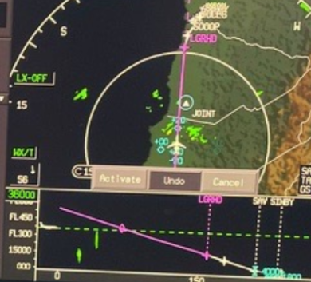
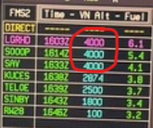
Cruise descent vs. early descent (cont’d)
What to watch out for in Early Descent:
Even after leveling off at preselector, FMS trajectory prediction assumes immediate descent at -1000 fpm until reaching a descent constraint or descent path
Workaround: Enter the current altitude as the cruise altitude if staying level after an early descent
Early Descent Region
TOD
Crz Alt
Preselector
Actual Path Flown
Predicted Profile

Slide 8
Auto NAV Preview Improvement
FMS initiates an auto-NAV preview when following conditions are satisfied:
FMS is the selected navigation source
Aircraft is within 75nm along track and 40nm direct distance from the destination
Localizer-based approach is in FMS flight plan
NAV radio is auto-tuned to the approach frequency
Several in-service reports of auto-NAV preview failure were due to pilots manually tuning the approach (i.e., Condition #4 not satisfied)
Questions for GCC Members
Should auto-NAV preview be allowed if NAV is manually tuned to the correct approach frequency?

Slide 9
Arrival Procedure Removal
STARs listed in the table are removed from NavDB for the following aircraft:
GVI
GVII
Falcon 8X with EASy III
Removal was due to VNAV’s failure to level off at the level segment at the end of STAR in some cases
This is SIL D201011000003 Item T
Underlying software issue has been resolved for GVII Blk 2, GVIII, and Falcon 8X with EASy IV
For aircraft with software fix, the procedures are restored
For aircraft without software fix, a new Database Modification (DM) logic is being explored which will mitigate the level-off issue without procedure removal
STAR | Airport(s)
CLMNT2 | 06FA, F45
TRISH4 | KBWI
ROLLN2 | KCLE
TSHRT2 | KEFD, KGLS, KHOU, KLBX, KSGR
OLAHS3 | KFXE
EMMLN1 | KHHR
KARLB3 | KONT
BHHIA3 | KOPF
COMIX2 | KSAN
DSNEE6 | KSNA
Last STAR Fix
Level Segment
Aircraft may fail to level off
Vertical Discontinuity
GPA
FAF
Preselector

Slide 10
Status of Previously Presented Improvement Ideas
Many improvement ideas were presented to GCC members over the years:
Enhanced ETP
RNP to xLS Capture Improvement
Continued LNAV / VGP beyond the MAP
Energy Management
Individualized FMS Customization
Speed Change Point Display
Circling Approach Assistance
Below Class B Shelf Speed Limit (200kts) Compliance
Custom Contingency Procedure
VNAV-Managed VS / FPA Modes
Vectors-To-Final Improvement
At & At-or-Above Speed Constraint Compliance
TOLD Computations with Published LDA/TORA/TODA/ASDA
Approach Transition Selection Improvement
Some were developed and evaluated, but none have made its way into the final product
There is a renewed focus to put these features on the table for future program planning

Slide 11
Voice of the customer
Pain points
Questions on existing FMS design
Suggested improvements
Desired new features

