Slide 1
TR Mapaero Production Process improvements
    Issue
    Since production introduction of MapAero in 2019: ~ 9% rejection at low hours
      Mainly peeling & blistering
    Investigation & Corrective Actions
    Process Walk conducted October 2023. Various process improvements identified and implemented by Safran and its sub-tier suppliers
      Honeywell / GKN / Safran continue to investigate standardization & process optimization
    Since process walk, no additional low time removals reported for top-coat peeling
    Also, no new reported production MapAero rejections in 2024
Low Time MapAero Rejections Appear Addressed

Slide 2
IN-SERVICE REPAIRS
  Objectives
  Avoid complete strip & re-coat of TR Doors & Beams if not required
    Improve observation identification & data collection
  Provide repair flexibility for the conditions actually experienced
    Top Coat Repair
    Localized bare metal visible / minor corrosion repair
    Make repair options viable in-shop or on-wing
  Eliminate 50-hour fly-on time limitation if possible
Provide Targeted Repair Flexibility – Reduce Operational Impact

Slide 3
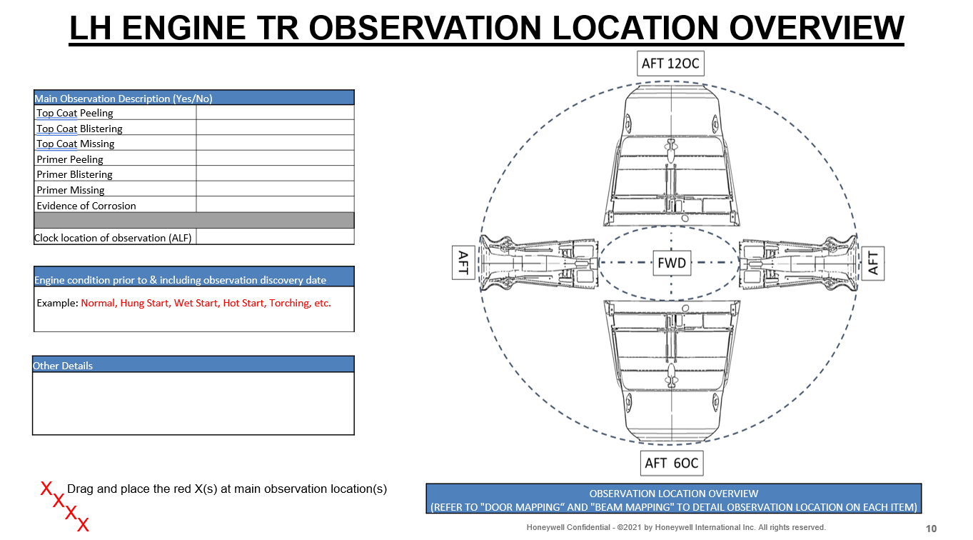
New Paint Observation recording template
  SIL D202308004115 updated to reference new template ‘HONEYWELL TR COATING OBSERVATION MAPPING AND IMAGES’ to facilitate identification
    Available in the Portal
    SPGM 34 revised to align with SIL revision
  Template in PowerPoint format as previously successfully used by operators
    Requests level of detail needed to ensure correct repair path is taken
TR Coating Communication Addressed

Slide 4
In-Service Repair – Top Coat Repair
Updated Repair Procedure RS-478 Rev H (CH300/CH350/CH3500), RS-554 Rev B (G280), and RS-553 Rev A (Legacy/Praetor)
  Provides a repair for situations without visible bare metal
    Primer intact, no corrosion present, only topcoat missing
  Allows for up to 300-hour approved fly-on if the affected area is re-inspected every 50-hours
  The repair can be completed with TR on-wing or removed; using brush or spray methods
Repair Experience
  Top-coat repair conducted on pair of G280 TRs in Gulfstream Back shop (Spray)
  Process conducted successfully
  Downtime limited to 2 days
  Positive feedback received from both Gulfstream Shop & Customer
Downtime Reduction Addressed

Slide 5
In-Service Repair – Bare metal visible
New Repair Procedure In Development: RS-705 (CH300/CH350), RS-702 (G280), RS-706 (Legacy/Praetor)
  Will allow small areas of bare metal including minor corrosion to be addressed with localized repair procedure for primer & topcoat
  The repair to be able to be completed with TR on-wing or removed; using brush or spray methods
  No limitation on number of repairs, provided base material min thickness observed
  Evaluating fly-on/periodic inspection prior to utilization of the repair scheme
  Estimated release: EOY 2024
Closing the Loop on Repair Options

Slide 6
In-Service Repairs – GTV Flow Chart Update
  Revised Fly-On Criteria
  Generic Technical Variances (GTVs) have been driving the 50-hour fly-on time limitation prior to conduct of full strip and re-coat repair
    CH300/CH350/CH3500: GKN-GTV-18386
    G280: GTV-1367651
    Legacy/Praetor: GKN-GTV-19182
  Updated the flow chart in the GTV so that it no longer depends on quantity of repairs (currently limited to 2) so that longer fly-on periods are available
  GTV Revisions released
Increased Flexibility to Fly-On Extensions

