Slide 1
HTF Nacelle: New special PROGRAM 34
Neftali Rios

Slide 2
New SPECIAL Program 34
Objective:
Establish a policy to clarify appropriate commercial program coverage for the HTF family of turbofan engines while Root Cause and Corrective Active is implemented, and to provide a mechanism for Honeywell to accept Channel Partner claims for early Mapaero paint anomalies that do not otherwise qualify for Shop Warranty.
Condition 1 - The T/R entered service with factory Mapaero and has less than 5 years or 3000 hours, whichever occurs first, since aircraft initial Entry Into Service (EIS), or: Full Coverage for Parts and Labor
Condition 2 - The T/R had Mapaero applied per the Mapaero SB and covered by SPGM 22 revision 6 or earlier, has less than 2 years or 1000 hours, whichever occurs first, since the last Mapaero reapplication. Coverage for Labor and Mapaero paint related materials. Discounted Hardware
NOTE: For Mapaero anomalies identified within 1 year or 200 hours, whichever comes first, the operator should first seek correction with the applicable Channel Partner under service center workmanship.
Coverage is limited to 1 reapplication.
Condition 3 – The T/R had MapAero applied but is outside the policy listed in Condition 1 and Condition 2 of this program. All costs for reapplication are to the operator. Discounted Hardware only.
Condition 4 – The T/R has not had MapAero applied- No coverage under this program. All costs for the application of MapAero are to the operator. No coverage.
Program Will Address Mapaero Anomalies
Honeywell Internal

Slide 3
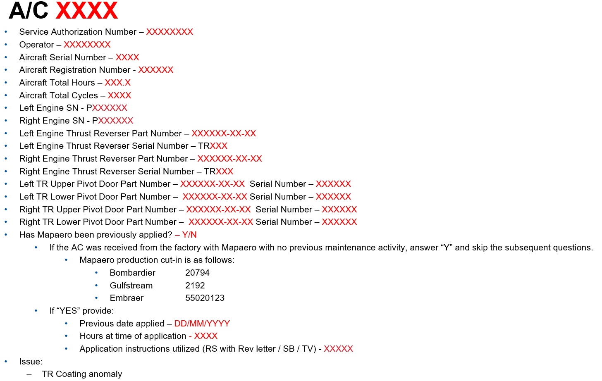
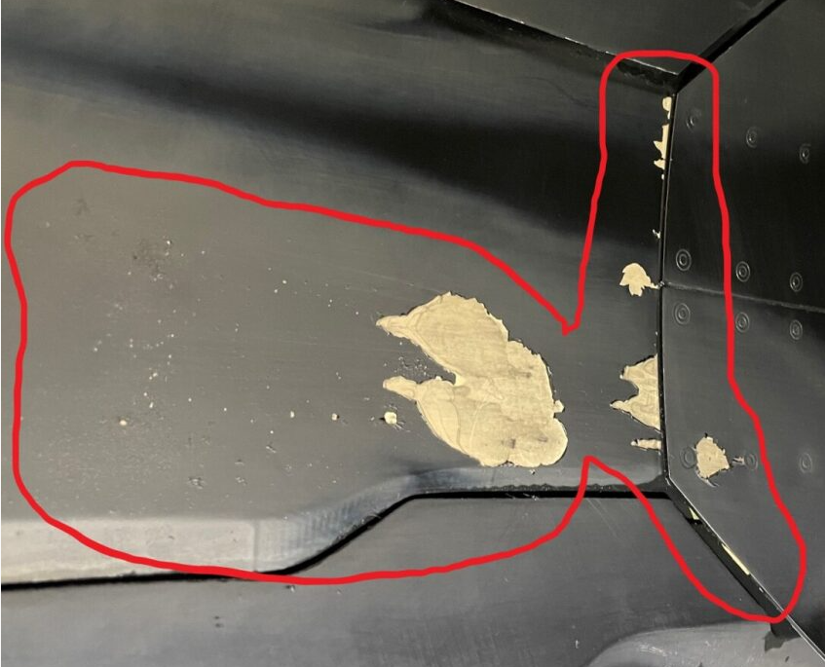
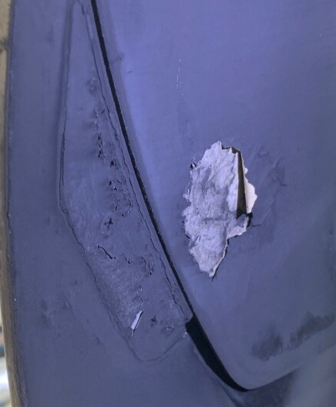
SPGM 34 Request Template
Pictures Required
SPGM 34 Request Template Required In Order to Proceed With Pre-Approvals

Slide 4
Questions (?)

