Slide 1
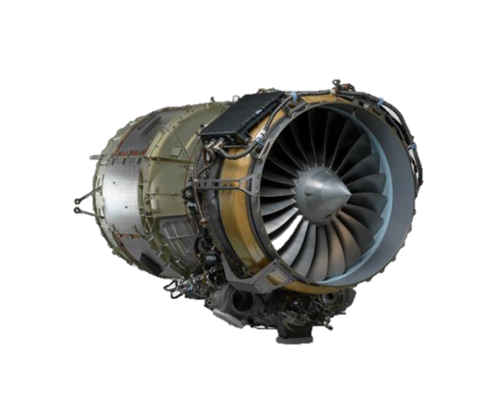
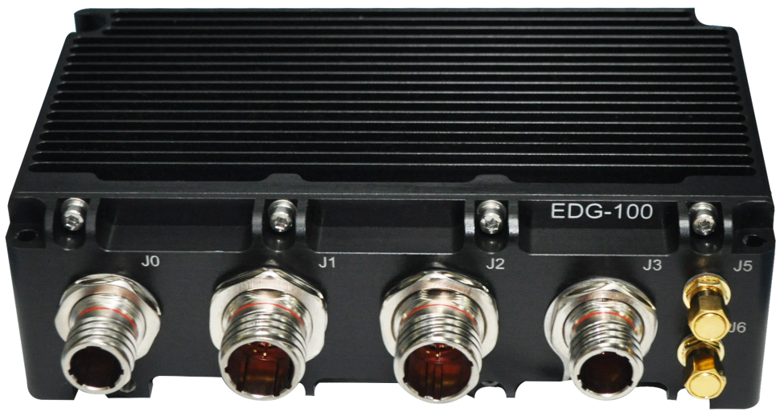
Honeywell Ensemble Engine Data Gateway (EDG-100)
Presented to GCC- 11/13
Nazar Janabi
EDG-100
Honeywell Confidentiality and IP Notice. The information disclosed by Honeywell on this New Feature Disclosure Form is the confidential and proprietary information of Honeywell International Inc. and is subject to copyright, contractual confidentiality and non-disclosure obligations and the following additional restrictions. The Honeywell intellectual property disclosed herein are Honeywell Core Technologies, are included in Honeywell’s road map and engineering design documentation and may include Honeywell Features, patented technology and patent pending technology. Content must not be disclosed or used by the recipient in pursuit of patents or patent applications. All rights reserved.

Slide 2
Honeywell Ensemble- Connected engine
Aircraft mounted Engine Data Gateway (EDG) Edge node system automates transmitting data wirelessly via wi-fi from engine ECU to Forge and CAMP for Engine Health Monitoring
Principles
Description
Press Release (PR)
HTF engine operators currently use a laptop and cable to manually perform engine data download. No modern wireless system available
Problem
\
Honeywell EDG-100 Connected Engines Service
Solution
Aircraft Mounted EDG-100
(Honeywell STC)
Who is it for?
Business aviation operators using Honeywell’s HTF7K turbofan engines
How will it be installed?
Via aircraft OEMs and Licensed engine service centers (Channel Partners) using Honeywell STC and PMA
OEM Value:
Platform modernization
Automation of FAA-required Engine data download
Improve engine assurance
Improve aircraft engine assurance
Enables advanced analytics/algorithms
Reduces engine maintenance burden/costs
Automated billing
Enables customer savings via Honeywell’s Usage Based MSP program
What is the value?
Launch EDG-100 Connected Engines Service in 2024
Notes:
Engine Assurance – predictive maintenance before it becomes an operational or safety issue.
Auto Billing – administrative easy
Maintenance Availability – e.g. advance notice of needs to MROs, FOBs, Flight Departments, etc.,

Slide 3
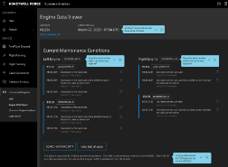
Honeywell Ensemble architecture
Engine Condition Trend Monitoring (ECTM)
Autonomous
BA Forge Cloud
Aircraft Mounted EDG-100
(Honeywell STC)
Engine Data Viewer (EDV)
in BA Forge
Cessna Longitude with Honeywell HTF7700 Engines
Ground Based
Mobile Device App (CMMA)
Type of HTF7K Data | ARINC 429 | ECFR RS-422 | RTDL RS-422
Available Data Parameters | ~70 | ~700 | ~90,000
FAA approval received for the STCs. Platforms completed:
Bombardier - Challenger 300/350/3500
Textron - Cessna Longitude
Embraer - Legacy/Praetor
RS422 engine data critical for trending

Slide 4
Data source comparison
Value for Trending
RTDL
(Datalogger)
EDG-100 only
Continuously broadcast by engine controller
Parameter list configurable through Honeywell Forge based on algorithm needs
Enables transient trending, LRU monitoring
~25 MB/hr/aircraft
RS422 / ECFR / EEI
Downloaded from engine controller
Focused on engine maintenance
Includes bin data, event recordings, etc.
Enables snapshot trending, UBMSP
~0.2 MB/month/aircraft
ARINC 429
Aircraft bus
Parameters needed for aircraft control
Enables basic trending
~0.5 MB/hr/aircraft
~100 params, 10 sets/sec
Snapshots of rich features
Subset of params, 1/sec

Slide 5
Ensemble value evidence
Rejected Take Off
Pilot rejected takeoff on the runway because one engine began surging.
Subsequent inspection revealed detached abradable material (used to ensure tight disc-shroud clearance).
Algorithms had been previously developed to identify detached abradable before a compressor surge.
Data received after the event confirmed that the signature of the detached abradable material was present 5 flights before the rejected takeoff.
Had this aircraft been equipped with Honeywell Ensemble, early warning could have been communicated to the operator, enabling them to borescope the compressor, see the missing abradable, and avoid the subsequent event.
Each of the red lines is a trigger from the algorithm
Ensemble Provides Early Warning

Slide 6
Key features of EDG-100
EDG-100 Edge Node
Near Realtime access to engine parametric data (including data not available over ARINC429) for prognostic trending.
Enables engine gas path and LRU prognostics to identify issues prior to a flight deck effect in the cockpit, avoiding operational disruption
Connects via Wi-fi. Honeywell recommends pairing device to on-board aircraft wi-fi system
Records real time engine data during flight, but transmits on the ground (only)
STC only
Data meets and exceeds requirements of Honeywell MSP program (ECFR and RTDL files)
Wireless software upload capability
Connects to RS422 port, allowing automatic download of the required engine ECFR snapshot data
Captures timeseries engine data throughout entire flight
Enables recording of any engine ECU software parameter, and over the air updates to parameter list
Cyber Security tested and approved (DAL A Certified)
Improves access to engine data / Saves customers time and money

Slide 7
Key features of EDG-100
Specifications​
Dual Core Processor 1.5 GHz​, 4GB RAM, 64GB eMMC Flash​
Dual Band Wi-Fi/ Bluetooth​
RS-232/RS422 Serial Ports​
Engine Interface Firewall Card (DO-178C DAL A)
Dedicated TPM 2.0 Module for Security​
3x Temperature Sensor
Cloud service hosted on Honeywell Forge
Engine Data Viewer, Forge web portal for viewing data
​Bluetooth Based Mobile App (Android & iOS) to view Real Time Data
Linux OS
6.7 inch (170mm)
Width
Operational
Temp: -40 to 80 c
Environmental: DO-160G
Powered by 16 - 32VDC (~300mA)
Power (Typical) - 8.4W
Size and Weight
3.1 inch (80mm)
Height
170 X 80 X 100 (mm) 6.7 x 3.1 x 3.9 (in)
900 gm (2.0 lbs)
Secured Engine Data upload @50–100 Mbps
Engine Real Time Data on Handheld device

Slide 8
THANK YOU
Aircraft Mounted EDG-100
(Honeywell STC)

