Slide 1
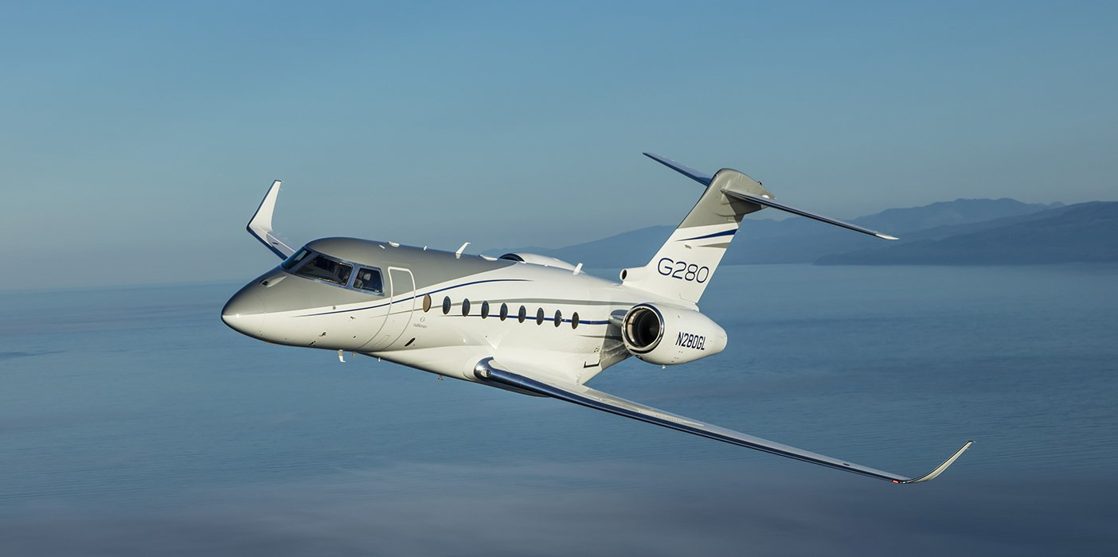
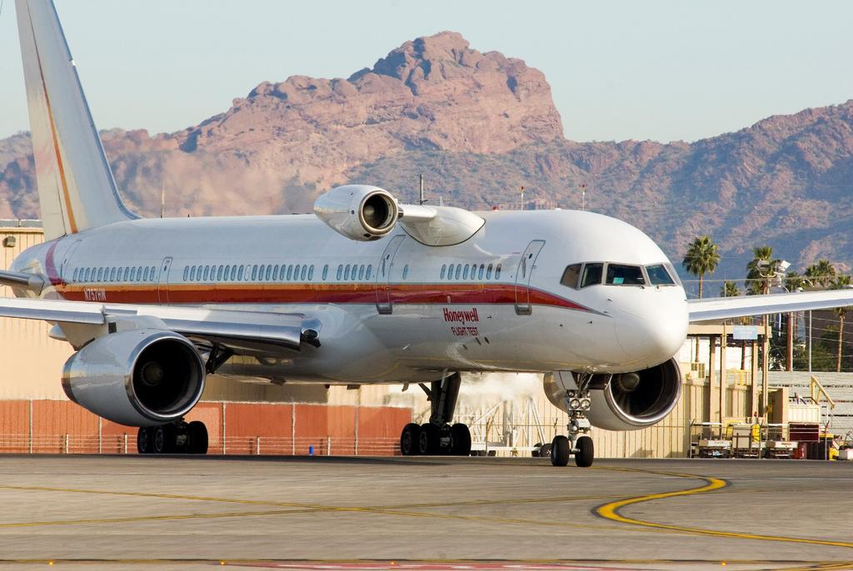
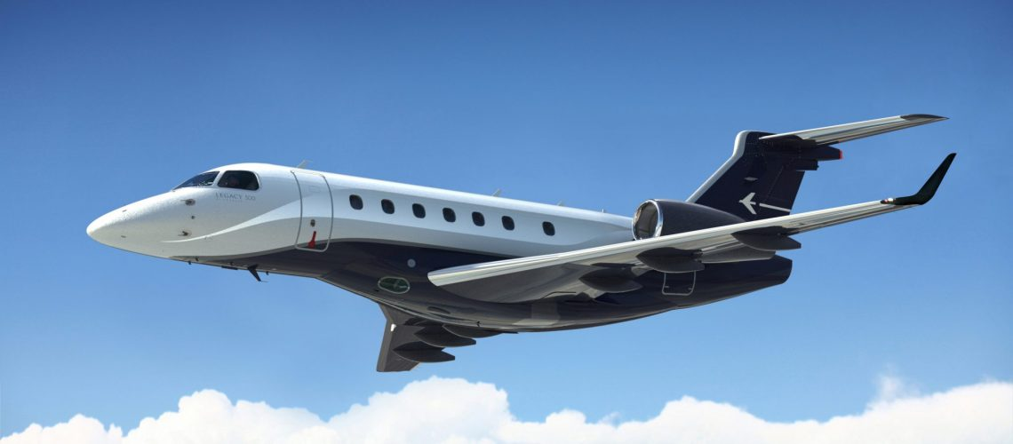
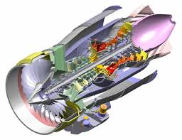

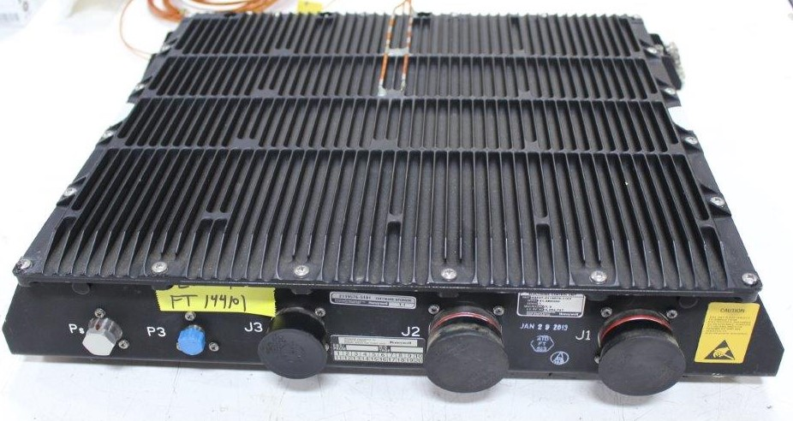

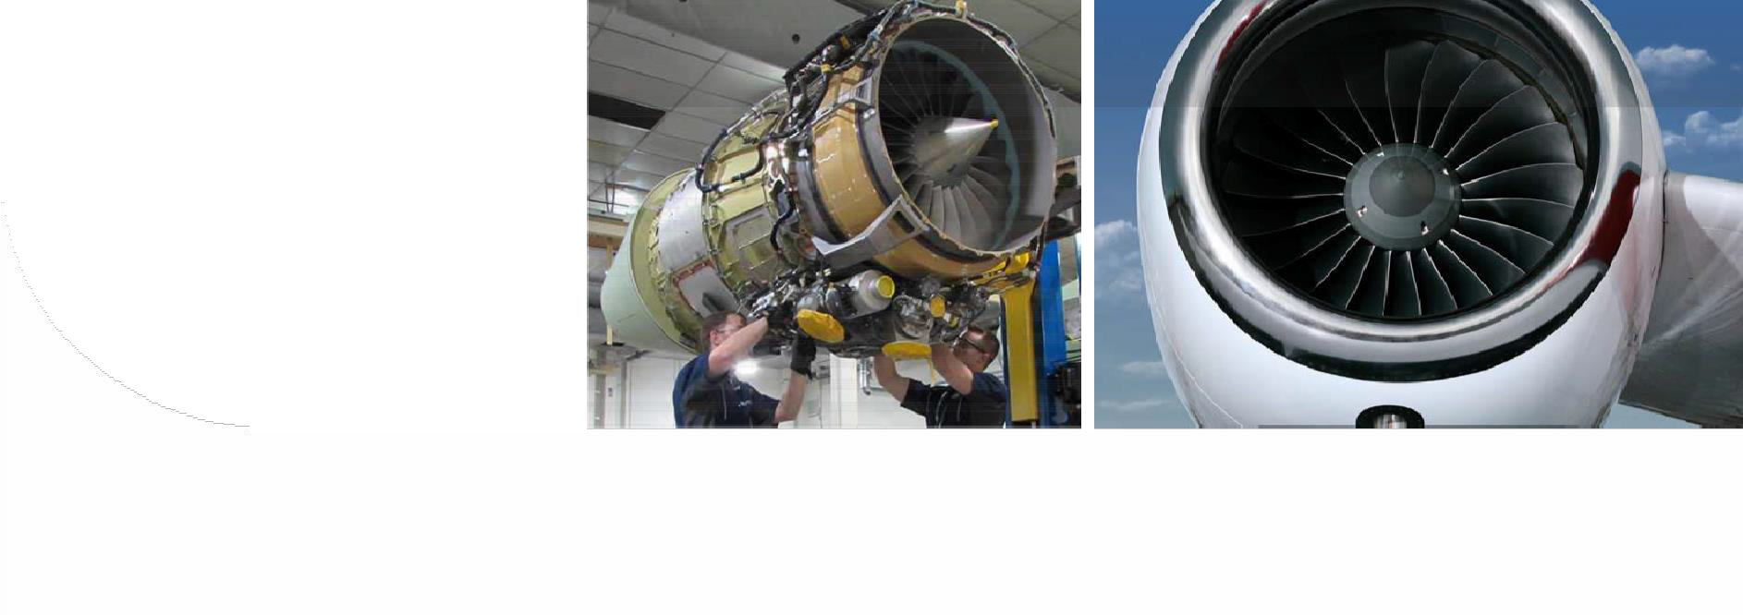
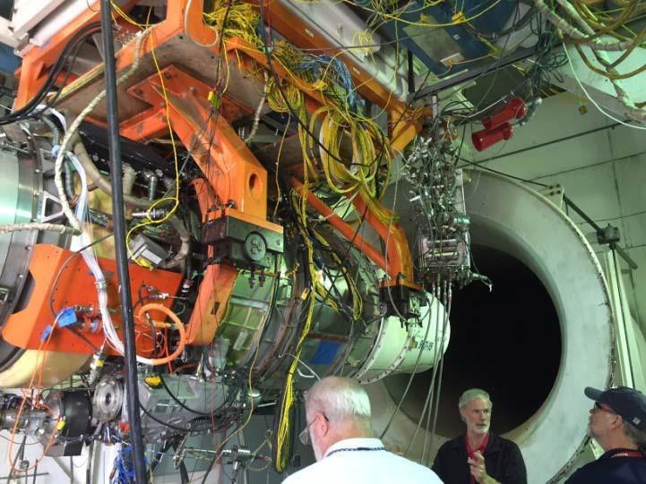

FORWARD Outer Bypass Hi-Lok Bleed Boss Issue
11/13/2024

Slide 2
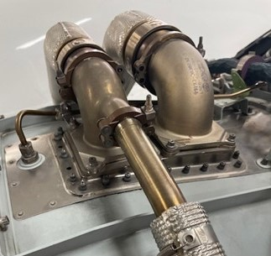
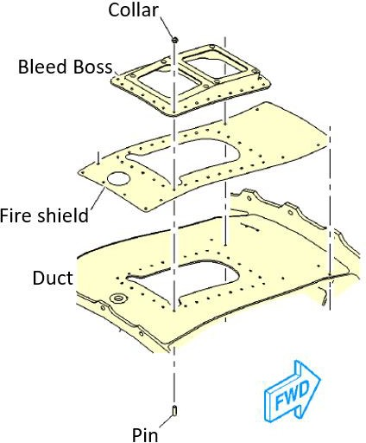
FORWARD Outer Bypass Hi-Lok Bleed Boss Issue
ISSUE
Hi-Lok fasteners have been reported as loose, missing or exhibit a “nested” condition
Secure the HP/LP bleed boss and fire shield to the forward outer fan duct assy
Typically observed at service center maintenance level – 4800 hour / compressor repair
The export classifications (HEC/TEC) in this watermark supersede any other classification. Document is restricted per applicable export laws. Protected under FOIA Exemption 4 and the Trade Secrets Act.
Downloaded By: Pursell, John H - 27 Aug 2024 15:12:14 UTC - TEC: 9E991
2

Slide 3
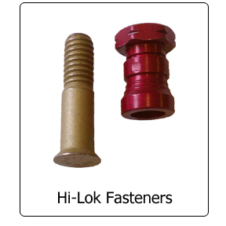
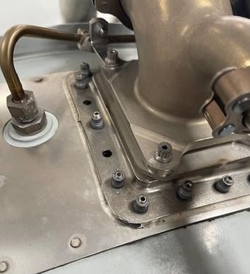
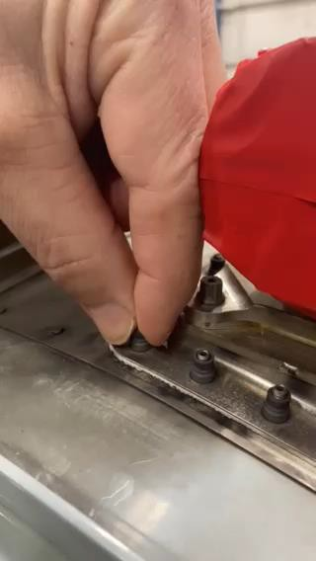
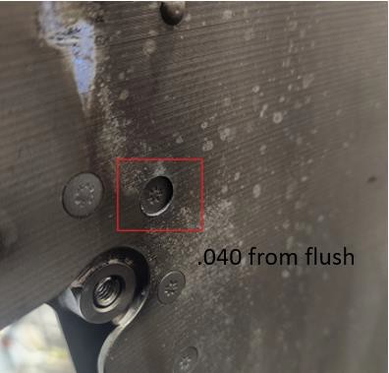
FORWARD Outer Bypass Hi-Lok Bleed Boss Issue
Background
Created in 1943 by the Hi-Shear company
First used on the North American P51 Mustang
Allows for one-side installation and pre-load control – no torque wrench required
Works well in restricted access applications
Field Observations
Missing, loose or “nested” Hi-loks reported
Appears to be more common on the AS907-2
No operational issues reported in conjunction with Hi-Lok condition
The export classifications (HEC/TEC) in this watermark supersede any other classification. Document is restricted per applicable export laws. Protected under FOIA Exemption 4 and the Trade Secrets Act.
Downloaded By: Pursell, John H - 27 Aug 2024 15:12:14 UTC - TEC: 9E991

Slide 4
FORWARD Outer Bypass Hi-Lok Bleed Boss Issue
Action
Working with GKN to determine cause and identify corrective action
Revising LMMs to outline allowable quantity of loose / missing Hi-Loks
  Will include a built in “fly-on” to schedule maintenance
Developing a field repair in order allow continued operation
Will be introduced via service bulletin – Target Q4 2024
The export classifications (HEC/TEC) in this watermark supersede any other classification. Document is restricted per applicable export laws. Protected under FOIA Exemption 4 and the Trade Secrets Act.
Downloaded By: Pursell, John H - 27 Aug 2024 15:12:14 UTC - TEC: 9E991
Questions / Comments

