Slide 1
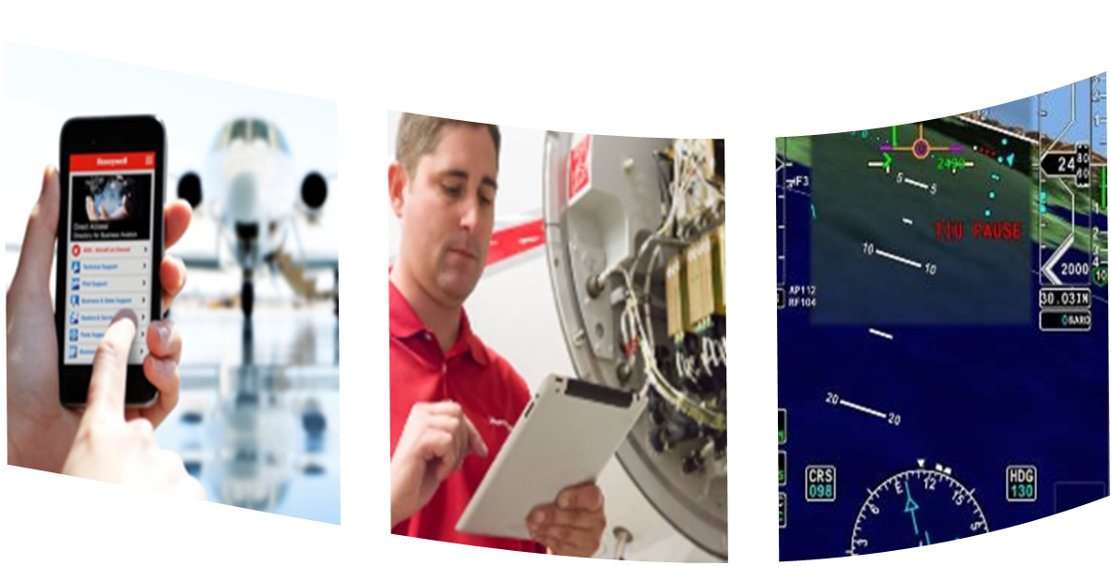
MSP Administration / Fly the Fleet

Slide 2
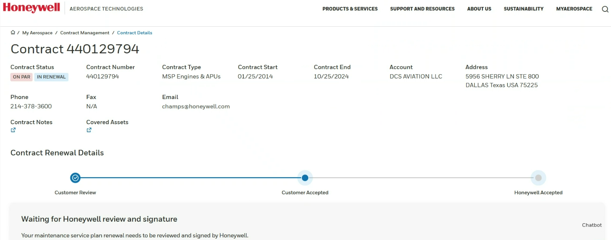
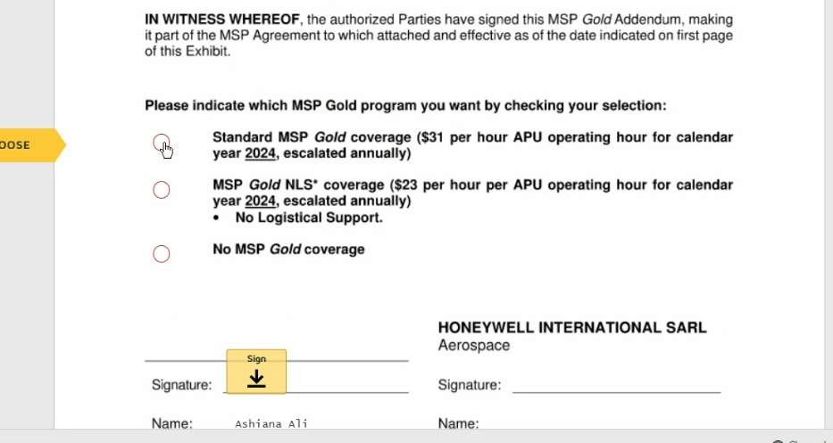
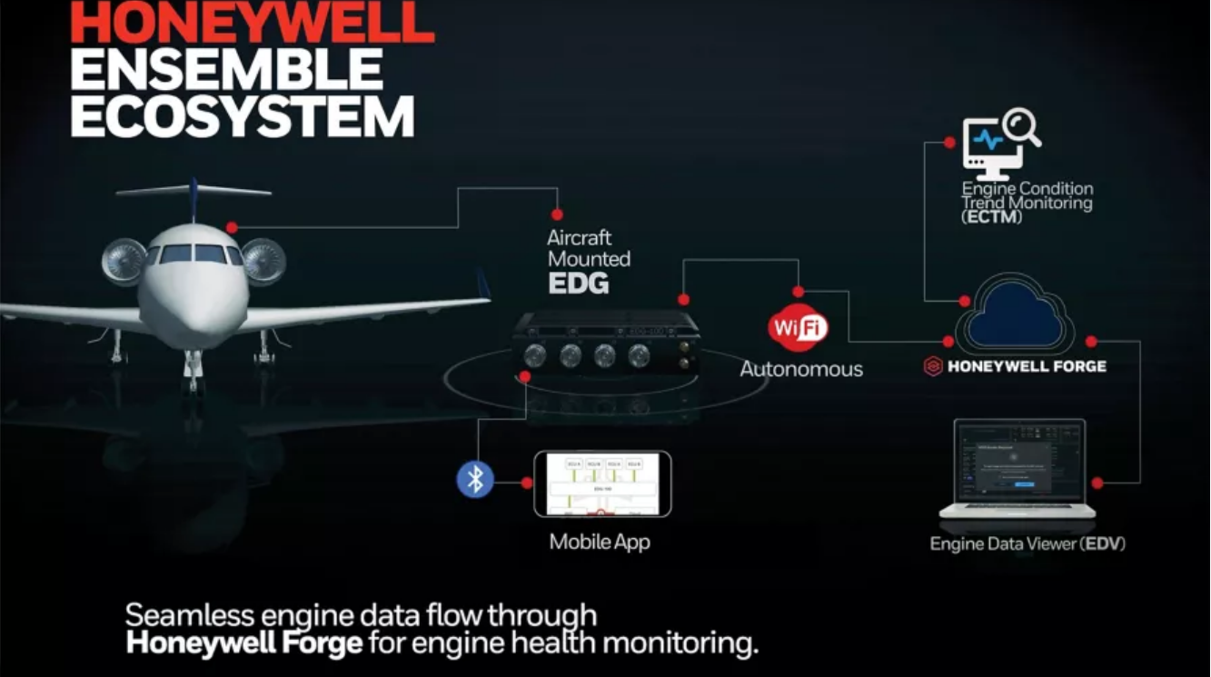
Msp automation and digitization Projects
2024 / 2025
Supervisors placed over;
  Avionics, Entry, Contracts, Support, Collections
Making portal robust: $0 invoices, duplicate invoices hours not recording, access questions
New
  Online renewal automation
  Online transfer notification (send through portal and electronic signatures) – January live
  Online new contract setup – January live
  Products this applies to;
    HTF / TFE / APU
    CFE/TPE manual
Coming; auto TSN reporting and auto billing
  Honeywell Ensemble– also performance trending
    Applies to HTF / TFE NG, APUs at 60% TSN
    January live - HTF contract renewals
  ADS-B TSN reporting
  Prior month usage hours
  Will be able to enter hours before pre-populating

Slide 3
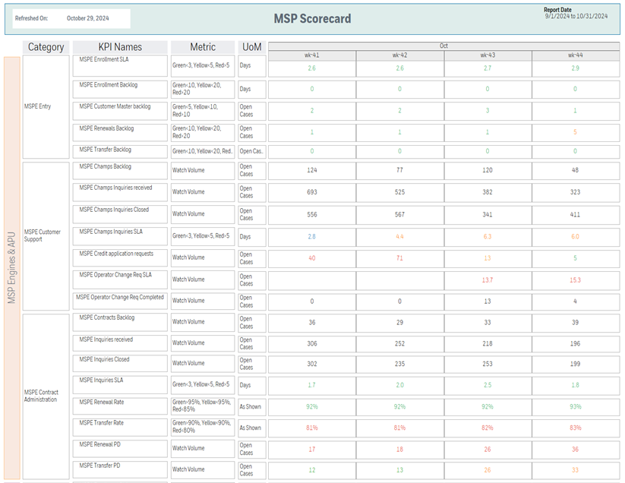
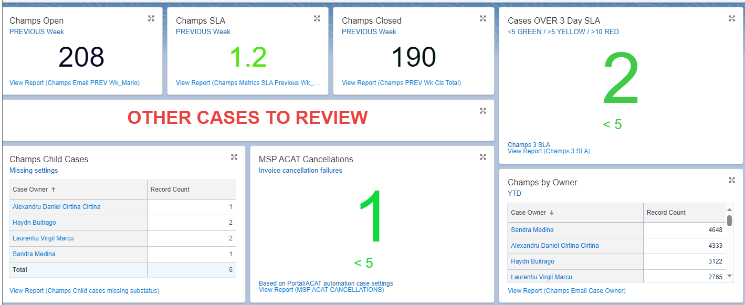
Case Management Tracking
Case Management (Email and Phone)
Networked through Salesforce.com & InContact Phone
Cust Sat Survey 80%, First Call Resolution 84%, Agent Sat 82%
  ~1500 cases per month
Similar set of metrics for Avionics, mainly dealer related
Continuing to refine case routing
Response time - 3 days is green
11/7 releasing SFDC Escalation path for aging
  4 days supervisor
  6 days Director
  8 days VP
MSP Contacts
Question or Issue | Email address | Phone Number
MSP Engine & APU Contracts for related items such as rates, renewals, transfer of ownership | MSPContracts@honeywell.com | 1-602-365-6442 Option 3
MSP Engine & APU support related to adding a new contract / aircraft to your account, reporting, hours issues | Champs@honeywell.com | 1-602-365-6442 Option 2
MSP Engine & APU payment issues | MSPPayments@Honeywell.com
MSP Avionics and Mechanical Components questions or support | MSPAvionics@honeywell.com. | 1-602-365-6441 Option 2
Include Contract in the email Subject Line, David.lopez2@honeywell.com

Slide 4
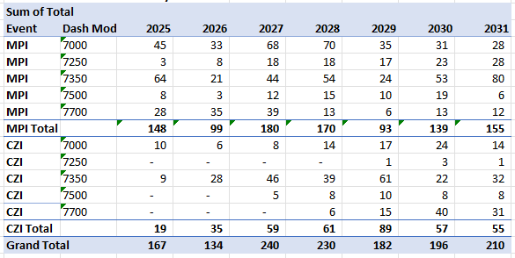
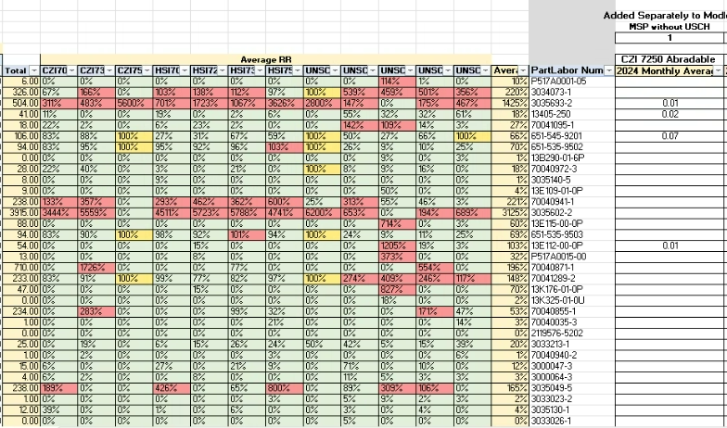
MSP Fly the Fleet
TFE
Includes unscheduled factor (Honeywell Ensemble performance)
ERB / HAT / T&M / Proactive added on above this for ISC
Similar process for HTF/TFE/CFE
Look at workscope like hot section or compressor
Bill of Material by Model / Event
20 of each engine. What are the parts going into a repair
Replacement Rates
Combustor P/N 123 New replacement rate
On order
On order aligned to events
Combustor P/N 123 Exchange replacement rate
Rework new details needed for exchange combustor
New, exchange, repair
Increase / Decrease on order
Supplier or Internal Honeywell
HTF
Past Event Data Used
Quarterly Run of Fly the Fleet Model, Looking out Multiple Years

