Slide 1
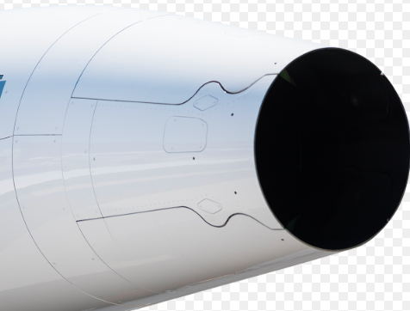
RAIL
Top 25
1086- AS907 Thrust Reverser (TR) Long-Term Solution
Initiator: GCC
Owner: John Pursell
Initiation Date: Apr 2024
Moved to Top 25: Apr 2024
Original Commit Date: NA
Problem Description:
The GCC committee has requested HON to provide a long-term solution for the AS907 Thrust Reverser coating issues
Estimated Completion Date: TBD
% Completed: TBD
Source: GCC
Criteria to Close:
Honeywell to develop a long-term solution for the AS907 thrust reverser for fielded engines
Status & Dates:
Honeywell TR Improvement Initiative (to be aimed initially at In-Service/STC Incorporation)
A concept has been proposed and is under evaluation by HON:
The concept incorporates composite and Titanium in the exhaust area
The goal would be to incorporate by removal/disassembly and replacement with new components with re-use of unaffected components
No modifications of components/no machining
Simplifies upgrade post-production or in the field at Service Centers/Channel partners
The improvement must meet all HON, AC OEM, and Regulatory requirements for certification
We have discussed with our AC OEMs, however we are not prepared to share further details due to the current proprietary nature of the proposed project
Affected OEMs: Bombardier, Gulfstream, Embraer
Impacted Regions: Americas, APAC, EMEIA

