Slide 1

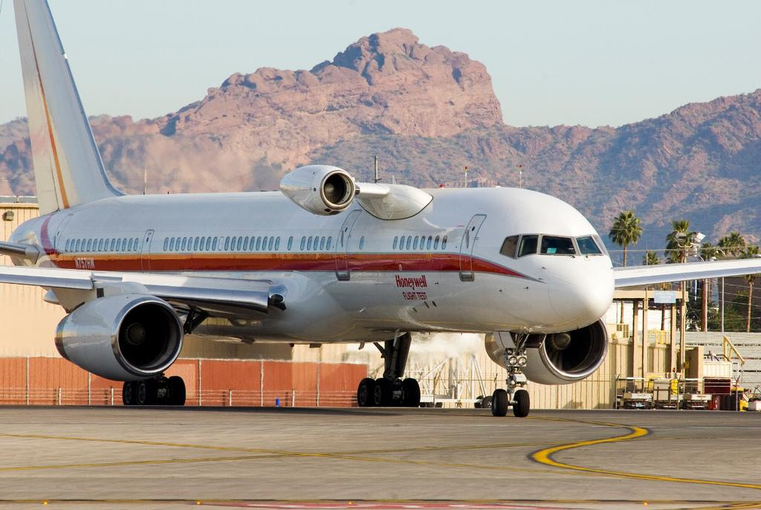
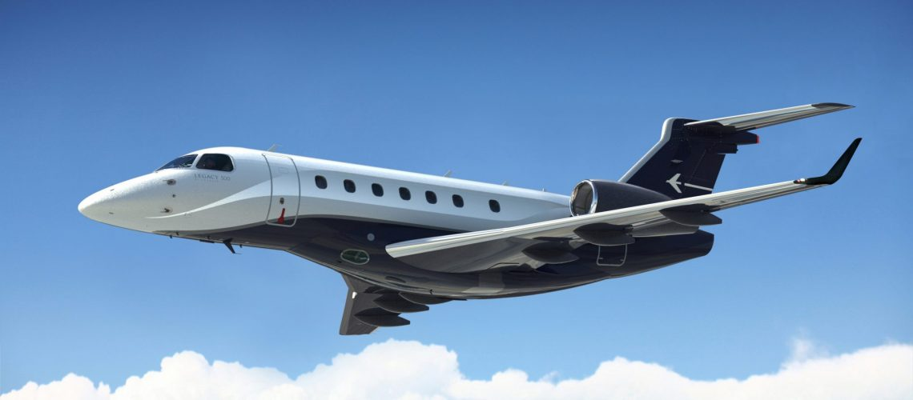
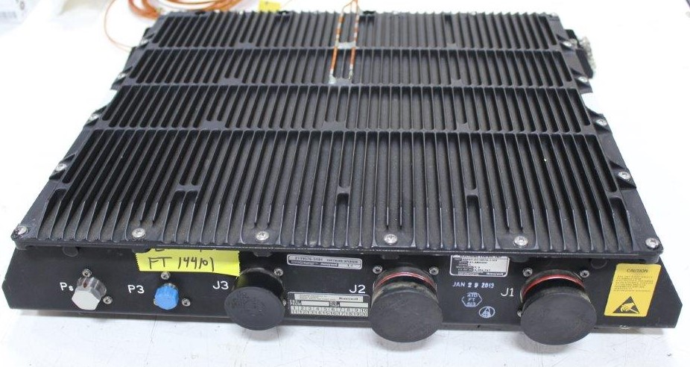

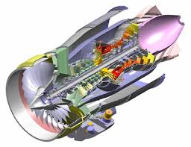


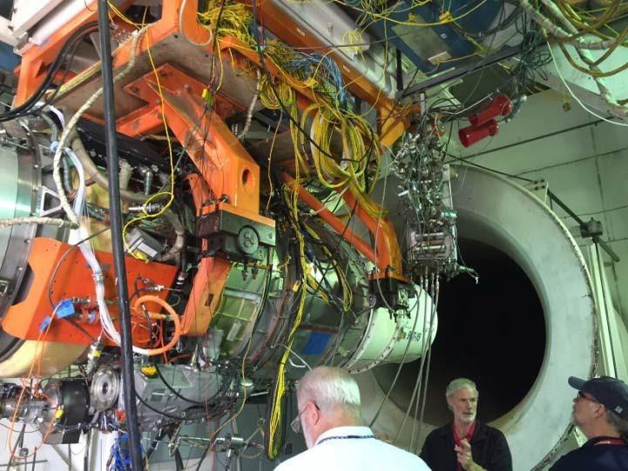

GCC Special Topic
Embraer Legacy / Praetor LP Bleed Air Check Valve Issue P/N 70040388-1
Date: 11/13/2024

Slide 2
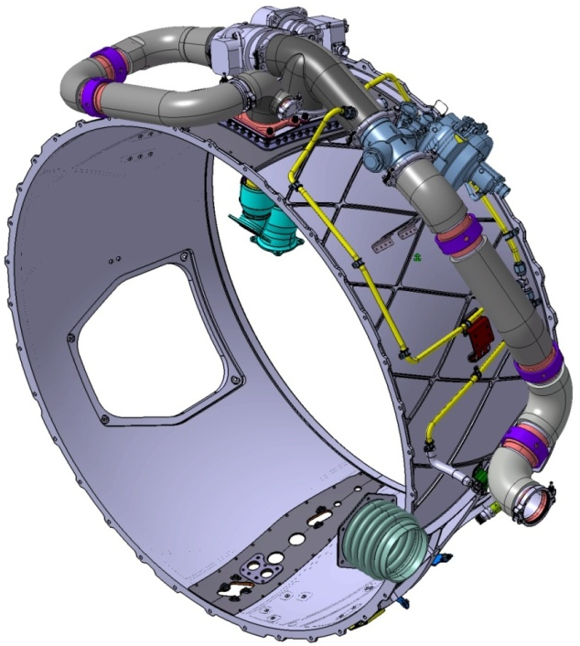
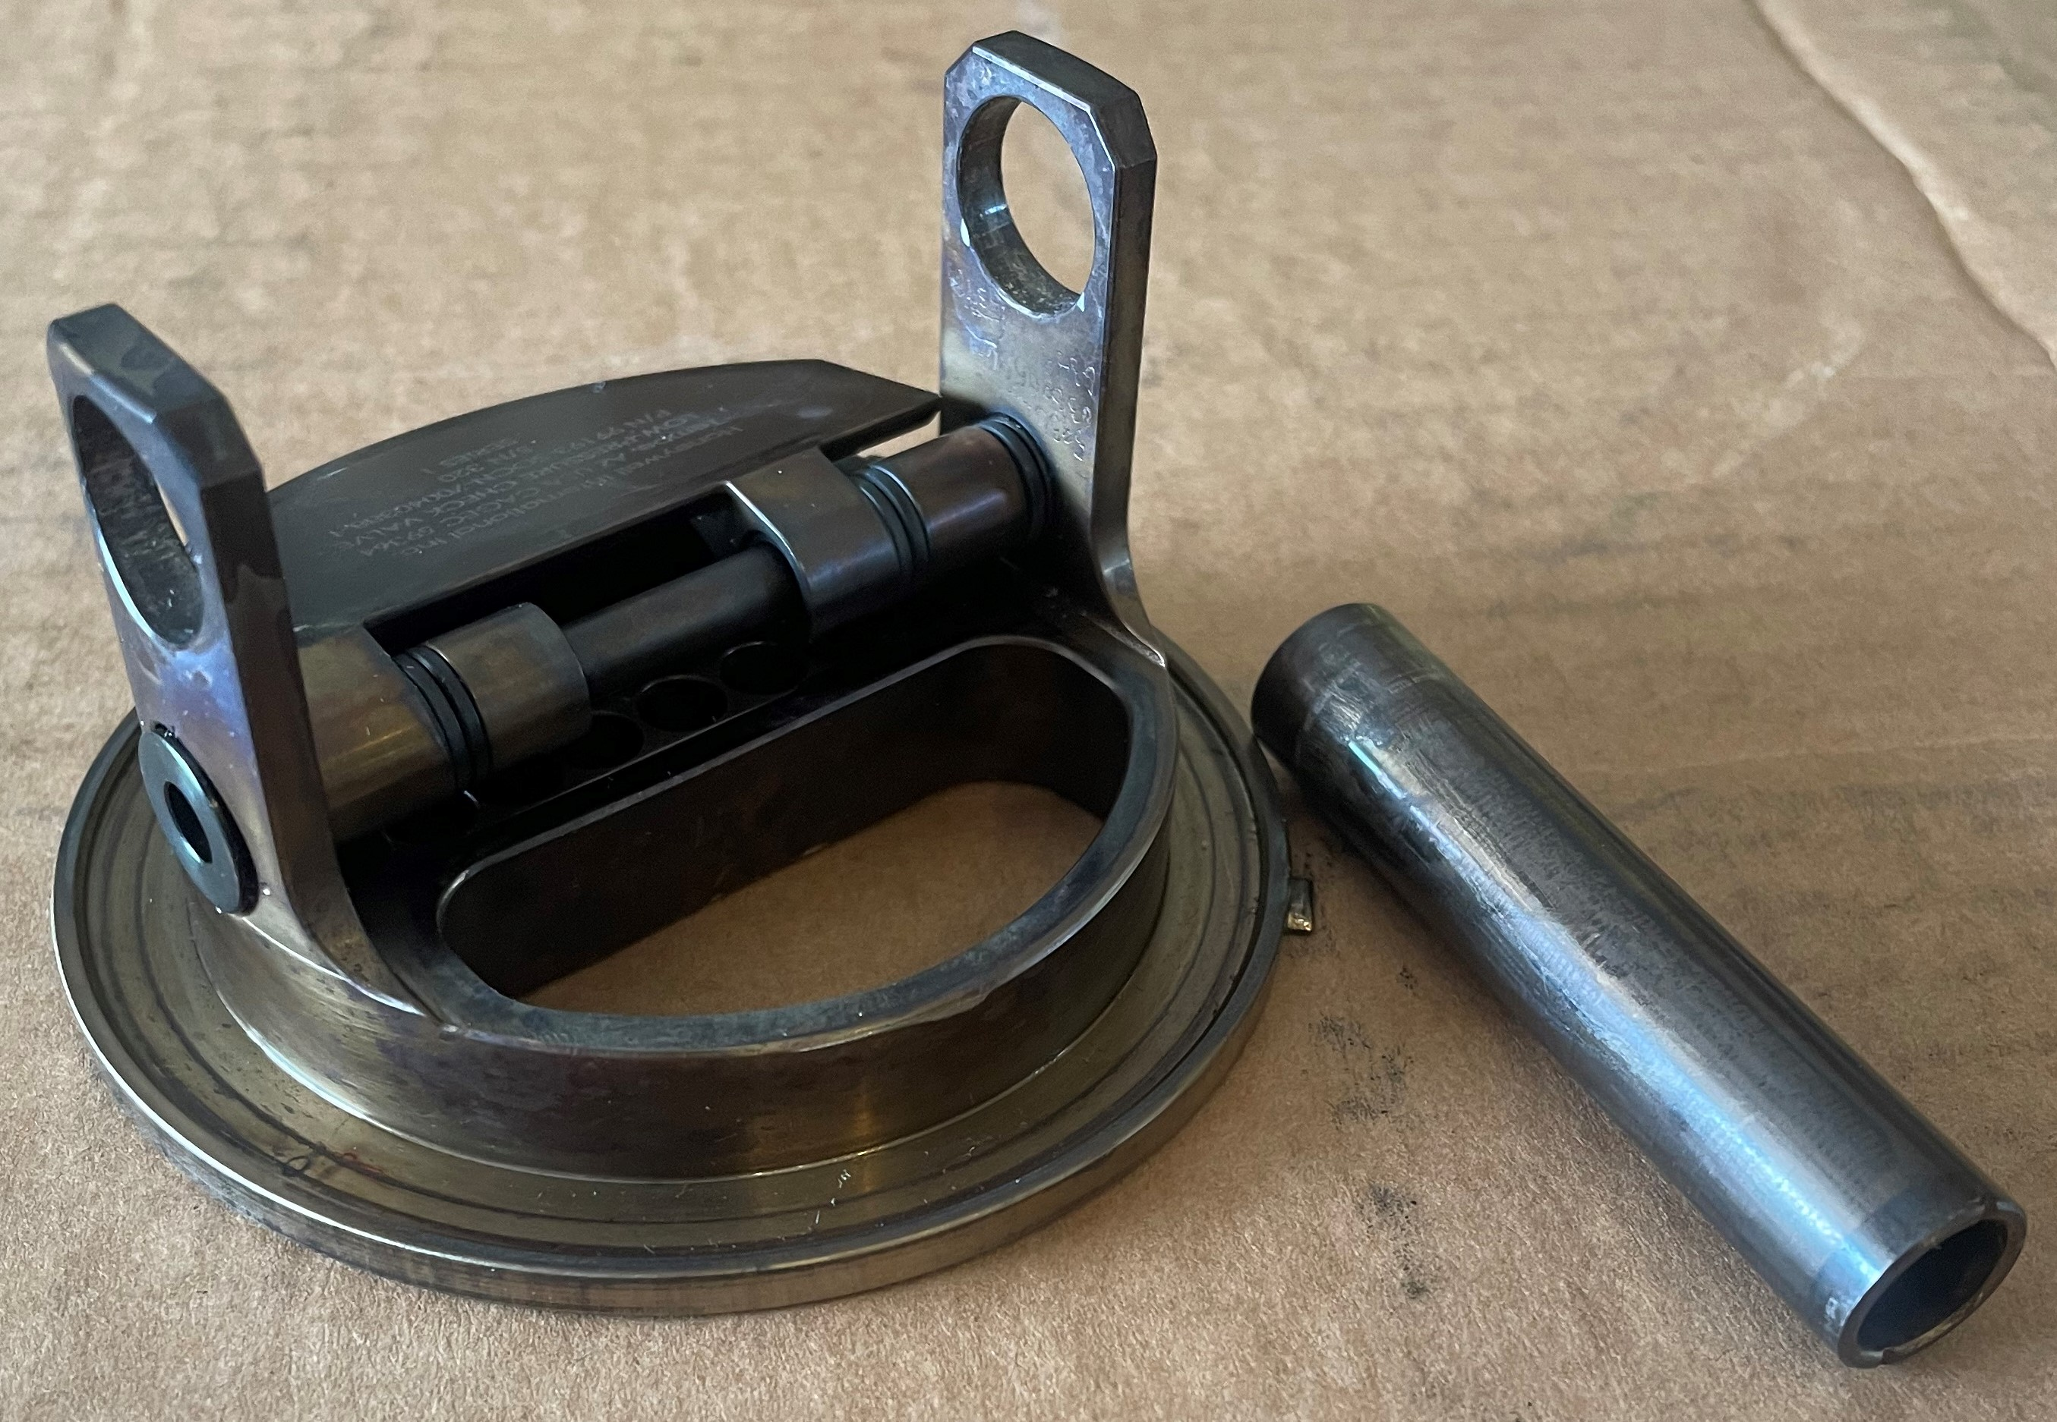
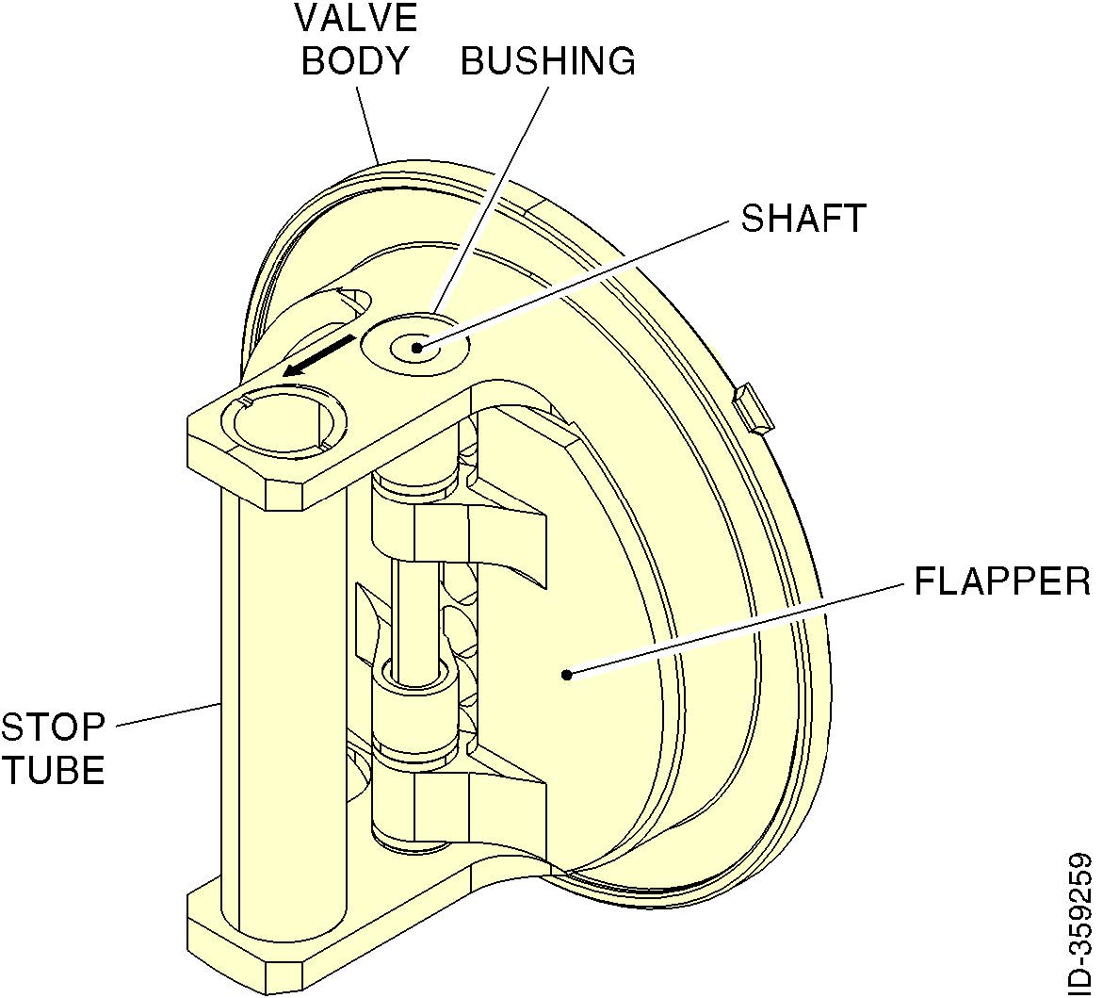
Embraer Legacy / Praetor LP Bleed Air Check Valve Issue P/N 70040388-1
ISSUE
In late 2023 several Legacy / Praetor aircraft have experienced compressor surges and ITT exceedances
Investigation of the engine revealed no anomalies
  Component swap
  Borescope
Cause determined to be the LP Bleed Air Check Valve, P/N 70040388-1
Flapper Stop Tube had migrated out of position allowing both flappers to rest on one side
Honeywell Internal

Slide 3
Embraer Legacy / Praetor LP Bleed Air Check Valve Issue P/N 70040388-1
CORRECTIVE ACTION
Stop tube is retained by four (4) stake points
Supplier has instituted a process change to ensure adequate staking is being applied
Existing stock of LP check valves were pulled and inspected
  Those that appeared to have less than adequate staking were reworked (2023)
Service bulletin No. 36-11-006 created
  Provides for inspection and rework, if necessary
  At first access or at 750 hour inspection
  Can be accomplished by service center or operator
Bulletin is with Embraer, pending release
Honeywell Internal

