Slide 1
Global Customer Committee
Autumn Meeting
November 12 & 13, 2024

Slide 2
Meeting Ground Rules
Phones silenced
Mute for those remote not actively in discussion
Remote questions – Use Teams Chat function.
Technical difficulties
Brian Baker (623) 670-2359
Danielle Richeti (602) 989-0489
Notes:
2

Slide 3
Confidential & Proprietary Notice
Proprietary Information Material may be enclosed in this presentation. This work contains valuable, confidential, and proprietary information. Disclosure, use, or reproduction outside of Honeywell International Inc. is prohibited except as authorized in writing. As a member of the Global Customer Committee, you may share information contained in this presentation exclusively with other Honeywell Operators and Channel Partners that have a valid Non-Disclosure Agreement.
Notes:
3

Slide 4
Introductions

Slide 5
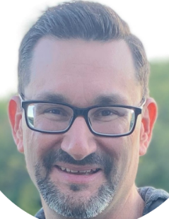
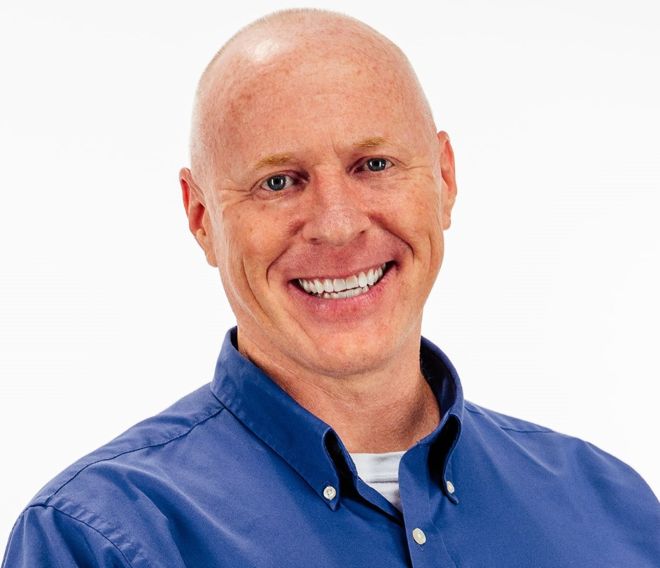
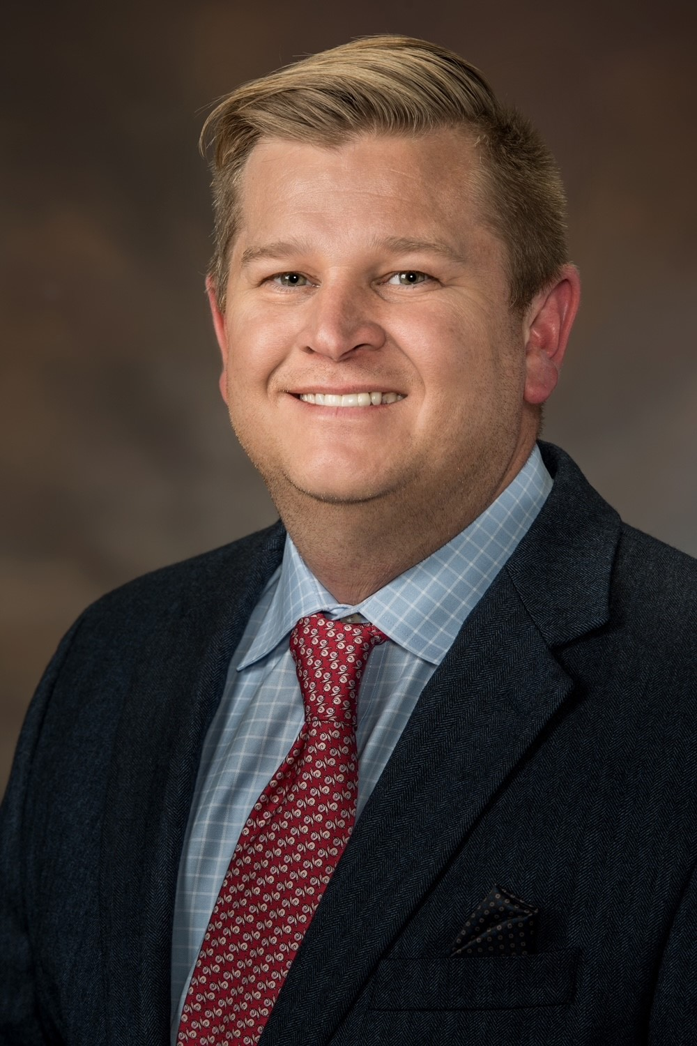
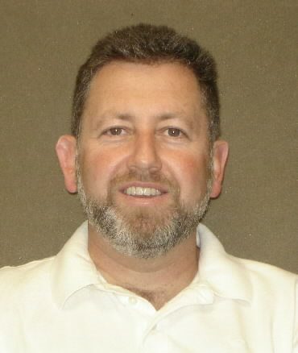
Leadership Welcome
Welcome GCC Members
Todd Owens
Vice President, C&PS
Americas Aftermarket
Honeywell Aerospace
Toby Price
Vice President, C&PS
Honeywell Aerospace
Malcolm Fleming
Vice President, C&PS
Global Technical Operations
Honeywell Aerospace
Jeremy Baich
Vice President, C&PS
Global Customer Care
Honeywell Aerospace
Brian Howell
Vice President, BGA Aftermarket
Honeywell Aerospace
Rod Kennan
Sr Director, C&PS
Americas Aftermarket BGA
Honeywell Aerospace

Slide 6
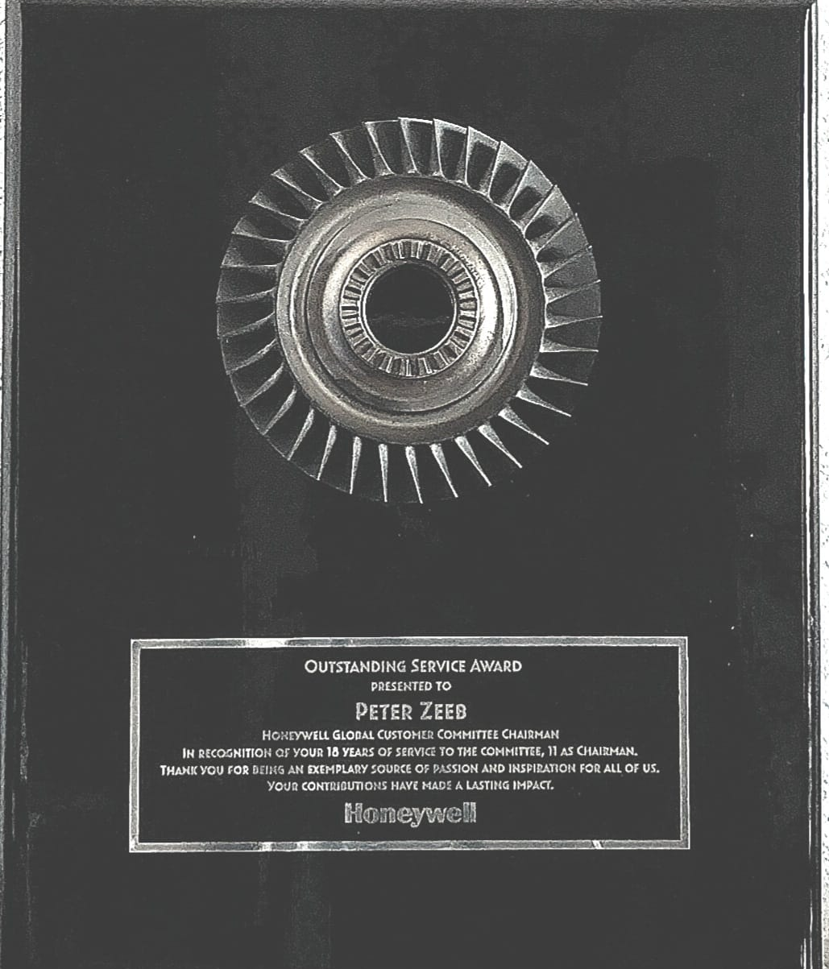
Peter Zeeb In recognition of your 15 years of service to the committee, 11 of which as chairman. Thank you for being and exemplary source of passion and inspiration for all of us. Your contributions have made a lasting impact.

Slide 7
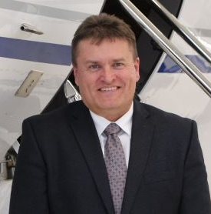
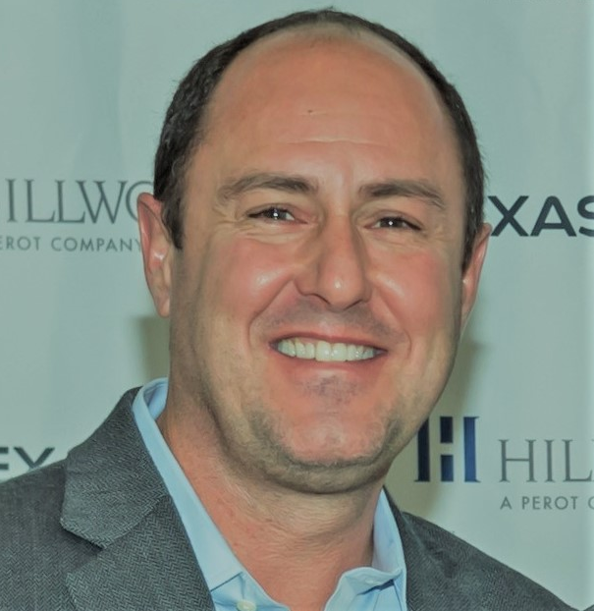
Leadership Welcome
Welcome GCC Members
Welcome Guest
Elliott Taub
Director of Aviation
Cardinal Health
Peter Zeeb
GCC
Americas Chairman Emeritas
Chris Christianson
GCC
Americas Chairman
Gerald Ferriss
GCC
Electrical Chair
Brian Reed
GCC
Mechanical Chair
Ron McKune
GCC
Operations Chair

Slide 8
General Session
Tuesday, November 12th
DAY 1 AGENDA
8:15 – 08:25 AM | Honeywell Leadership Welcome - Todd Owens, Malcolm Fleming, Toby Price & Rod Kennan (10 min)
8:25 – 08:35 AM | GCC Leadership Welcome - Peter Zeeb, Chris Christianson, Brian Reed & Ron McKune (10 min)
8:35 – 08:45 AM | General Introductions (10 min)
8:45 – 9:30 AM | Support Updates – Todd Owens, Malcolm Fleming, Rod Kennan (45 min)
9:30 – 10:15 AM | SPEX & ERB – Riley Shelton (45 min)
10:15 – 10:30 AM | Break (15 min)
10:30 - 11:00 AM | R&O Update - Lesley King (30 min)
11:00 – 11:45 AM | ISC Parts Delivery & Support MOS – Graham Davies, Edwin Leon, & Nick Jarrett (45 min)
11:45 – 12:15 PM | Lunch – (30 min)
12:15 – 1:00 PM | Product Licensing & Ontic Update – Todd Owens, Jason Locklar, Vanessa Pleitez (45 min)
1:00 – 1:30 PM | AOG Update – Ryan Soethe (30 min)
1:30 – 2:15 PM | MyAerospace Portal Updates– Keith Doty (45 min)
2:15 – 2:30 PM | Break (15 min)
2:30 - 2:45 PM | Cabin Management
2:45 – 3:15 PM | Advisory Input - Discuss Pre event questions (30 min)
3:15 - 3:45 PM | Wrap up / Key Action Capture (45 min)
3:45 - 4:15 PM | All GCC Chairs – Meet on GCC go forward (30 min)
Survey
End of day 2
Pilot breakout | FMS Guided Visuals, Chart VOC - Erik Tobler (45 min)
Pilot breakout | FMS Users Forum - Yasutaka Miyazaki and Robert Son (90 min)

Slide 9
Break Out Sessions - Wednesday, November 13th
DAY 2 Electrical Breakout
8:00 - 8:15 AM | Intro/Agenda - Eric Anderson (15 min)
8:15 - 9:00 AM | RDR 4K/7K - Bob Miller/Ben Miles (45 min)
9:00 - 9:30 AM | Jamming/Spoofing update - David Woodcock (30 min)
9:30 - 10:30 AM | Connectivity - Adam Sheppard & JetWave X Update - Tamara Roberts – (60 min)
10:30- 10:45 AM | Break (15 min)
10:45 - 11:15 PM | Navigation & Terrain Data Svcs/INDS - Abilene Gonzaga (30 min)
11:15 - 11:45 PM | Primus EPIC Overview - Jorge Verduzco (30 Min)
11:45- 12:15 PM | Lunch (30 min)
12:15 – 12:45 PM | Honeywell Anthem Update - Thomas David (30 min)
12:45 - 1:15 PM | New Offerings VOC - Allison Haugen (30 Min)
1:15- 1:45 PM | OEM updates Bombardier, Dassault, Embraer, Gulfstream, Pilatus, Textron (30 Min)
1:45- 2:15 PM | Rail Review (30 min)
2:15 - 2:30 PM | Break (15 min)
2:30 - 3:00 PM | New Rails / New Issues (30 Min)
3:00 - 3:30 PM | Electrical /OPS Debrief - Committee Leaders and GCC Focal (30 Min)
3:30 - 4:15 PM | GCC Leadership Report Out (45 Min)
4:15 - 4:30 PM | Honeywell Leadership Closing (15 Min)

Slide 10
Break Out Sessions - Wednesday, November 13th
DAY 2 Mechanical Breakout
8:00 - 8:15 AM | Introduction and Agenda - Tyler Souther (15 min)
8:15 – 9:45 AM | Mechanical Top 25 and Queue Rail Review (90 min)
9:45 - 10:15 AM | OEM Updates (30 min)
10:15 –10:30 AM | Break (15 min)
10:30 -11:00 AM | Tech Pubs TFE731 & HTF – Kannan Suresh (30 Min)
11:00 -11:30 AM | AS907TR/MAPAERO Updates - Nefti Rios-Marquez (30 Min)
11:30 - 11:45 AM | Embraer LP Bleed Check Valve Issue – John Pursell (15 Min)
11:45AM - 12:15PM | Lunch (30 min)
12:15 - 12:30PM | AS907 Bypass Duct HiLok issue - John Pursell (15 Min)
12:30 - 1:00PM | EDG-100 Update (Nazar 30 Min)
1:00 - 1:30PM | MSP - Admin/Fly the Fleet (Dave Lopez 30 Min)
1:30 - 2:30PM | New Rails / New Issue Items (60 Min)
2:30 - 2:45PM | Break (15 min)
2:45 - 3:30PM | Mechanical Debrief – Mech Sub-committee Leader & GCC Focal (45 min)
3:30 - 4:15PM | GCC Leadership Report Out (45 Min)
4:15 - 4:30PM | Honeywell Leadership Closing (15 Min)

Slide 11
Customer Support Updates
Rod Kennan
Sr. Director, C&PS BGA Americas
(602) 228-7287
rod.kennan@honeywell.com

Slide 12
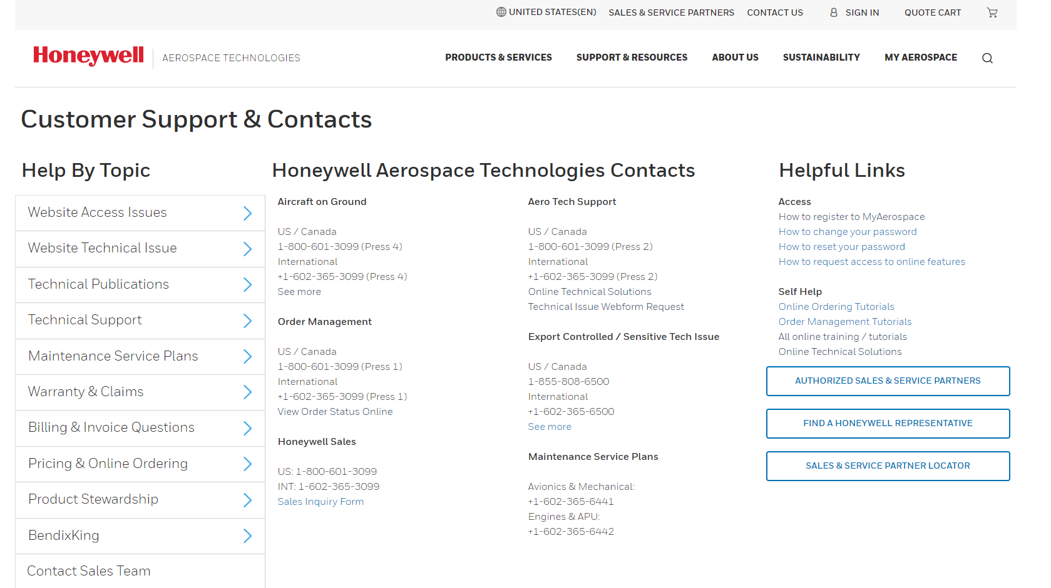
What we heard you tell us......
New Feedback
Need connectivity in the room. In this day and age, it is a must
Ease of contacting Honeywell
One stop QR code for support
Personal contact & Responsiveness
Support structures to emulate – Satcom Direct, Gulfstream
Product lines transitions
Provide multiple effective communications to ensure message conveyed
Customer Protection Plan to ensure continuity of support
Insufficient attention to chronically challenged parts – must be forward looking
HTF ECU, HMU, ITT Harnesses, Blades
Feedback on ISC presentation/data? Restructure to cover ERB/SPEX first
Market perception of MSP value declining
Constructive suggestions on minor portal updates to improve experience
Continuing Themes
MSP - Would like to see holistic MSP offerings, even for parts that have been licensed
SPEX stock (red bins)
Honeywell AOG communications need to include what is preventing delivery, when it will be resolved, and updates on steps as they are completed
Retool monthly GCC meetings – Involve GTO, Portal Team, Effective ISC updates, publish agenda’s a month in advance
Continuity across Committee meetings

Slide 13
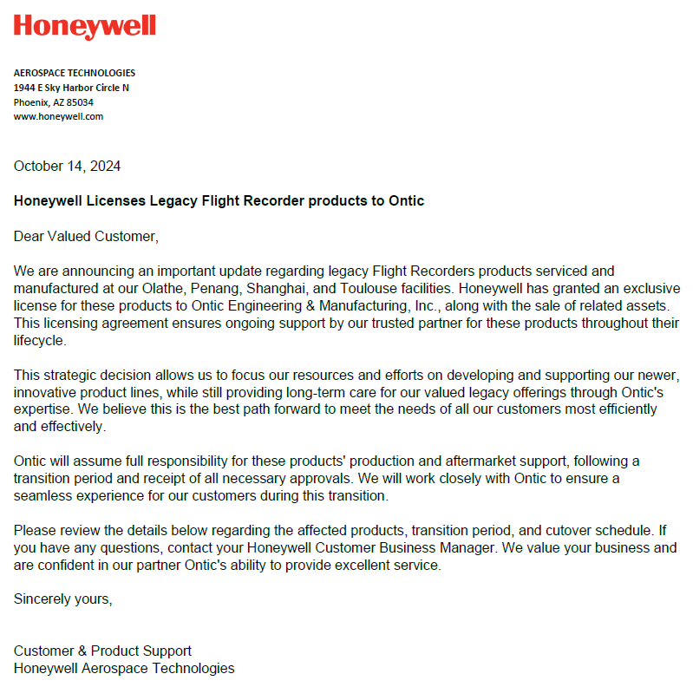
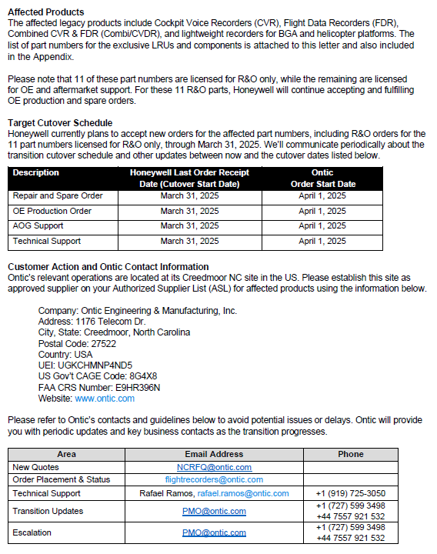
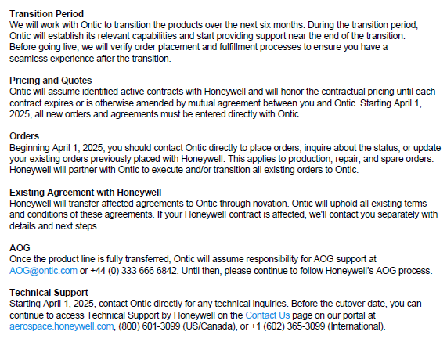
Licensed Product Customer notification

Slide 14
Customer Protection Plan checklist in Due Diligence
(Pre-Deal) CPP Checklist focusing on Risk Migration
(Post-Deal) CPP Checklist focusing on CX
Process
Pipeline Generation
Phase 0 Go/No-Go
Phase 1
Due Diligence
Phase 2 Offers, Agreement, Approvals
Phase 3
De-Integration Planning
Phase 4
De-Integration Execution
Phase 5 Close-Out
1.1 | Impact to key customers
 | - Which customers are potentially impacted (rev+vol.)? Any of them requires special attention/plan?
 | - Which customers are on the consent list? On MSA/MSP list? Any potential risks or issues?
 | - If the licensee is not authorized by certain customers (esp. OE), any challenge to get authorized?
 | - Which customers have high AOG demand in past 3 years against what PNs?
 | - What is HON's obligations under PSAA/SSC for the affected products?
 | - How to transfer customers under MSA? To amend contracts and adjust rate? Or no contract change but just do a rev reconciliation w licensee?
 | - Any impact to existing/new contracts under negotiation, e.g. renewal, expansion?
 | - Any production backlog existing for key customers?
 | - Are any PNs applicable for NG A/C (e.g. 4091900-941 display still in 777 production)? Is it considered 'legacy'? What's the potential impact to customers and HON?
1.2 | Licensee's customer support capabilities
 | - Is the licensee candidate already key customers' ASL? Candidate to provide a list of customers with whom they are authorized.
 | - How is customer and product support org (esp. order admin) structured and located?
 | - What is the process of order entry and fulfillment? PO via email, portal, EDI?
 | - What is the AOG process? Is it true 24/7? via phone, email, website?
 | - What is the exchange capability? Is an exchange pool existing?
 | - Where do they stock serviceable spares/LRUs?
 | - How do they meansure performance, OTTR, OTD? What is their delivery performance?
 | - What certs do they have for R&O? What level of R&O capability do they have? Locations?
 | - How do they manage and communicate ROCAP-like repair info for customers?
 | - How are contracts & warranty administrated?
 | - What is the process and policy for RMA?
 | - What is the process for disputes?
 | - What tech support capability do they provide? Hotline? 24/7? Field service available?
 | - Can they support reliability issue and product improvement?
 | - Do they have obsolescence support capability?
 | - Do they have build-ahead capability, if needed? TE/tooling/skills in place?
 | - Do they have capability to support PSAA/SSC obligations in general, incl. 4-hr AOG per PSAA?
 | - How do they measure CSAT? Survey feedback available? Reputation in general?
 | - Do they have a previous experience w the licensed product, or need to gain and be trained?
 | - Is there a dedicated transition leader/team? With what experience?
C&PS supports the due diligence and tracking of the CPP/CX checklist

Slide 15
Customer Protection Plan checklist in Transition
(Pre-Deal) CPP Checklist focusing on Risk Migration
(Post-Deal) CPP Checklist focusing on CX
Process
Pipeline Generation
Phase 0 Go/No-Go
Phase 1
Due Diligence
Phase 2 Offers, Agreement, Approvals
Phase 3
De-Integration Planning
Phase 4
De-Integration Execution
Phase 5 Close-Out
 | (Refer to Phase 1 Due Diligent checklist)
3.1 | Communications
 | Internal/external general communications (OE/AM)
 | Targeted communication plan for key customers
 | Supplier communication, MSP-operator/dealer communications, etc.
 | Consent, Notification, License agreement notifications
3.2 | Licensee's Customer Support Capability in general
 | Authorization by OE and key customers. If not, plan to be authorized
 | Team structure, skills, hours, shifts, regions, escalation
 | Customer engagement approach (phone, email, portal, EDI, etc.)
 | Order fulfillment Current and To-Be Processes due to the transition
3.3 | Contract
 | Consent MOS
 | Assigned contracts (OE, MSA, MSP…) review and planning (e.g. expiring, renewal)
 | MSP instruction/plan, communication to CBT
 | PSAA/SSC obligations by HON and licensee, guidance, talking points
3.4 | AOG
 | AOG team, hours of operation, true 24/7?, how to engage customer, MOS of AOG mgmt
 | HON AOG/exchange analysis, history/forecast, risk mitigation plan incl. safety stock
 | HAT support as needed for part availability (detail parts and LRUs)
3.5 | R&O
 | Licensee's current certs. If no certs, plan to obtain
 | Licensee's current capability (equipment, tooling, skill, location) If no capability, plan to establish
 | TE/tooling transfer, phased approach to keep capability available
 | Top LRU/piece part analysis to identify critical PNs
 | Piece part inventory transfer plan (phased approach if needed)
 | Phased TE/tooling transfer plan (phased approach if needed)
Licensee Readiness
Assessment Audit #1
Audit #2.
Test of Order Flow
3.6 | Build-ahead
 | Build Ahead requirement (OE+spares, >1 mth shelf stock, new+repaired)
 | Demand forecast, plan for backlog burn down
3.7 | Order Management
 | HON-Licensee order transfer resource/process in place. If no, plan to establish
 | Plan for open orders
 | Service Level Agreement (SLAs) to support order entry
 | RMA process / policy
 | Dispute process / policy
 | M2M capability/maturity (AEX, b2b Aero, EDI…). If none, plan to establish
 | Training requirement for HON products/PO process (allocation of support hours as needed)
3.8 | Technical Support
 | Technical support model
 | Technical documentation maintaining
 | Field service structure Ground support equipment
 | Knowledge sustaining SRD capability and process
3.9 | Business Policy / Practice
 | Spare/repair annual pricing process (to ensure compliance with PSA obligations)
 | Surcharge to customers (e.g. testing, exchange)
 | MOS btw HON and Licensee for transition oversight. Leadership review
3.10 | Plan before Closeout
 | HON's oversight during the entire transition (e.g. Licensee Readiness Assessment by C&PS)
 | HON system updates (SAP, ROCAP, Portal, SIL, Catalog…)
 | Plan of HON-licensee co-testing customer order flow before closeout
C&PS will support the de-integration process and test customer order flow

Slide 16
Active engagement, listening, benchmarking
OEM Alignment
Senior leadership participation in OEM advisory boards
CX lab conducted with Dassault focused on service centers
AOG customer experience lab conducted with Gulfstream
AOG customer experience lab planned with Bombardier on November 21st
Benchmarking Bombardier CX Improvement in the AIN survey results
Operator Alignment
Director of Maintenance peer group visiting PHX on Nov. 19
CX labs with customer flight departments
Active Engagement to Improve Customer Experience

Slide 17
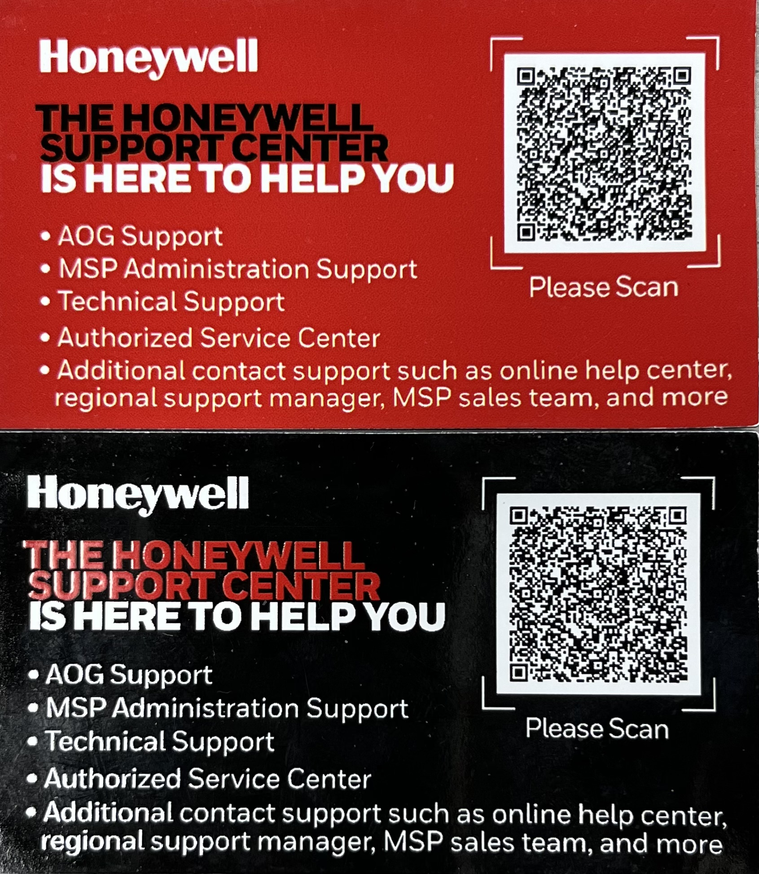
Key improvements in 2024
AOG
Staff increased by 12 to 36
38% reduction in open AOG case backlog
Automation & AI based tools supporting AOG decisions
ISC
Output up 19% in 2024, planning to increase another 18% in 2025
Dual/Multisource parts: +1298 in 2023, +1273 in 2024
R&O
$10M capital investment, 200 direct labor resources added
GROE repair development relieving pressure on new supply (e.g. repair of 23,000 bearings)
SPEX
$38M on order to increase pool capacity, $23M received YTD
Red bins reduced by more than 30% in 2024
ERB
$32M in engines added in 2024
Expanding capacity by partnering and use of 3rd party
Tangible progress in 2024…..will continue driving in 2025

Slide 18
SPEX Performance
Past due SPEX orders reduced by 12%
On time to request increased by 10%
Red bins reduced by >30%
Organizational realignment under customer facing team
Resource hired on-site at Olathe to drive red bin recovery

Slide 19
Top 5 pain points Survey
Consistent Themes: Owners:
Parts Availability ISC, Repair & Overhaul
Price Increases (Parts & MSP) Aftermarket Americas CBT & Pricing
Customer Support Customer & Product Support
Rental Assets (Engines & SPEX availability) Customer & Product Support
Portal Issues Global Marketing Services
Promise Dates ISC, Repair & Overhaul
Comments:
Feels like HW is not specifically addressing parts availability.
GCC expects more than the typical response.
Need more Sr. Leadership to be “in the room”.
What is the clear path to fix the issues….don’t see this getting better
Seeking Continuous feedback from Customer and Advisory Input

Slide 20
Multi-Channel Feedback | Critical projects
ISC Recovery
Talking points for customer comms to summarize key R&O initiatives & progress against KPIs
Supply & Demand Planning enhancements via AI
Multi-source / in-source critical parts
Effective Communication
Customer centric & targeted
Effective internal/external talking points & FAQs
Regional newsletters
Topic-based – Technical & Delivery Performance webinars & forums
Estimated Ship Date Fidelity (ESD)
SAP enhancement to calculate ESD recent demonstrated performance (30/60/90) 11/1/24
~7% improvement in date fidelity
ESD automation upon part availability
Dedicated R&O material leader
AI-validated supplier commit dates
Invoice & Past Due Prevention
Partnership to prevent Past Due & Disputes
Design for Administrable Contracts
Continued adoption of E-Invoicing
Coordinated annual pricing process
Aircraft On Ground
Executive escalation focus
Active Site Leaders and Exec. Leadership
Follow sun model with 24/7 coverage
HAT engagement for rapid solutions
Customer Experience
Delivery Performance
SPEX Delivery / ISS
Prioritized Red Bin Report for SPEX – proactive AOG resolution
Red bin prioritization with ISC – Added focal in Olathe
Dedicated materials focal assigned to drive allocations (voice for SPEX over R&O & OEM
Technical Support
Proactively investigate negative reliability trends
Ensure Stakeholder alignment, urgency, and communication for in-service reliability
Improve fix effectiveness & reduce overall cycle time
Drive adoption for strategic Service Bulletins (SBs)
Reduce # of products in platform Delays & Cancellation (D&C) / removal lists
Transitions
Customer Protection Plan(s) and CX dashboard deployed
Deployed a unified de-integration checklist
Reduced customer effort (e.g., M2M, PO flow test before cutover)
Effective talking points & FAQ’s for proactive OEM communication
Order management & AOG support equal or better
Strategic Support Initiatives – Continuing/Evolving into 2025
Notes:
Estimated Ship Date notes:
3 Dashboards will be used to monitor the fidelity of the shipment dates that are being provided to our customers
# of Past due Basic Finish Dates – Will allow us to see where we need to prioritize resources to provide a date that will allow the customers to plan their operations
# of Basic Finish Date changes – Will allow us to see how many times on average Basic finish dates are being updated. Goal is to keep this as low as possible so customer are not experiencing constantly changing dates
Variance between Basic finish date and actual shipment date – This will show how late or early we are on average based on the dates that are being provided to the customer. The goal is to keep this as close to 0 as possible
All Dashboards will show orders by plant, customer, part number so we do not lose improvement opportunities in the averages of larger datasets.
An SAP enhancement is being developed to update all past due Basic Finish Dates based on the recent demonstrated performance by plant, customer, material. This will standardize date management across all Honeywell repair centers.

Slide 21
aerospace.honeywell.com

Slide 22
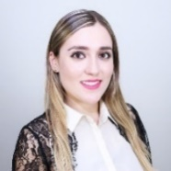
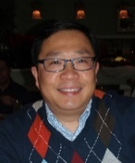
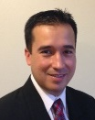
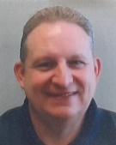
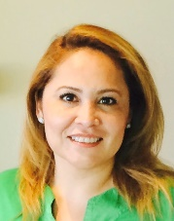
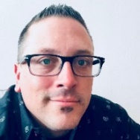
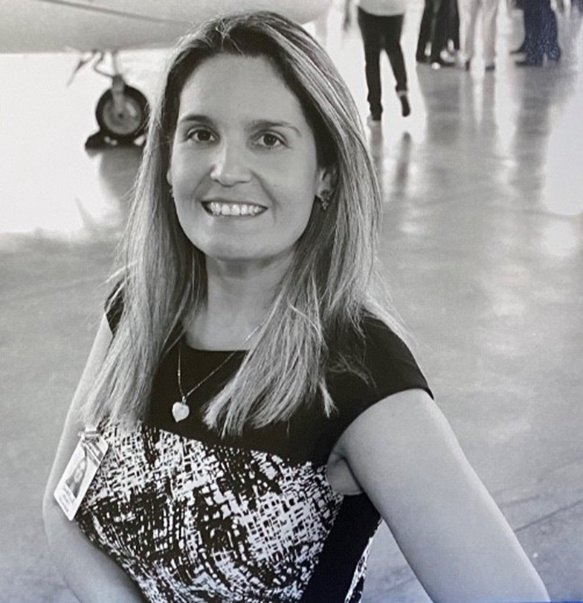
Americas
Rod Kennan
Sr Director, C&PS – BGA Aftermarket
Phoenix, AZ
Mobile: +1 602-228-7287
Rod.Kennan@honeywell.com
Corinna Camarillo
Mexicali, Mexico
Mobile: 602-826-6222
Corinna.Camarillo@honeywell.com
AK
Michael Kong
Redmond, WA
Mobile: 425-922-1678
Michael.Kong@honeywell.com
Yukon
Northwest Territories
Nunavut
Kasey Brennan
Urbana, OH
Mobile: 937-869-9884
Kasey.Brennan@Honeywell.com
Brian Baker
Phoenix, AZ
Mobile: 623 670 2359
Brian.Baker3@Honeywell.com
British Columbia
Newfoundland and Labrador
HI
Alberta
Manitoba
Quebec
WA
Saskatchewan
Ontario
Israel Lizarraga
Mexicali, Mexico
Mobile: 602-541-0253
Israel.Lizarraga@Honeywell.com
Michael Schubert
Phoenix, AZ
Mobile: 602-478-5293
Michael.Schubert@honeywell.com
OR
MT
ND
MN
VT
ME
ID
SD
WI
NY
NH
MA
WY
RI
NV
NE
IA
MI
PA
NJ
CT
UT
IL
IN
OH
MD
DE
CA
CO
WV
DC
Jazmin Meza
Mexicali, Mexico
Mobile: 760-317-6138
Jazmin.Meza@honeywell.com
KS
MO
KY
VA
AZ
NM
OK
AR
TN
SC
NC
Karl Licon
Dallas, TX
Mobile: 469-875-8227
Karl.Licon@honeywell.com
TX
LA
MS
AL
GA
FL
Danielle Richeti
Sr. Customer Support Manager
Phoenix, AZ
Mobile: (602) 989-0489
Danielle.Richeti@Honeywell.com
HI
Dania Arellano
Mexicali, Mexico
Mobile: 602-781-1637
Dania.arellano@honeywell.com

Slide 23
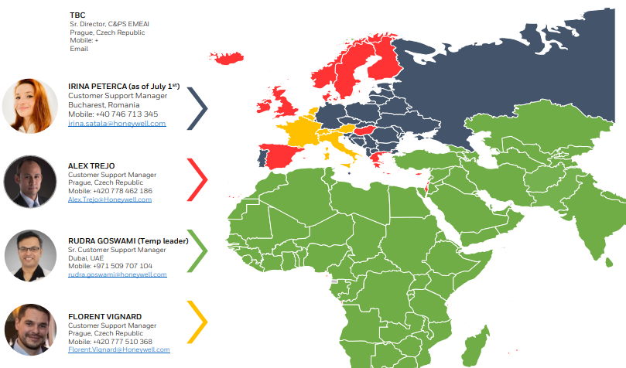
Europe – Middle East – Africa - India
Notes:
JOSMINE BREEDA– India, Sri Lanka, Nepal, Bangladesh
JIRI HUML – Albania, Armenia, Aruba, Azerbaijan, Belarus, Bulgaria, Bosnia & Herzegovina, Croatia, Czech Republic, Georgia, Germany, Kazakhstan, Macedonia, Malta, Moldova, Republic of Montenegro, Russia, Serbia, Slovenia, Turkey, Ukraine, Uzbekistan
MIKE VIRANDO– United Kingdom, Ireland, Africa (Angola, Botswana, Cameroon, Chad, Congo (DRC +ROC), Djibouti, Egypt, Equatorial Guinea, Ethiopia, Gabon, Libya, Madagascar, Malawi, Mauritius, Mozambique, Namibia, Nigeria, Reunion, Seychelles, South Africa, Tanzania, Uganda, Zambia, Zimbabwe)
ALEX TREJO – Afghanistan, Bahrain, Denmark, Egypt, Finland, Gibraltar, Greece, Iceland, Iraq, Israel, Jordan, Kuwait, Lebanon, Netherlands, Norway, Oman, Pakistan, Portugal, Qatar, Saudi Arabia, Sweden, United Arab Emirates, Yemen
ANNA TOMOVA – Andorra, Belgium, Estonia, France, Latvia, Liechtenstein, Lithuania, Luxembourg, Monaco, San Marino, Switzerland.

Slide 24
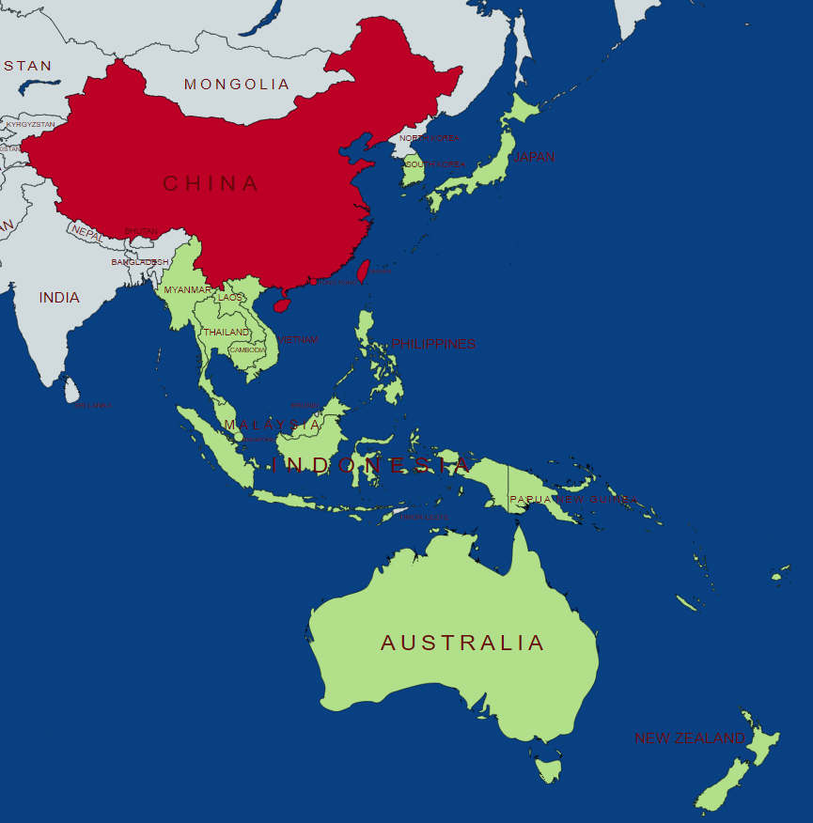
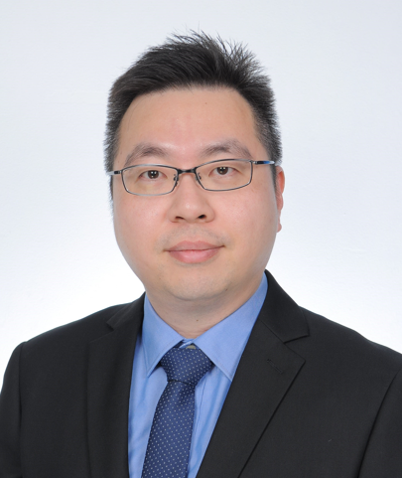
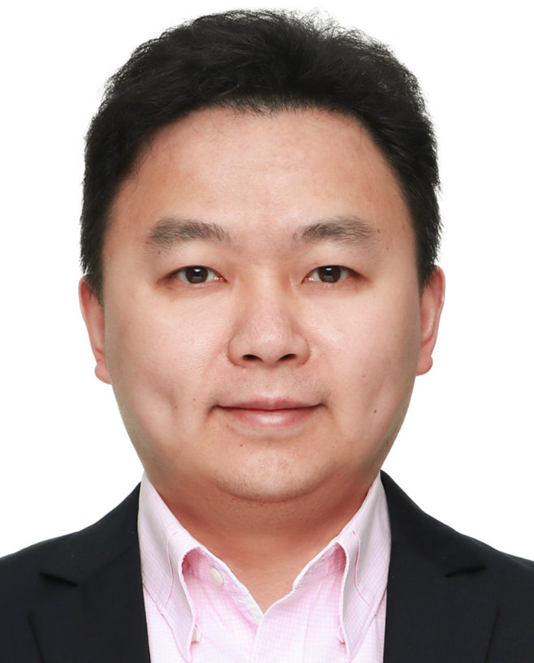
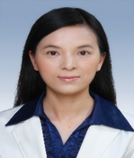
Asia Pacific
OOI KAR WAI (Director, C&PS)
KUALA LUMPUR, MALAYSIA
CELL: +60 12 326 4181
E-MAIL: karwai.ooi@Honeywell.com
Asia Pacific (Non China)
Liu PU (Director C&PS)
SHANGHAI, CHINA
PH: +86 18521798236
E-MAIL: pu.liu@Honeywell.com
CHINA and CHINA WEST
SIMON HUANG
SHANGHAI, CHINA
CELL: +86 152 2182 4151
E-MAIL: jianjun.huang@Honeywell.com
AUSTRALIA | NEW ZEALAND | PACIFIC ISLANDS | SINGAPORE | MALAYSIA | INDONESIA | THAILAND | PHILIPPINES | JAPAN | INDO-CHINA | S. KOREA
CLAIRE CHEN
SHANGHAI, CHINA
PH: +86 152 2183 3554
E-MAIL: claire.chen@honeywell.com
CHINA SOUTH | HONG KONG | TAIWAN | MACAU | CHINA NORTH

Slide 25
Major Account Coverage

Slide 26
Order Escalations
Jeremy Baich
VP, Global Customer Experience
480-235-9436
jeremy.baich@honeywell.com
HON AOG definition:
Next Scheduled Flight < 5 days
Minimum Equipment List (MEL) Expiration < 5 days
Return to service <5 days
ESCALATIONS
Escalation Best Practices
ALWAYS maintain the same email chain, with case # and ref ID (text in brackets)
Always leave “AOG” in subject if it is there
Always add, never delete, contact / escalation names
General Escalations
CSM: Karl Licon Cell: 469-875-8227
Director, C&PS-AM: Rod Kennan: Cell: (602)228-7287
VP, C&PS-AM, OE: Todd Owens Cell: (623)363-9372
Business CBD: Michael Ryan Cell: (973)270-1914
Sr CBD: Brian Howell Cell: (316)347-3579
Escalations to AOG – must do both steps
Draft brand-new email (DO NOT forward previous escalation)
Call AOG team - WARM HAND OFF
US: 800-601-3099
Int’l: 602-365-3099
Reference your case and order number
Escalation path for….
Required AOG info
Aircraft Make, Model & Serial Number
Aircraft Tail / Registration Number
Operator / End-User Name & Address
Location of Ground Aircraft
Next Scheduled Flight / Minimum Equipment List (MEL) Expiration Date
Failed Part Number (and Serial number if applicable)
Any additional details regarding the aircraft's current situation
Spares
Mailbox
orders@honeywell.com
OrderStatus@Honeywell.com
orderchanges@honeywell.com
CSM: Karl Licon
Director, C&PS-AM: Rod Kennan
VP, C&PS-AM, OE: Todd Owens
Business
CBD: Michael Ryan
AAM VP Sales: Brian Howell
Repairs
Mailbox: aerorepairs@honeywell.com
CSM: Karl Licon
Director, C&PS-AM: Rod Kennan
VP, C&PS-AM, OE: Todd Owens
Business
CBD: Michael Ryan
AAM VP Sales: Brian Howell
AOG orders
CSR: AOG@honeywell.com
AOG Supervisor: Josh Olson
AOG Manager: Cesar Contreras
AOG Director: Ryan Soethe
CSM: Karl Licon
Director, C&PS-AM: Rod Kennan
VP, C&PS-AM, OE: Todd Owens
Business
CBD: Michael Ryan
AAM VP Sales: Brian Howell
Critical notes
International shipments (PEI, Toronto, etc.) take a minimum of 3 business days once shipped AOG from HON.
Credit hold / PPO cannot by bypassed. Business teams must clear.
Click icon to visit AOG website

Slide 27
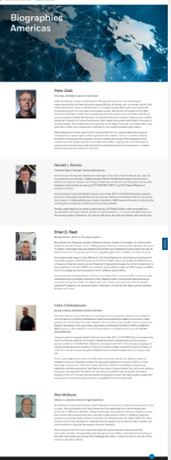
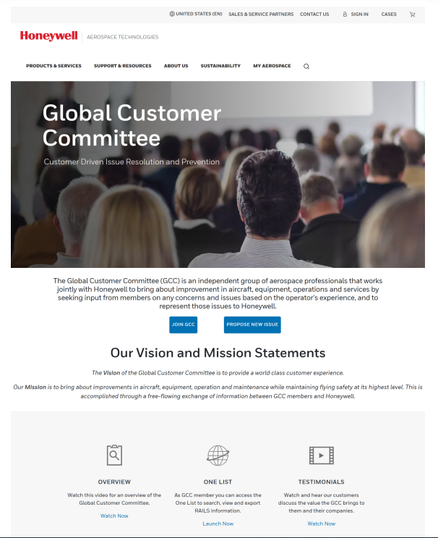
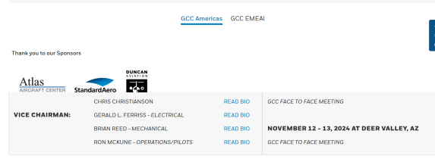
GCC website updates
Webpage refreshed
Included new functionalities - Join GCC and Propose New Issue - buttons/forms
Revitalized Mission and Vision of the Global Customer Committee
Updated members and bios
Secured space to include action items and materials
https://aerospace.honeywell.com/us/en/about-us/global-customer-committee
Website Refreshed; Improved Functionality

Slide 28
GCC regional alignment
Operating System in place to maintain alignment
Staff transitions in EMEAI
EMEAI GCC next meeting 11/19 in Prague
Shared RAIL items
Insufficient upload capacity in GTO webform (FHDB)
7329 Maintenance Tasks on Honeywell Rental Assets
7330 Portal does not include a filter for Avionics Platforms

Slide 29
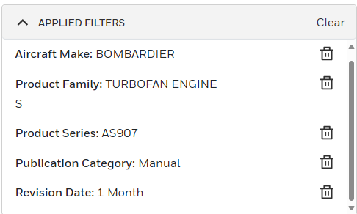
Gcc rail 7330 | Portal does not include a filter for Avionics Platforms
Problem Statement
Current Portal Filter Option
There is currently no ‘collection’ for avionics suites in the way that they are available for engines, for example. Hence, to retrieve publications related to the avionics suite, a manual search for each component needs to be made
70K documents in TechPub Portal
Honeywell TechPubs portal has 70K documents
Documents pertain to different platforms, products & product families
Currently, we have filter faucets for Aircraft Type, Product Family and sublevels
Challenges
Current Portal do not have a high-level faucet filter to add Product Platforms
Documents not classified as Avionics or Mechanical which will take enormous efforts
Physically need to open each document and categorize the product platform level
Go Forward Plan
Honeywell TechPubs Portal contain approx 70K documents
Work with Portal IT team for enabling high level faucet filter and it sub levels
Open each document and identify them to their respective product platforms & ATA
Associate the Platform to product family, application and Model to reflect in portal
Search criteria to be defined based on Platforms as well.
Notes:
Today, customers are restricted to uploading files no larger than 10 MB and are limited in the file formats they can use. This constraint is particularly problematic in urgent Aircraft on Ground (AOG) events where timely access to comprehensive engineering data is critical. As a result, customers are forced to wait for a case to be opened before they can email the necessary data, causing significant delays. These restrictions on file size and format, coupled with the procedural delay, impede swift resolution and efficient handling of AOG situations, ultimately impacting operational efficiency and customer satisfaction.
Keith,
Part of the consent decree exit actions included turning off the ATS email address and transitioning to webforms. We did this because we cannot control what customers email us and SFDC is not ITAR compliant. We also wanted to minimize the risk of 500/600 series data going into SFDC as well. We worked with Allen and the export control team on this action.
Therefore, Customers could no longer email us product download files and are complaining about the multiple interactions required to send us our own product download files. For example, our #1 cause volume driver is decoding product Flight History Decode Databases (FHDB) and Pilatus refused to use the process so we have a work around in place right now. In addition, NetJets shared with us that this is very painful when their maintenance control is trying to manage a fleet of 1000 A/C and now they have use the webform and have multiple interactions to send us files to review.
What else do you need?
Best regards,
Malcolm Fleming

Slide 30
AOG support – MSP customers
AOG order should be placed with Honeywell which will create a CASE
Honeywell AOG will evaluate best options:
SPEX exchange
SPEX-Work out of Repair: when immediate exchange is not available -- highest priority at the R&O plant
Alternate PN / upgrades
Honeywell Aerospace Trading (HAT) market search
If HAT can not supply / open market search
Channel Partner search, recovery of recent supply
If there is no availability and operator finds 3rd party part:
Send the details (Owner, contact info and location) to the AOG team via a reply to the AOG email with CASE tracking
Honeywell will review/approve/purchase and drop ship

Slide 31
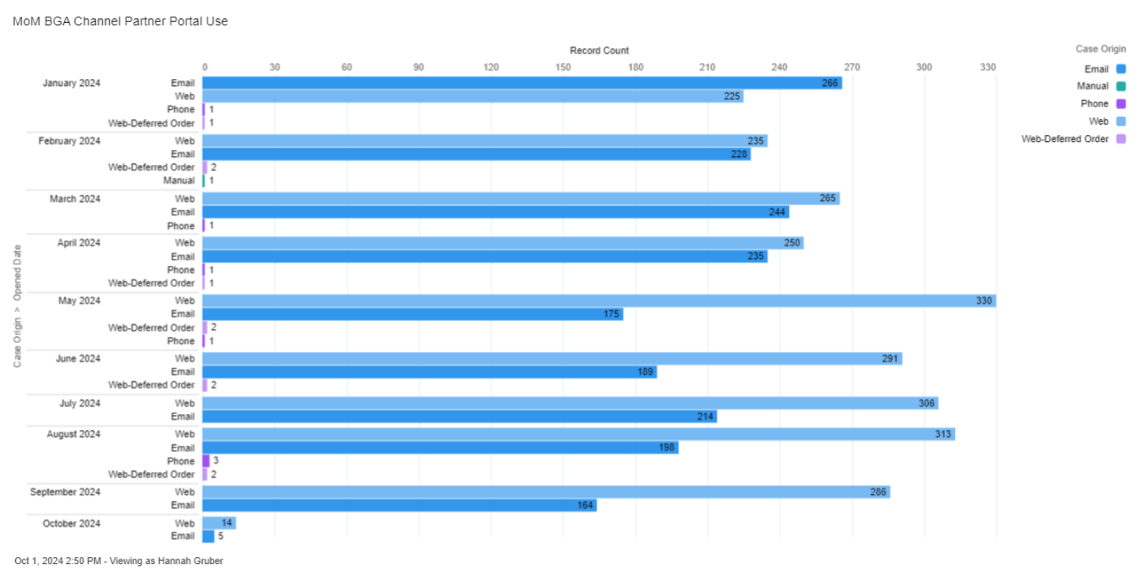
Portal utilization
Continued focus on enabling customer self-service

Slide 32
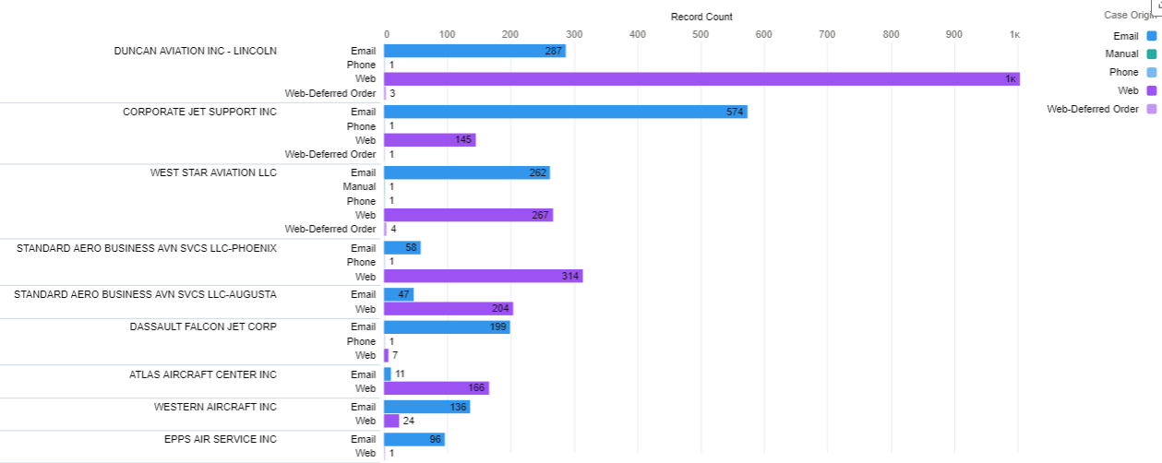
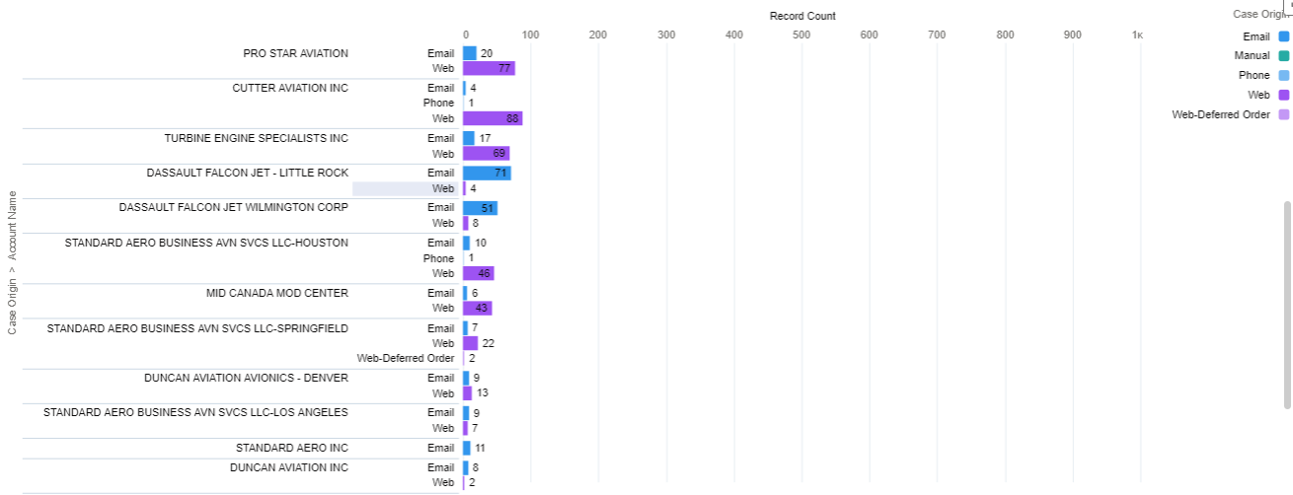
Portal utilization by Channel partner
Increasing portal utilization across support network

Slide 33
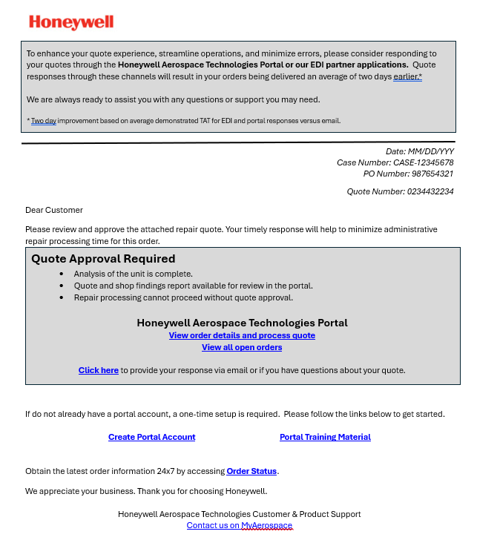
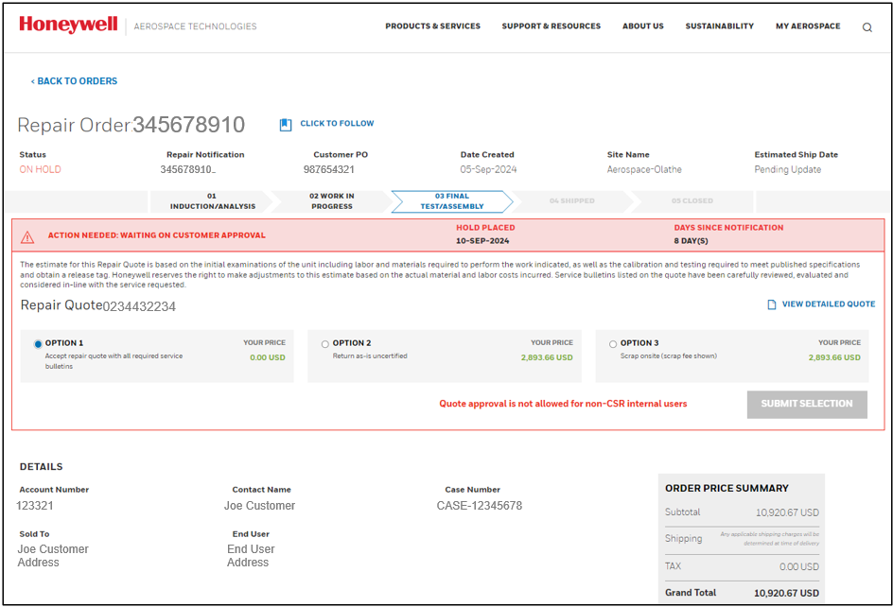
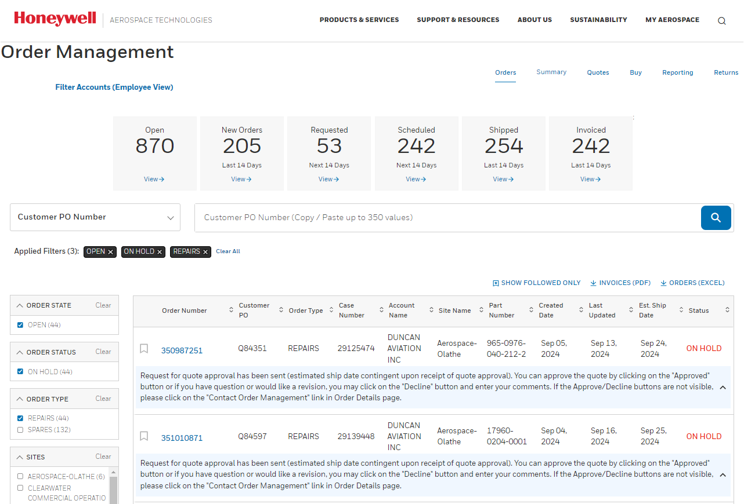
NEW quote approval request template

Slide 34
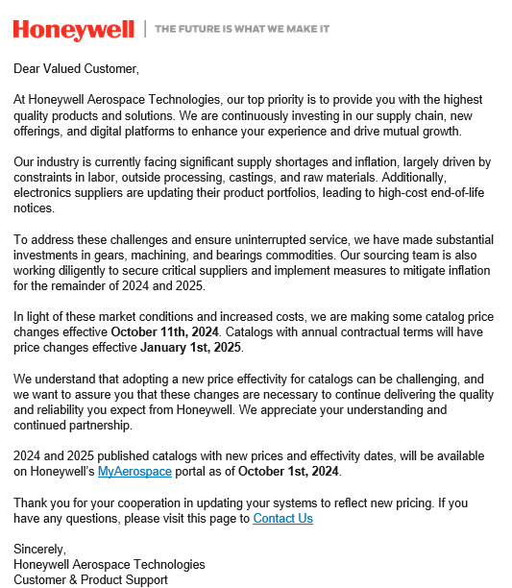
2024 Catalog pricing updates
Change Management Communications

Slide 35
Support resources
Channel Partner Network
Spares, Repairs, Exchanges, MSP, Warranty, etc.
AOG
aog@honeywell.com
Ph: 602-365-3099 option 4
MyAerospace Portal – https://aerospace.honeywell.com/
Core administration, returns, ordering, quotes, pricing, publications, repair capabilities, technical support. Warranty, HAT, tutorials, others.
Currently active channels (as applicable per service level)
orders@honeywell.com
orderstatus@honeywell.com
pubs@honeywell.com
quotes@honeywell.com
corerecoveryinteam@honeywell.com
returns@honeywell.com
aerorepairs@honeywell.com
spex-bgaorders@honeywell.com
aerospacewarranty@honeywell.com
MSP – multiple email addresses to support customers

Slide 36
Technical Support Updates | Since Q2 GCC
Operations | ATS, Tech Pubs, & Ground Support Solutions (GSS)
TechGPT maturation | Visibility for cases transferred between HON groups
ITEM go-live delayed to Q1 2025 | Scope changed based on Customer feedback
Drive ATS best practices into Tech Pubs & GSS to improve customer support
Released 4 RNP and 7 FMS Guided Visual Procedures
RNP | Released 5 HON special procedures
FMS Guided Visuals | Released 15 HON procedures, 10 in work
Prioritized 4 TFE731 2nd generation manual revisions
IPC 72-03-13 (✓), LMM 72-03-06 (✓), RM 72-IR-02, & HMM 72-03-07
Addresses 389 of 672 changes to TFE731-20/-40/-50/-60 manuals
Product Reliability
Communicate Fleet Issues & Reliability via Webinars
RDR4k Mod-31 | 55%+ adoption for all platforms | MTBUR @ 25.5k ⬆ (was 8k) hours
Released the AS907 acoustical resonance fix for all models
What other feedback does the committee have on Tech Support?
Notes:
Notes:
Released 4 RNP and 7 Guided Visual Procedures since Q2
RNP | Two for Chicago Exec (KPWK)Hailey (KSUN), and Telluride (KTEX). Aspen.
FMS Guided Visuals | Cabo San Lucas (MMSL), San Francisco (KSFO), two for Burbank (KBUR),Truckee/Tahoe (KTRK), & two for Singapore/Seletar (WSSL)

Slide 37
Pilatus & APEX | GTO Improvement Areas
PC-12/-24 IETM Flight Line Maintenance Manuals
Improved customer experience
Integrated Technical Videos
PC-12/-24 FHDB Download App
Wireless capability
January 2025
Pilatus Service Center Support
Detailed YoY training & Tech Connect Plan
Data driven scorecard
Trained 8 partners in past 10 months
PC-24 LDI Updates
Better troubleshooting & fault isolation
Periodic refreshes
Q1 2025
ATS FSE skillset & regional support
Americas “Tech Core Team Leader”
Expand from 6 to 14 APEX SMEs
Service Center training playbook
Customer
Focus
PC-12/-24 APEX FHDB Decode App
Enhanced FSE toolset to isolate faults
2025 AOP request
Quality & Reliability
Detect out of the box failure trends
Early identification and faster fixes: RDR-7K & AH1000 AHRS
Proactive campaigns: AGM200, KSG7200 & MMDR
Prevent Workarounds | Human Factors
INDS website chart file downloading
IDM IPAD wireless loading process
Enhanced Support & Fault Isolation | Reduce Spare Part Consumption | Leverage Data
Notes:
This slide summarizes 8 critical activities GTO is driving to improve our relationship with Pilatus, their service centers, and operators.
It starts with increasing our FSE skillset, as shown in the middle of the left-hand side of this chart. Pilatus APEX cases are number one case volume driver for ATS and complicated to T/S. This is also an enabler to increasing our engagement with the Pilatus Service Center network, which includes close to 80 different channel partners and distributors.
Moving to the right hand of this slide,
We’re working with Pilatus to make it easier to T/S APEX by adding ~5000 new CAS messages to the PC-24 APEX system. These CAS messages are like fault codes on your care. This project these new fault codes will help us resolve 60% of our cases faster and address 40% of NFFs that we have today. When I was in Switzerland a few weeks ago the Pilatus Avionics leader shared that success looks like regular LDI updates based on what we’re seeing in the field so going forward we’re going to do periodic updates.
The second key enabler to improve our T/S is getting our FSEs the tools they need to do their job more effectively and our 2025 AOP includes an APEX FHDP app.
From a user experience perspective,
We have three key items.
On the right hand of the slide, we need to enable wireless downloads of the APEX Flight History Database, or FHDB. The Pilatus A/C often fly in remote locations and due to airworthiness regulations in other countries Pilots are only allowed to download the data wirelessly. We have this capability with the legacy Maintenance Advisor App, but it is no longer available due to cyber security advancements.
On the lower right corner, we need to address process gaps for DBs. While this is not easy, it’s critical to improving the Customer Experience and preventing system issues when uploading data, which can lead to AOGs and unnecessary spare part consumption.
Lastly, moving to the upper right corner, one of the ways I want to address Service Cetner training gaps is to deploy IETM manuals for the PC-12 and PC25 Flight Line Maintenance Manuals. This manual format will improve the customer experience and ease of use for our manual and allow us to embed T/S videos into the manuals, which will be a first for us.

Slide 38
Tech Pubs | Key improvement elements
“A / 100%”
97%
5/5 score
4.75/ 5 score
BGA OEMs
Drive Improved Customer Satisfaction
AIN Tech Manuals: Avionics (8.4) & Engines (8.3)
Airbus Airlines survey Documentation (GREEN)
Customer Satisfaction (C-SAT) > 95%
Release 4 TFE731 manuals in 2024
Enhanced Tech Pubs portal CX
Enhanced security for browsing
Faster downloads & better search algorithm
User defined library, favorites & subscription status
Faster Revision & Release Cycles
Improved OEM approval TAT
Synchronized with OEM portals
Periodic revision cycle: Yearly
Incorporate outstanding Temporary Revisions
Convert Documents to S1000D
Converted 3200 manuals; 1300+ in plan
Data modules enable faster discrepancies TAT
Enable Data Modules delivery options
Customer Experience
Technology Deployment
Enable IETM Manuals
Online engine / APU manuals, IETM deployment moved to Q1 due to scope change and enhanced feature web-based access (without dependency on third party desktop application).
Enhanced user experience
Enable manuals with repair procedure videos (2025)
Deliver Higher Quality Documents
Deliverables quality at 99.6%
Reduce reported discrepancies: 250 to 150 monthly
IETM Features
Hotspots: Correlation of parts from text to illustrations
Navigation: Easy to switch between previously viewed pages
Links to external documents: Viewed within context of a single document
Advanced search: Find content anywhere & easily identify version changes
Technotes: Annotations, discrepancy reporting and resolution
3D models: Improved visualization for repairs in complex parts
Video
Improved Customer Experience | Adoption of Latest Technology
Notes:
Summary:
Our strategy is to adopt the latest technology as an enabler for higher quality manuals, an enhanced customer experience, and to make it easier to maintain and refresh manuals. In addition to this, we’ll be going live with a completely refreshed Tech Pubs portal page that will greatly improvement our digital experience.
Details on each improvement area
Drive Improved Customer Satisfaction:
Airbus - improved score from D (3 years ago) to A today and goal to maintain top score A
Boeing – improved score from 80% (3 years ago) to 100% today and goal to maintain top score 100%
BGA OEMS – improved scores from 3.5 / 5 (2 years ago) to 5 / 5 today and goal to maintain top score 5 / 5.
AIN Tech Manuals score improved from 7.5 (2 years ago) to 8.2 today and goal to improve to >9.0 in next 3 years.
Faster Revision & Release Cycles:
Improved end to end authoring CT from 85 days (3 years ago) to 60 days (30%) and goal to reduce to 42 days in next 3 years.
Deliver Higher Quality Documents
PPM decreased from 1500 (3 years ago) to 500 today (30% improvement) and goal to achieve 250 PPM in next 3 years.
Reduced reported discrepancies monthly from 250 (2 years ago) to 170 today (32%) and goal to reduce to <100 per month.
Convert Documents to S1000D
Converted 3200 manuals to S1000D and goal is to convert total 4500 manuals.
Enable IETM Manuals
Enabled 151 manuals with IETM features and end goal to enable 25% (>1000) of manuals to IETM.

Slide 39
Tech Pubs | Engine manuals revision
Problem Statement
AIN Survey: Honeywell score (8.3) is at 4th place compared to GE (9.1), RR (8.8) and P&W (8.6)
TFE manuals not revised for years (Avg 15 years old) and inGCC/CPAB meet customers looking manuals with TRs & SBs incorporated
247 TFE731 TRs outstanding and end users unable to co-relate with the procedures (outcome of GCC meet & surveys)
Per industry specification (ATA 100 / iSpec 2200/ S1000D) TRs are to be incorporated within 90 days & SBs within 180 days to the respective manual
Driving factors and Implementation strategy
ATA / S1000D Guidelines
TRs to be incorporated within 90 days in manual
SBs to be incorporated within 180 days in manual
Enable quick revision in S1000D elements TRs
Engineering Requirements (Adhoc)
Incorporate SBs / TRs for issues reported in field
Software updates for Engine Electronic Control (EEC)
Incorporate after market requirements
Tech Pubs Strategy and go-forward plan
Migrate to S1000D to meet Industry standard
Timely incorporation of DR, TR & SB and provide updated manuals
Periodic revision of manuals based on requirements
Deployment of Interactive Electronic Technical Manual (IETM)
GCC / CPAB inputs
Manuals not revised and latest updates not available
Many TRs and unable to co-relate the TR content
SBs outstanding and latest PNs not in manuals
Revision plan of 4 TFE manuals in 2024
Manual | ATA Number | Release date
IPC | 72-03-13 | Sep 2024
LMM | 72-03-06 | Nov 2024
HMM | 72-03-07 | Q1 2025
IR | 72-IR-02 | Q1 2025
Improved revision cycle and AIN scores

Slide 40
Support network
ATS
(AERO TECH SUPPORT)
EXPERT TECHNICAL SUPPORT
OF HONEYWELL PRODUCTS
CSM
(CUSTOMER SUPPORT MANAGER)
ESCALATION OF CUSTOMER SUPPORT RELATED ISSUES
ASM
(AREA SALES MANAGER)
PROVIDE EXPERT ADVICE ON
HONEYWELL PRODUCTS, RETROFITS, SERVICES, ETC.
MSP
(MAINTENANCE SERVICE PLANS)
EXPERT ADVISE AND SUPPORT ON AFTERMARKET PROGRAMS

