Slide 1
Honeywell Global Customer Committee Aircraft on Ground
Ryan Soethe AOG Sr Director

Slide 2
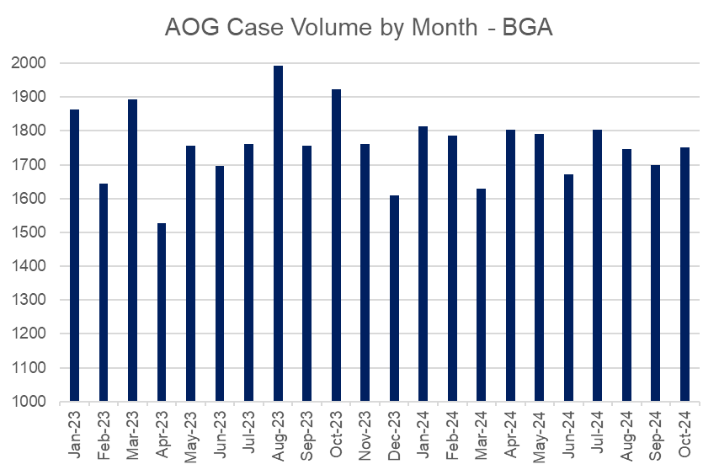
Honeywell AOG | Volume & Performance
AOG Key Actions:
Action | Owner | Timing
AOG Agent Staffing (+Regional Support) | R. Soethe | Complete
AOG Case Mgmt Tool Optimization | R. Soethe | 1Q2025
Regional Escalation Repair Gate 3 | L. King | On Going
AOG Performance Metrics:
Metric | Goal | 2024 Q1 | 2024 Q2 | 2024 Q3 | Trend
Customer Satisfaction (CSAT) | > 95% | 84% | 87% | 87%
Customer Delivery (OTTR) | > 98% | 48% | 49% | 54%
Customer Communication (TSLI) | < 5% | 43% | 27% | 15%
Open Cases Backlog (>5d aged) | 0 cases | - | 119 | 98
Repair Orders Driving Open Case Backlog Growth

Slide 3
AOG Digital Transformation
Manual Processing of AOG
Automated Processing of AOG
AOG TEAM
36 Senior level CSRs
24 / 7 / 365
All Sites
All Products
Manual Contract Review
AOG Customer Case
Order Solution Tool
Improved response fidelity
Increased capacity
Reduced case closure timing
Manual Site Notification
Current State
Future State
Review Knowledge Articles
Evaluate Open Order Report
Review Honeywell
Aerospace Trading
Manual SAP Stock Search
Reduce time to provide relevant
information back to customers
Automate solutions via an integrated toolset
Manual→ Automation of complex solution
AI-driven solution recommendations

Slide 4
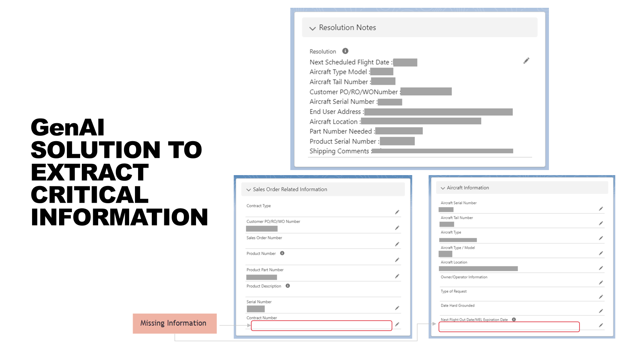
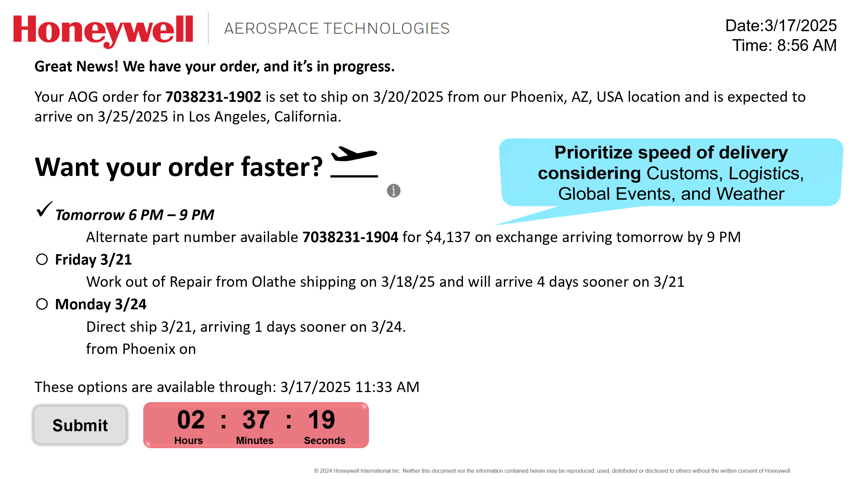
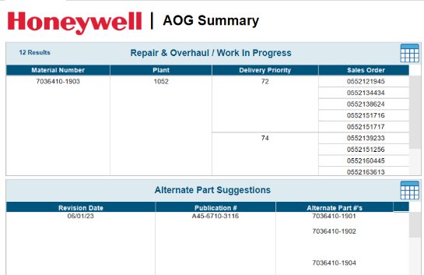
AOG Process of Tomorrow
Inquiry Data Validation & Extraction
Automated Decision-Making + Order Entry
AI Empowered Optimized Delivery
GenAI model leveraged to capture all required details from customer case before moving into the next phase
Facilitate the best course of action through a pre-defined decision tree to Enable CSR
Enabled via GenAI to provide efficient solution considering logistics and global macro-variables
Interim solution: Tableau Dashboard for real-time SAP Data in one place Live - 5/21
Ideal State: Provides the timeliest solution to the customer by taking in account alternate part numbers, channel partner inventory, higher/lower-level assemblies, etc. and provides CSR with recommendations.
Next phase: Incorporating decision tree methodology (if, then, else logic) to mimic CSR decision-making
Live 8/22
March 2025
December 2024
Notes:
Buzzwords:
Moving away from sequential decision-making to concurrent/simultaneous
Inbound & Triage = 10%, Solutions & Decision = 30%, Order Entry = 20%, Communications = 40%
Human-dependent orchestration → future is automated orchestration
Ensuring the intent of the solution remains more important than checking a box
Chunking and never forgetting to stitch

Slide 5
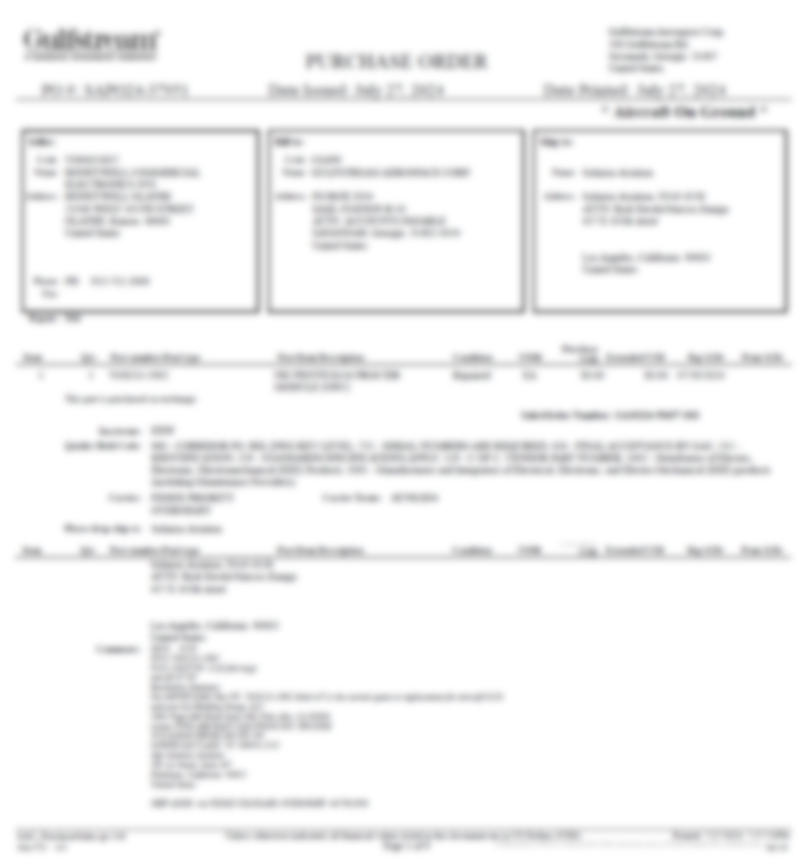
AOG Case Creation -
Customer PO

Slide 6
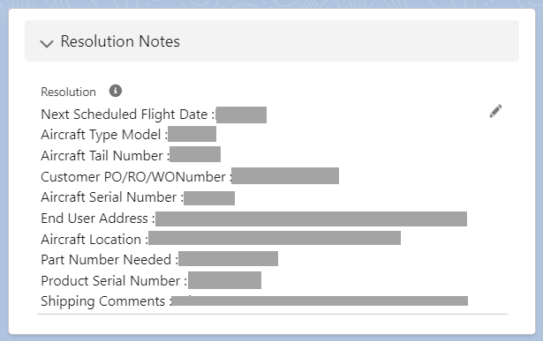
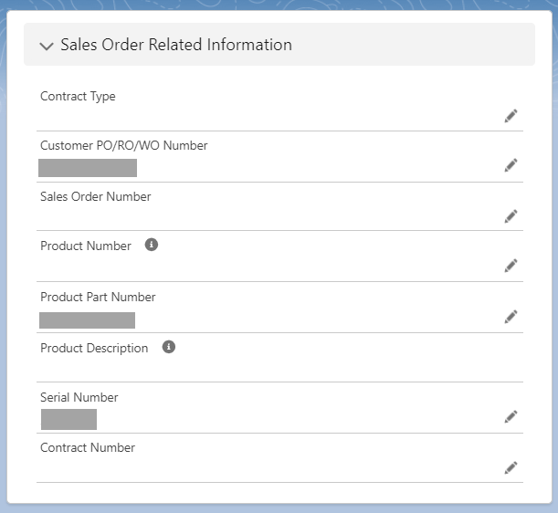
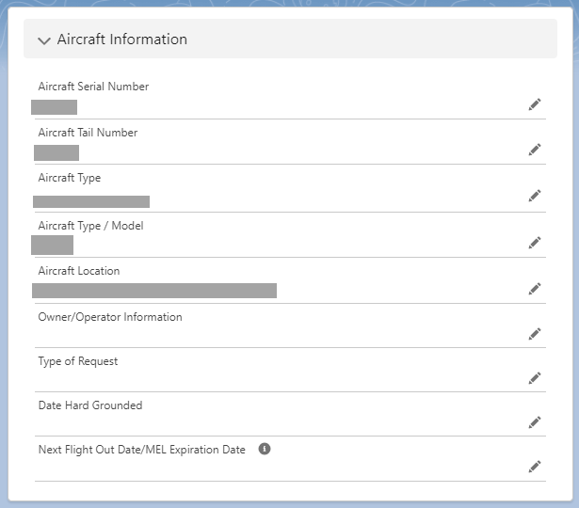
GenAI Solution to Extract Critical Information

Slide 7
Drafted Email response to the Customer

Slide 8
Automated Decision-Making
Phase 2a – Decision Tree Automated
Phase 2b – Recommendation with Execution
Solution
In Stock
Hi Agent, we have found a few viable options for this customer:
Please select the best options and the next best action will be executed.
Current State:
CSR stops at 1st viable option
R&O Unit
Estimated
Delivery
- Est. Delivery 96 Hours*
Alternate Part Number
48 Hours
Submit
Execution of order placement and close loop communication with customer
Production Stock Transfer
✔ Ready to Ship
✔ Est. Delivery 2 days
HAT
48 Hours
Request HAT Approval
Higher/Lower Level
- Est. Delivery 72 Hours*
✔ Stock Available
✘ Approval Needed
Unlike Exchange
All options configurable based on business rules
R&O Unit
96 Hours
Request ISC Update
✔ In Gate 3
✘ No Est. Delivery
Alternate Part Number
- Est. Delivery 48 Hours
Higher/Lower-Level
Customer Approval
✔ Stock Available
✘ Cost Variance
72 Hours
HAT
- Est. Delivery 48 Hours*
Selection of option to process in ERP or SFDC
Channel Partner
ILS
End State: Next best action is automatically processed without CSR intervention
Buy-back

Slide 9
Date: 10/08/2024
Time: 8:56 AM
Great News! We have your order, and it’s in progress.
Your AOG order for 7038231-1902 is set to ship on 10/9/2024 from our Phoenix, AZ, USA location and is expected to arrive on 10/12/2024 in Los Angeles, California.
Want your order faster?
Tomorrow 6 PM – 9 PM
Alternate part number available 7038231-1904 for $40,137 on exchange arriving tomorrow by 9 PM
Friday 10/11
Work out of Repair from Olathe shipping on 7/29 and will arrive 4 days sooner on 7/30
Saturday 10/12
Direct ship 7/31, arriving 2 days sooner on 8/1.
from Phoenix on
These options are available through: 10/08/2024 11:33 AM
Prioritize speed of delivery considering Customs, Logistics, Global Events, and Weather
Submit
02 : 37 : 19
Hours Minutes Seconds

Slide 10
AOG support – MSP customers
AOG order should be placed with Honeywell which will create a CASE
Honeywell AOG will evaluate best options:
SPEX exchange
SPEX-Work out of Repair: when immediate exchange is not available -- highest priority at the R&O plant
Alternate PN / upgrades
Honeywell Aerospace Trading (HAT) market search
If HAT can not supply / open market search
Channel Partner search, recovery of recent supply
If there is no availability and operator finds 3rd party part:
Send the details (Owner, contact info and location) to the AOG team via a reply to the AOG email with CASE tracking
Honeywell will review/approve/purchase and drop ship

