Slide 1
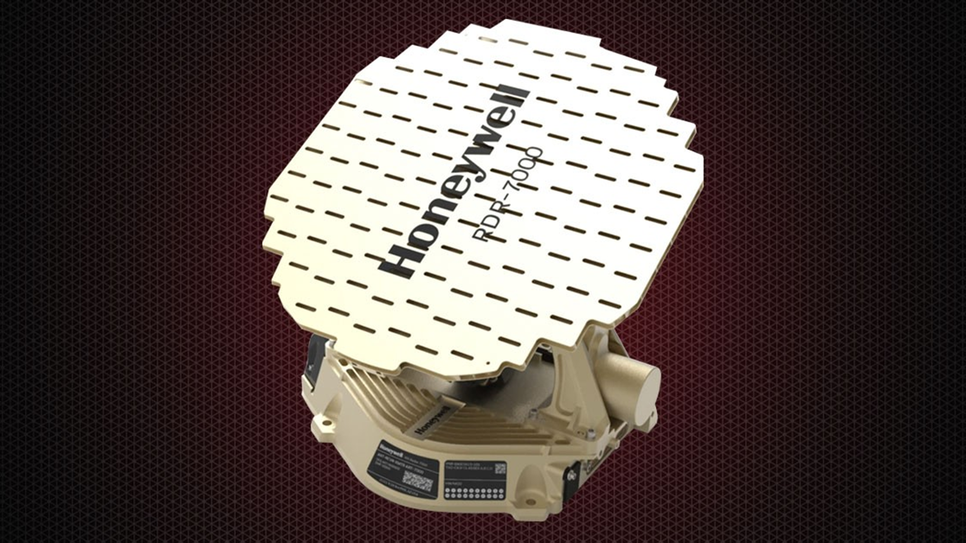
RDR-7000 Technical & Reliability Updates
Eric Anderson
In-service Engineering
Global Technical Operations

Slide 2
Reliability Updates
Notes:
2

Slide 3
RDR7K Removal Status
Last 12 Months Removal Cause
Removal Cause Improvement | Improvement Quarter | Last Failure Mfr. Quarter
RF Module -003 MOD RF Module Q12 Overstress ORI | Q4 2020 Q3 2023 | Q1 2023
Azimuth Motor Testing Improvements | Q4 2023 | Q4 2023
PCIE Cable Assembly Drawing Revision | Q1 2022 | Q4 2021
Power Board Low Transmit Power | Q1 2024 | Q1 2024
PLL MOD 2 Fix | Q4 2020 | Q3 2020
Removals by Manufacturing Quarter
RF Module -003 Assy Q4 2020
PLL MOD Q4 2020
PCIE Cable MOD Q1 2022
All Major Engineering Issues Solved

Slide 4
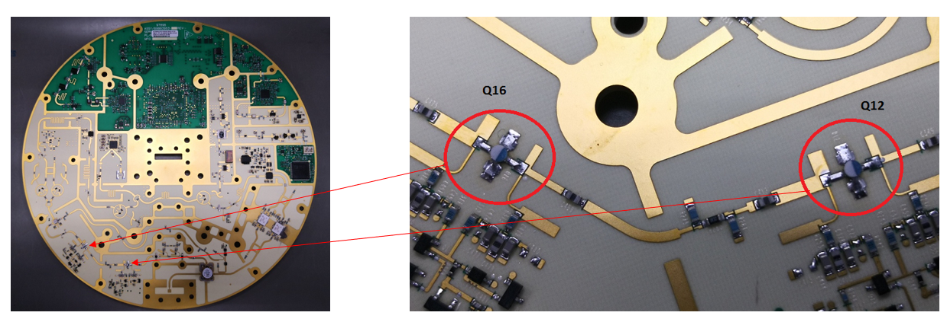
RF Module Q-12 Overstressed / Burning up:
Issue:
Q12 fails and burns up at various points in the value chain.
Root Cause:
In-circuit Test (Flying Probe) used wrong profile, latent damage.
Tested as resistor not diode, injected current into drain.
Containment:
  Remove ICT/FP for this component PN (no failures detected at ICT/FP)
  Generate Overhaul Repair Instruction
Corrective Action Completed Q3 2023
Notes:
4

Slide 5
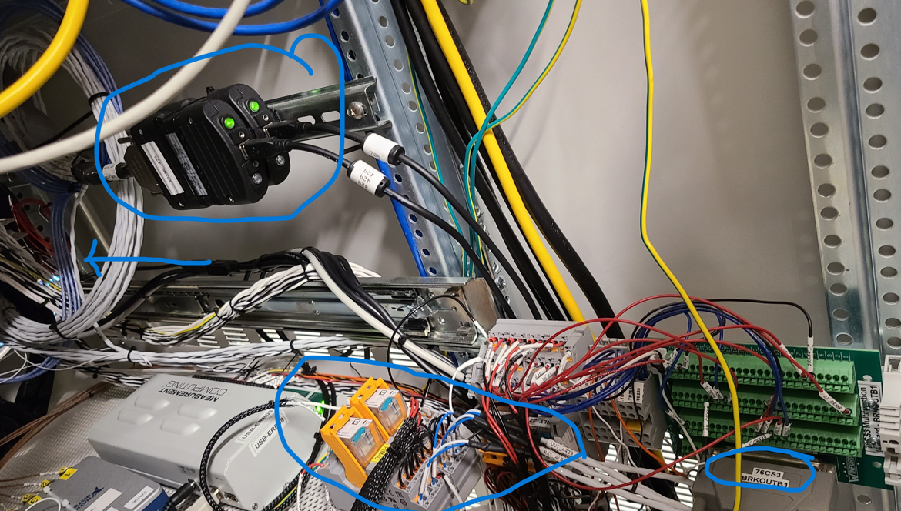
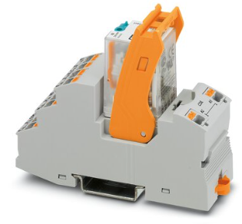
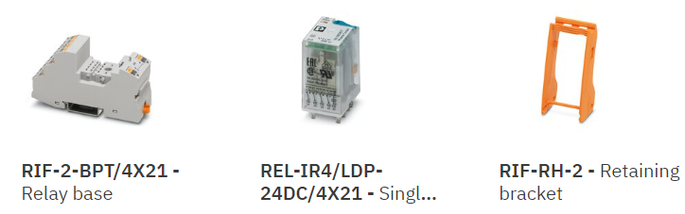
Analog Pitch / Roll / Heading (A-PRH):
Issue:
A-PRH is derived from a low voltage measurement that corresponds to degrees during mechanical antenna movements.
Threshold is ± 1 degree, which correlates to ± 270 mV
Root Cause:
Defective in-station relay generating 200mV noise on A-PRH lines.
Containment:
Update TPM Plan to include defective relays, 12 mos cycle
2 relays replaced in ATP, 6 replaced in ESS setup (Nov21-23)
P/N: 2903308
Corrective Action Completed Q4 2023
Notes:
5

Slide 6
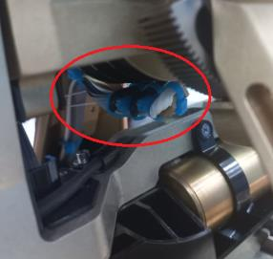
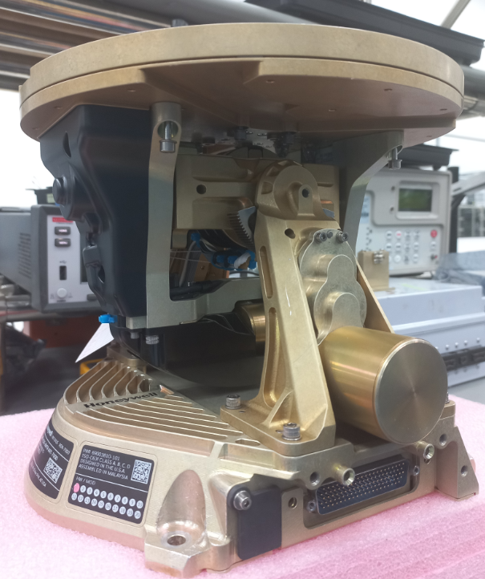
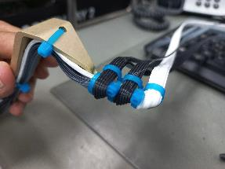
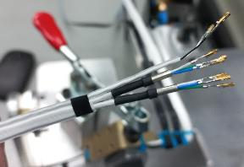
PCIe Cable Communications:
Issue:
Communication bus between RP and RF not linking (pass/fail)
Root Cause:
Cable assembly process / ambiguous work instructions
Containment:
Update Cable Assembly Dwgs (69003940-004):
  Manual twist of final 1” of TSP going into connector
  Extend ground wire 3mm to full length of ferrule, solder both ends.
Corrective Action Completed Q1 2022
Notes:
6

Slide 7
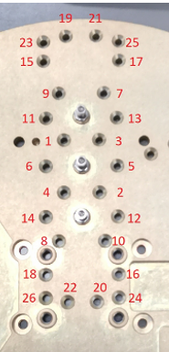
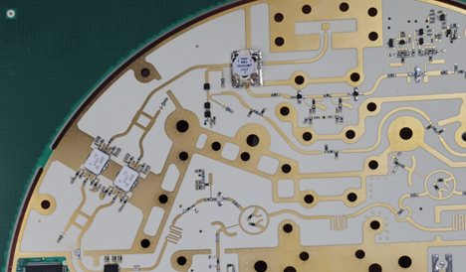
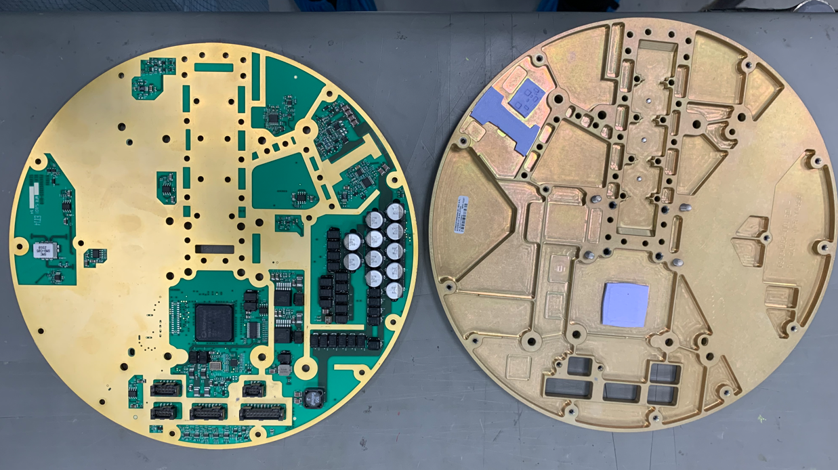
Low Transmit Power:
Issue:
Test results were hovering around the lower limits required by our TSO
Root Cause:
0.44dB adaptor loss missed during calibration when assigning static offset constant
Filter cover flatness
U5 temp-compensated attenuation pad value not ideal (1dB)
Containment:
Implemented torquing sequence to area around RF Filter to ensure tight fit
Created new parts for U5, made this tunable at 3dB, 4dB (default), and 5dB.
Make Test Select process mandatory, enhanced procedure verbiage
Adjust static cal constant
Add RF Cables to TPM Plan
Eval Power Meter vs. Spectrum Analyzer for test methodology & TRS Update
Measure Tx Power as a discrete sample of 3, requiring 3x pass, not averaging.
Torque Sequence
U5 Attenuation pad
Waveguide Output Filter
Corrective Action Completed Q1 2024
Notes:
7

Slide 8
Production Improvements
2nd ESS Chamber
Spare Harnesses
Partial 2nd ATP
Waveguide Calibration
Synchro Card x2
Nov23
Dec23
Jan24
Feb24
Mar24
Apr24
May24
Jun24
Nov24
Sig Gen (Hon Loan)
Pwr Dist Unit
Sig Gen (Repaired)
Sig Gen (NEW)
NW Analyzer
Power Sensor
FULL 2nd ATP
Capacity & Reliability Increases

Slide 9
Software Fixes/Enhancements
Notes:
9

Slide 10
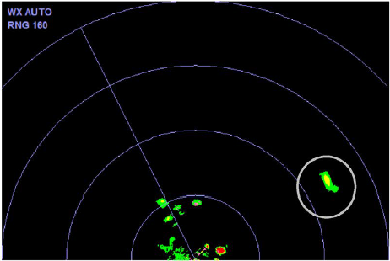
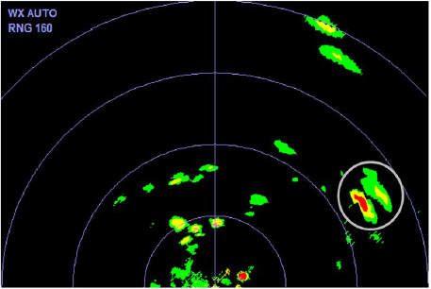
PN: SW69003810-508
Fixes:
Allow retro turbulence to work without air speed
Fixed ground override issues
Fixed WXPD manual altitude text overlay refresh issue.
Enhancements:
Two level turbulence
Long range convective turbulence
Volumetric Buffer retro configuration
Volumetric Buffer processing improvements
Configurable altitude dependent gain and CWD (convective weather determination)
Configurable CFAR threshold for O&G (oil and gas) target overlay
Use topography PDI (Parameter Data Item) water bit for Volumetric Buffer processing
Add download of part number list
12x18” antenna for helicopter installation
Improved test pattern.
SB: 69003810-34-0009 SIL: D202402004286
Notes:
10

Slide 11
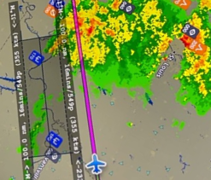
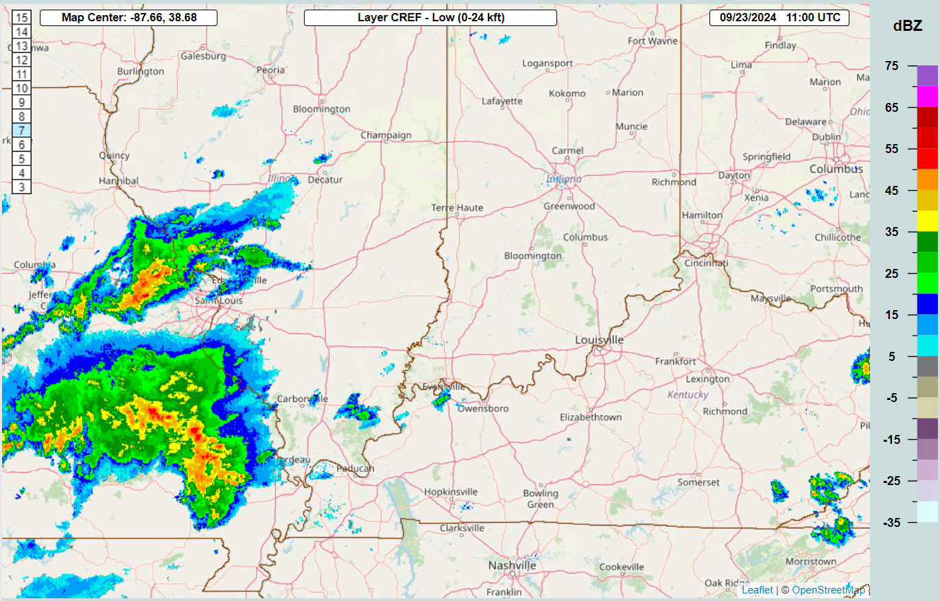
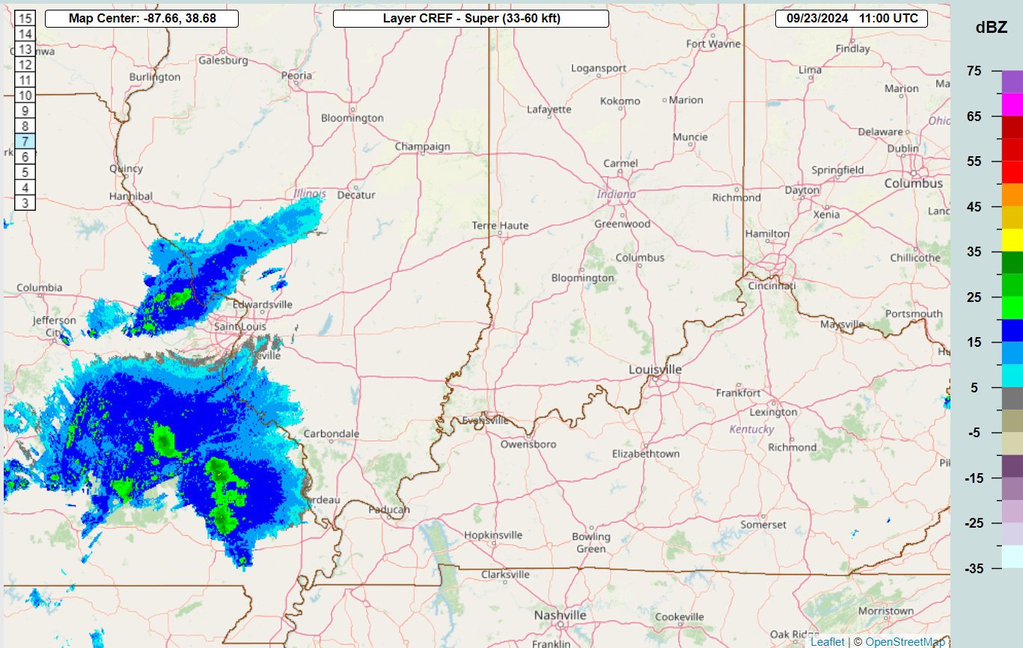
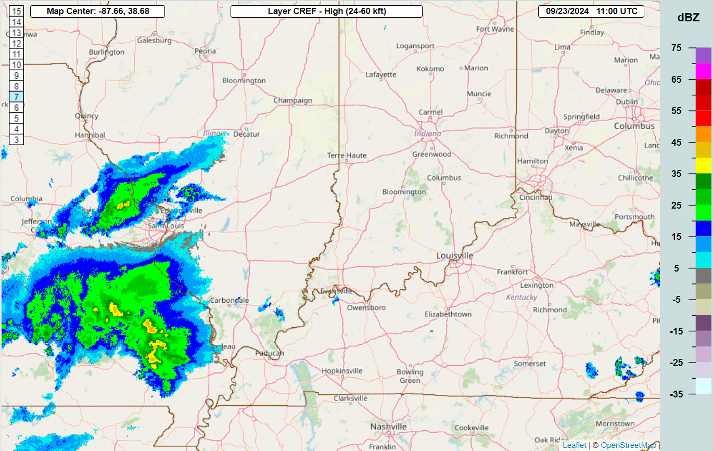

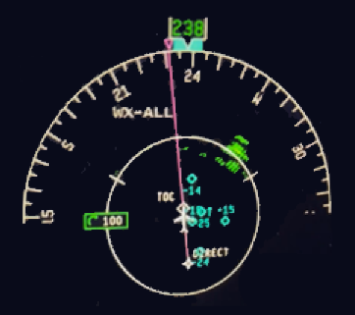
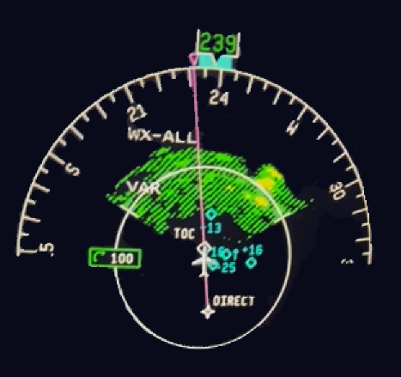
TextRon User Experience
Below 24,000 ft
Above 24,000 ft
Pilot Experience: The customer had the original -504 SW and was disappointed by the level of improvement with the -508 SW loaded.
Case Analysis: Aircraft: Sovereign, Antenna: 12"
Composite weather indicates that weather above 40dBz was present in the area.
Analysis of the weather altitude relative to aircraft altitude (43000 ft) shows that this weather was not hazardous.
Analysis of the weather shows that the higher reflectivity weather would not be detected by any airborne weather radar.
Initial analysis of the config file values indicate that the display of the weather could be modified to more closely match the customer’s expectations by,
1) increase the weather below the aircraft considered to be on-path
2) to increase the gain of the weather at altitude
Above 33,000 ft
100% Manual Gain
Auto Gain
The radar was detecting the weather out to ~130nm
Notes:
11

Slide 12
Additional Online Resources
Notes:
12

Slide 13
RDR-7000 Technical Information
Additional Tools to Address NFF
Pilot Gateway - pilots.honeywell.com
Tech Pubs - aerotechpubs.honeywell.com
  SIL: D202402004286 late weather troubleshooting guide, and improvements for the -508 software (TSO 2.0)
  Pilot Guide: D201911000094
Videos:
  IntuVue RDR-7000 & RDR-4000 | 3D Volumetric Buffer Explained | Honeywell Aerospace (youtube.com)
  Analysis Using Constant Altitude Slices | Honeywell Aerospace (youtube.com)
  RDR-4000 IntuVue Weather Radar Pilot Training for Airbus Aircraft w/Hazard v2.0 Display Features (youtube.com)
Notes:
Here the link to the Honeywell Pilot’s Portal. It contains some of the material listed here and some extras. This is the official weather radar operational portal. You may need to create an account first before you can enter. There are no charges for this operational training material:
13

Slide 14


