Slide 1
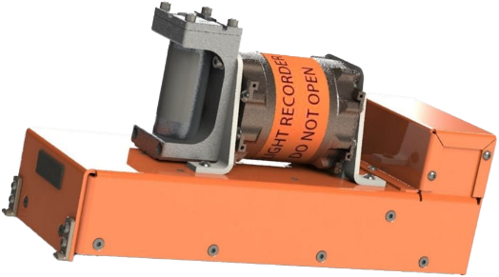
Next-gen recorders
Product FEEDBACK

Slide 2
RECORDERS MANDATE UPDATE
25 HR. CVR MANDATE
FAA REAUTHORIZATION BILL
H.R.3935 - Securing Growth and Robust Leadership in American Aviation Act signed May 17,2024
EASA Reg. 2015/2338, Dec 2015 (Forward fit)
CVR with a recording duration of 25 hours on board aircraft, manufactured after 1 January 2021, with a maximum certificated take-off mass of over 27 000 kg
Other regulators issued mandate (Forward fit)
Malaysia, Singapore, India, Hong Kong, Qatar and China (7/1/2022), All Latin America and Caribbean
FAA issued NPRM, Dec 2023, (Forward fit)
Sec 366 - 25 Hr. Cockpit Voice Recorder (forward fit and retrofit )
Timing: 1 year for forward-fit; 6 years for retro-fit.
COVERED AIRCRAFT.—The term ‘‘covered aircraft’’ means:
(A) an aircraft operated by an air carrier under part 121 of title 14, Code of Federal Regulations; or
(B) a transport category aircraft designed for operations by an air carrier or foreign air carrier type-certificated with a passenger seating capacity of 30 or more or an all-cargo or combi derivative of such an aircraft.
Sec 352 - Flight Data Recovering From Overwater Operation
Timing: 18 months to issue a for new build a/c to comply with means of recovering data
“(1) fitted with a means, in the event of an accident, to recover mandatory flight data parameters in a manner that does not require the underwater retrieval of the cockpit voice recorder or flight data recorder;
Applicable a/c: New build a/c after 1/1/2028 to comply with means of recovering data
GR plan to Support Mandate in Other Countries for Both Forward/Retrofit
CAAC plans to follow the FAA mandate very soon
EASA adopted 25 Hr. recorders first, however no indication on retrofit – GR team to follow up
Latin American countries also discussing about following FAA rule on retrofit
Sec 333 - Helicopter Safety
Timing: 1 year to bring recommendations for legislative or regulatory action to improve safety
Applicable a/c: turbine-powered rotorcraft certificated for 6 or more passenger seats to comply with means of recovering data
Bill Signed for FAA Mandate – Forward Fit and Retrofit (ATR Platforms)

Slide 3
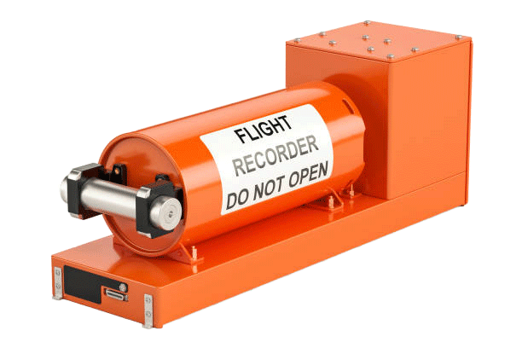
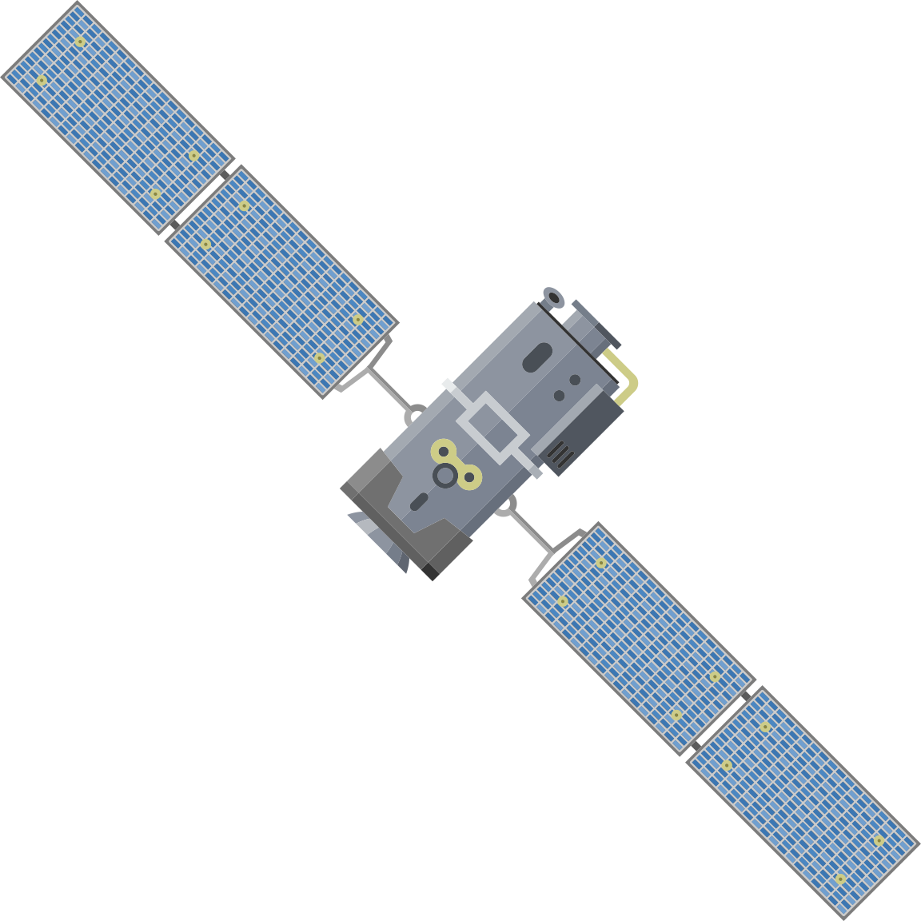
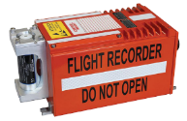
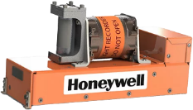
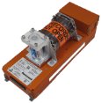
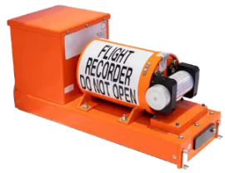
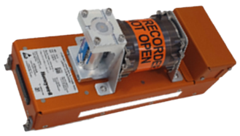
RECORDER PORTFOLIO OVERVIEW
COCKPIT VOICE RECORDERS
+ New Capability
HCR 25 CVR is Connected Recorder with Honeywell developed RTAR (Real Time Access Recorder) Software features built in
HFR 5 CVR Recorders (Olathe production)
HCR 25 CDR
FLIGHT DATA RECORDERS
+ New Capability
HCR 25 FDR is Connected Recorder with Honeywell developed RTAR (Real Time Access Recorder) Software features built in
HFR 5 FDR Recorders (Olathe production)
HCR 25 FDR

Slide 4
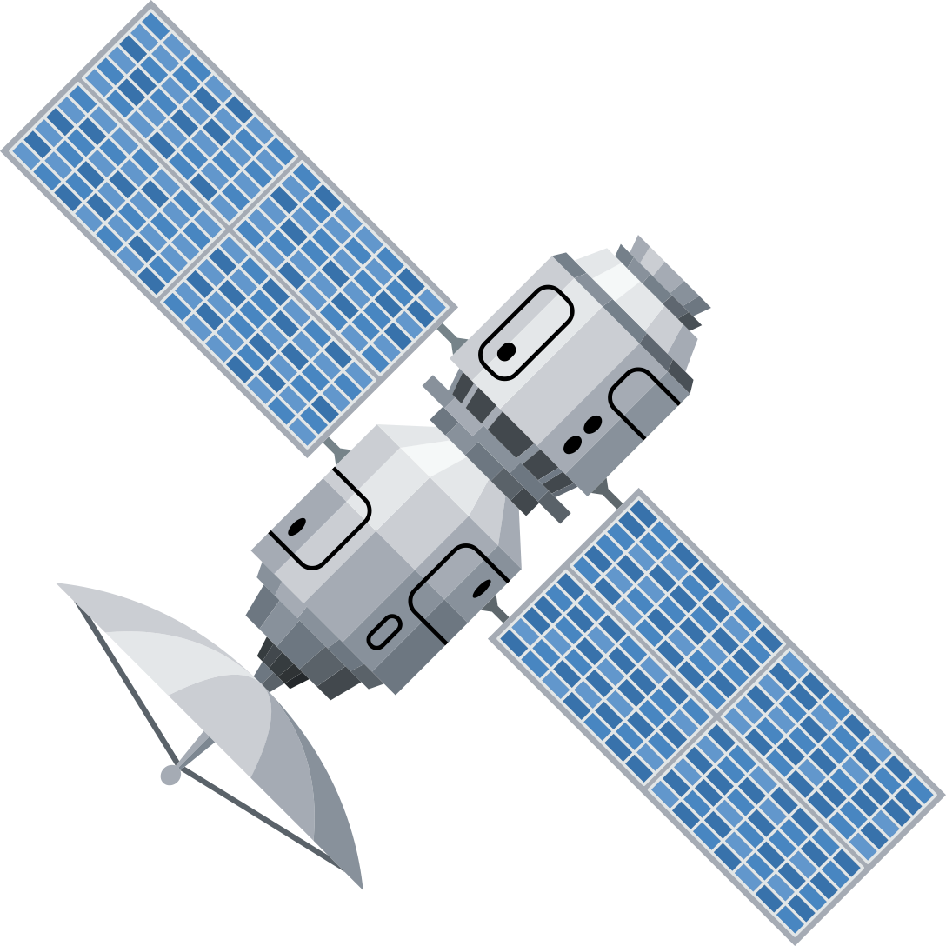
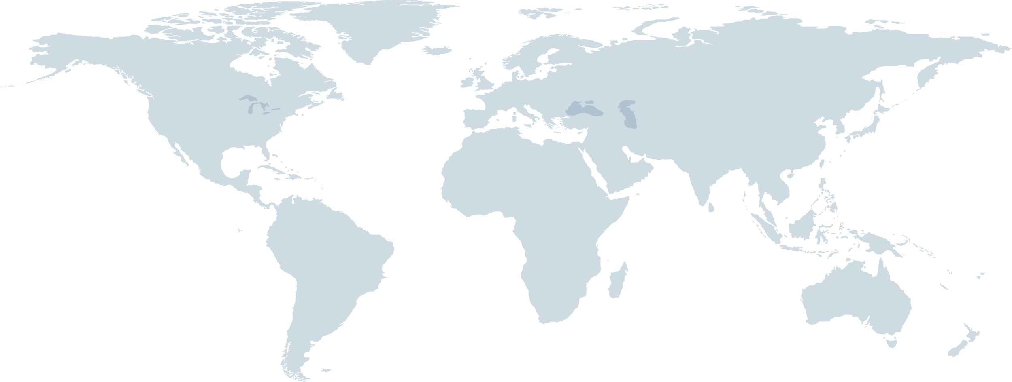
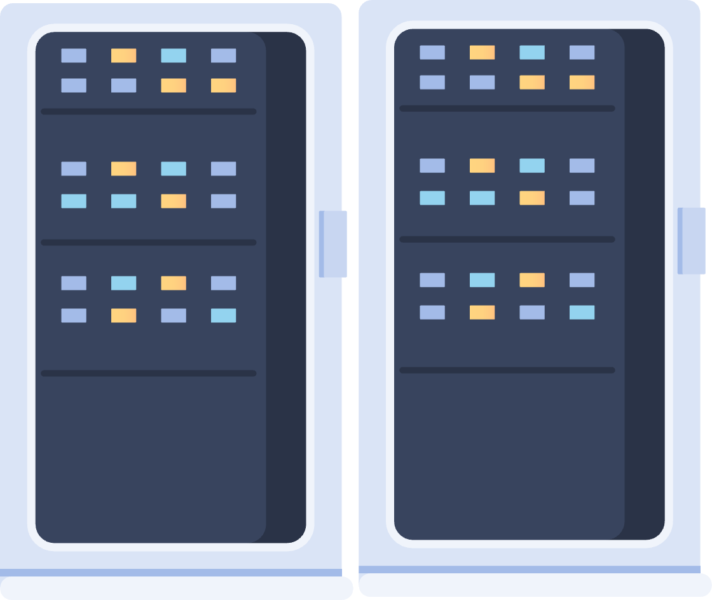
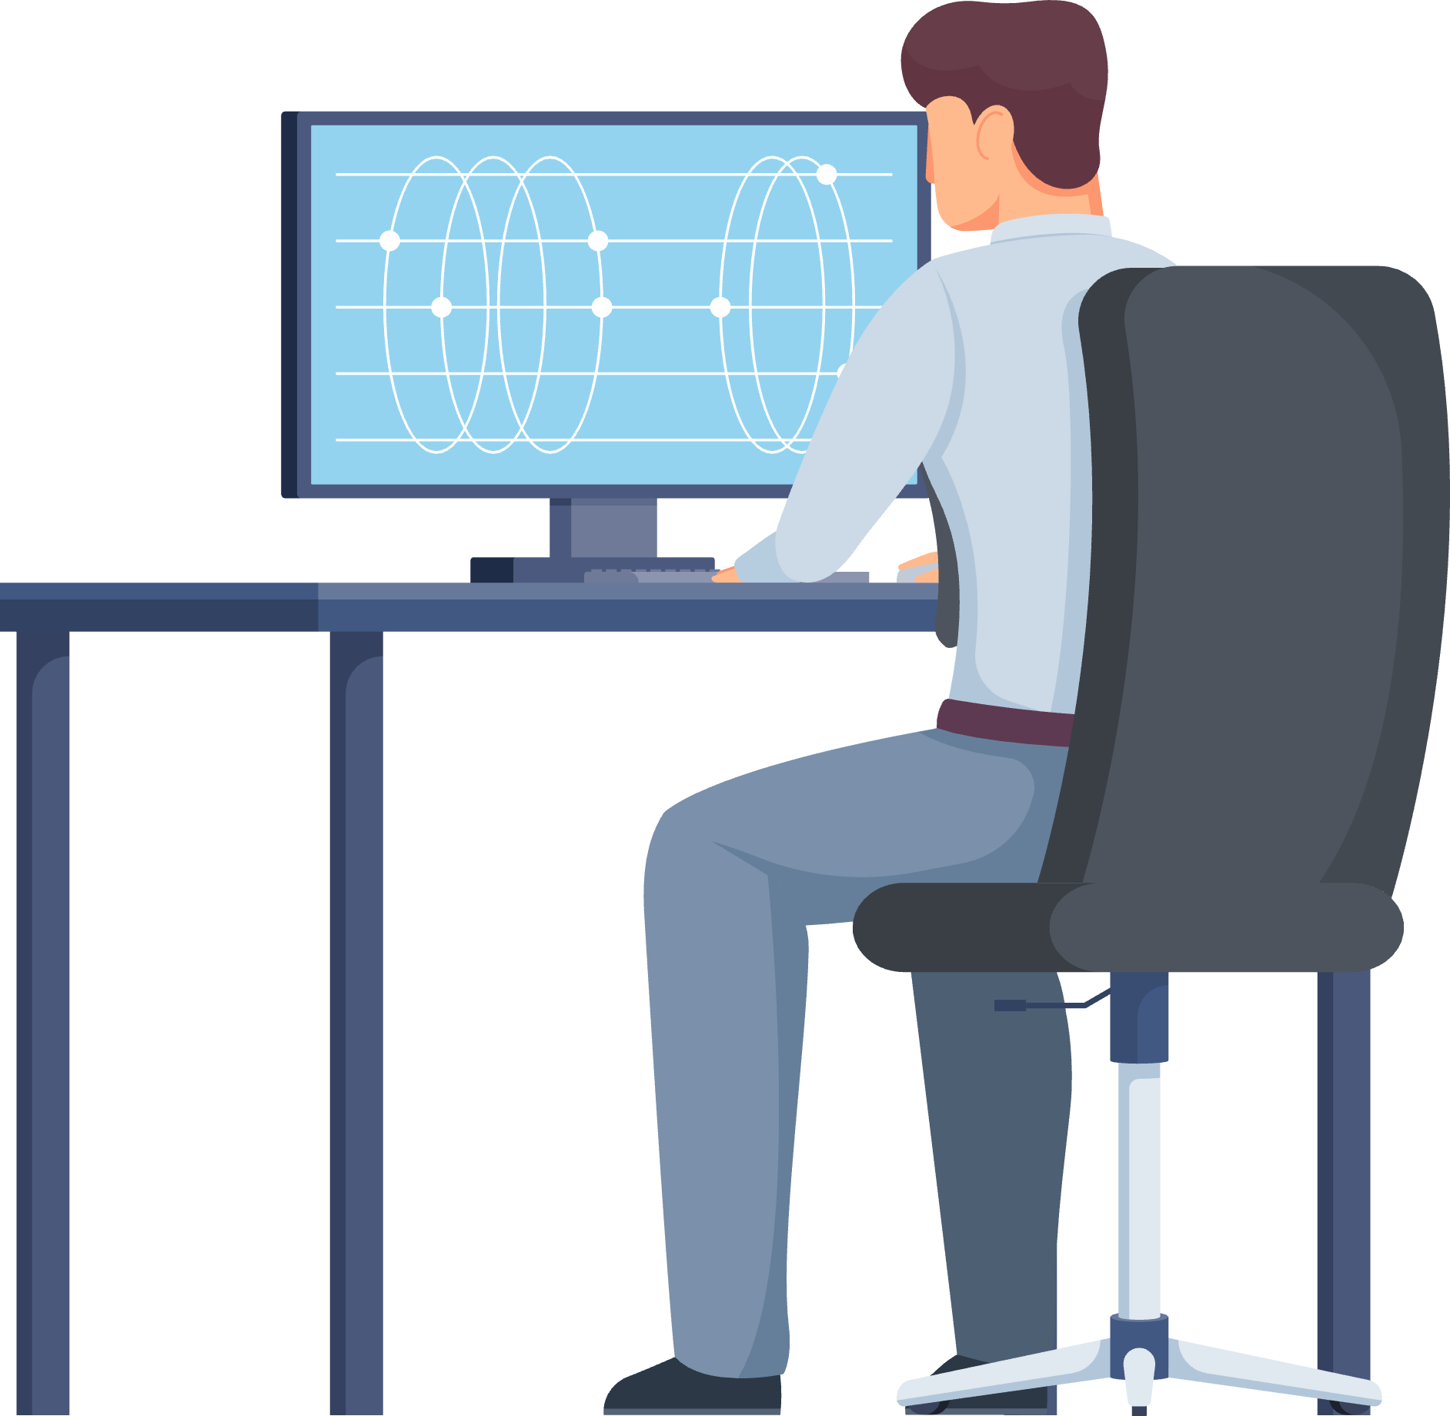
BLACK BOX IN THE SKY
2
Satellite Network with sufficient transmission speed (Mbit/s) and global coverage
HCR 25 contains the hardware and software to support streaming RTAR (real-time access recording software )
1
Monitored airplane with HCR-25 recorder and RTAR installed
Fielded HCR 25 units are ready to be enabled
Service offering to be developed
Ground station used to process received data and reroute it to Data Center
Secured Data Center to store and maintain all received data across fleet
Analytics provided to airline operators. FOQA/Alarms/Event of distress
3
4
5
FUTURE CAPABILITY Safety Personnel could request addition info, modify streaming content in real-time
6
Onboard units (RTAR + SATCOM terminal) capable of Streaming data through secured link
+
Reliable Satellite Network with global coverage
+
Satellite Ground Station with secured connection to data center
+
Cloud - Data Center capable of FDR/CVR data reception and archiving
=
BBITS

Slide 5
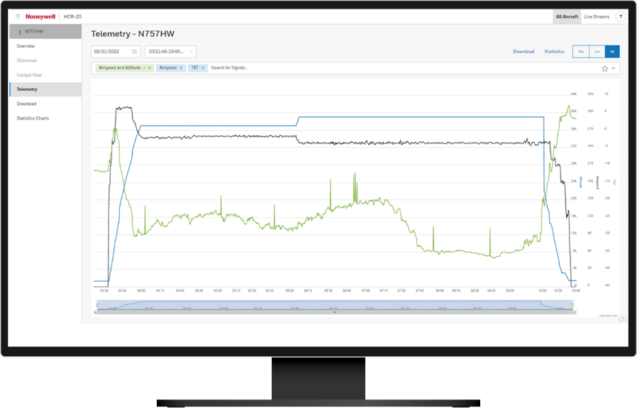
BLACK BOX IN THE SKY
Compliant with FAA mandate for Timely Recovery of Flight Data (Applicable to Part 121). Will this apply to private, charter, and business operators in the future?
Beyond the mandate: Supports real-time streaming of data for flight data monitoring, alerting, and extended analytics.
Safety Alerts - Ability to receive and monitor Flight data parameters in Real Time and provide timely safety alerts, exceedances reports for immediate action or further investigation
Safe Storage - Streamed data stored on an infrastructure - with redundancy to avoid such loss of data
Regulators Action - Immediate access to FDR data by investigators will allow efficient regulatory decisions about grounding fleet
$$ Savings - Maintenance and automated regular inspection of the recorders
Superior solution to competitors — Deployable recorders (75% recovery rate)

Slide 6
VALUE PROPOSITION
Honeywell is a leading supplier of flight recorders for 60 years
HCR-25 CVR + RTAR meets upcoming FAA mandate: 25 hrs of voice recording, TFRD
Data is easy to retrieve in the air or on the ground (configurable on any network)
Drop-in replacement for legacy recorder
Easy retrofit (ARINC installation)
No impact to aircraft wiring or installation
Reduced weight
Future-proofed
Refreshed design and technology, addressing obsolescence
Designed for industry developments or future mandates for Timely Recovery of Flight Data (TRFD)
Connected Recorder
Timely Recovery of Flight Data (TFRD) enabled by RTAR (Real Time Access Recorder) software
Reinvented recorder technology to make critical data available when it’s needed
Cost reductions
Re-use of existing ground support equipment, automated compliance, operational and maintenance checks
Data can be used by airline/operator for operational improvements that may translate to the avoidance of events (i.e., Pilot training)

Slide 7
BLACK BOX IN THE SKY
FEEDBACK Qs for GCC:
If you could analyze FDR/CVR data in real-time, what type of information or analytics would be valuable to you?
Without a mandate in place, would you consider upgrading your current FDR/CVR for this new data capability?
Which connectivity services or channels would this product need to be compatible with to seamlessly integrate into your operations?
2
Satellite Network with sufficient transmission speed (Mbit/s) and global coverage
1
Monitored airplane with HCR-25 recorder and RTAR installed
Ground station used to process received data and reroute it to Data Center
Secured Data Center to store and maintain all received data across fleet
Analytics provided to airline operators. FOQA/Alarms/Event of distress
3
4
5
FUTURE CAPABILITY Safety Personnel could request addition info, modify streaming content in real-time
6
Onboard units (RTAR + SATCOM terminal) capable of Streaming data through secured link
+
Reliable Satellite Network with global coverage
+
Satellite Ground Station with secured connection to data center
+
Cloud - Data Center capable of FDR/CVR data reception and archiving
=
BBITS

Slide 8
Thank You
← Honeywell product feedback interest form
Scan to be notified of product feedback opportunities in your areas of interest.
For additional information, contact:
Jason Pendlum
Sales & Business Development
jason.pendlum@honeywell.com
480-901-3331

Slide 9
BLACK BOX IN THE SKY
Safety Alerts - Ability to receive and monitor Flight data parameters in Real Time and provide timely safety alerts, exceedances reports for immediate action or further investigation
Safe Storage - Streamed data stored on an infrastructure - with redundancy to avoid such loss of data
Regulators Action - Immediate access to FDR data by investigators will allow efficient regulatory decisions about grounding fleet
$$ Savings - Maintenance and regular inspection of the recorders SS saving
Superior solution to competitors — Deployable recorders

