Slide 1
Rail Review
Honeywell Confidential - ©2024 by Honeywell International Inc. All rights reserved.
Honeywell Internal

Slide 2
Rail Review
3051 |  | Pilatus PC12 KSA-2700 Servo Reliability
3053 |  | CMC UTIL Function Fail.
3054 |  | CD-830 Plan/Roadmap
5036 |  | PC-12 NG Fuel Calculations after amending Flight Plan
5037 |  | PC-12 NG Unable to modify flight ID in air.
5040 |  | RDR-4000 Going into STBY after operating in GND Override
3055 |  | Create user guide and create CMC data customized for each platform including known issues/problems
3056 |  | CMS/Ovation - Switch panel built and lit backwards/incorrectly
3057 |  | CMS/Ovation -UIO P/N 990-E2002-002 cycles internal relays when booting up.
3058 |  | CMS/Ovation - CIU DHCP external versus internal - When Ovation is installed
3059 |  | CMS/Ovation - The MIU and briefer panel have ARINC 429 issues
3060 |  | CMS/Ovation - The MIU info box differs from the FMS
3061 |  | CMS/Ovation - SCALAR UNIT
3062 |  | CMS/Ovation - PCU-100 brand new has burnt out pixels
3063 |  | Update CPDLC approved list/equipment/CMF version, etc
7029 |  | CMS/Ovation - Ovation post installation support is NOT the same
Honeywell Confidential - ©2024 by Honeywell International Inc. All rights reserved.
Honeywell Internal

Slide 3

RAIL
Electrical
3051 – Pilatus PC12 KSA-2700 Servo Reliability
Queue
Initiator: Jack Shields
Owner: Ben Miles
Initiation Date: 07-20-2023
Moved to Top 25:
Original Commit Date: 06-30-2024
Problem Description:
Estimated Completion Date: 03-31-2025
    The KSA 2700 PN 065-00190-0101 primary servo MTBF has been greatly reduced over the last year. Each PC-12NG and NGX has 3 of these in each tail. When a single servo fails, the entire AP is disconnected.
% Completed: 50%
Source:
GCC
Criteria to Close:
    Review of the HES Calibration Test Software.
  Repair analysis to determine if anything can be improved.
Status & Dates:
    12 month repair data shows 231(192) returns | October 2024 MTBF 7512(9485)/15000
    Determined previous reliability effort (MOD 1 new interface board) is effective.
    Motors are being saved for FA. Found mostly being replaced as precautionary.
    The ATP has been modified to download the event data first. Decoder has been found.
    Review of the system bench procedure to reduce NFFs. Correlate event data with the repair.
    10/31/24: Sent motors to Clearwater Failure Analysis Lab for teardown and fault isolation.
    11/08/24: Review HEST and determine any improvements (Merle Gaddis).
    11/11/24: Engaged Hardware Engineering
2023 Removals | 12 mos. October 2024
36% Fail incoming test and corrected with HEST. 25% NFF with HEST performed. 14% MOD 1 7% Motor and Magnet. (18% Various Other Reasons) | 23% Reseated Bearing 21% Interface Board 16% NFF 8%Proper Tension 6% Motor and Magnet (15% Various Other Reasons)
KSA-2700
Affected OEMs:
Pilatus
Impacted Regions:
APAC, EMEAI, Americas
Honeywell Confidential - ©2024 by Honeywell International Inc. All rights reserved.
Honeywell Internal

Slide 4
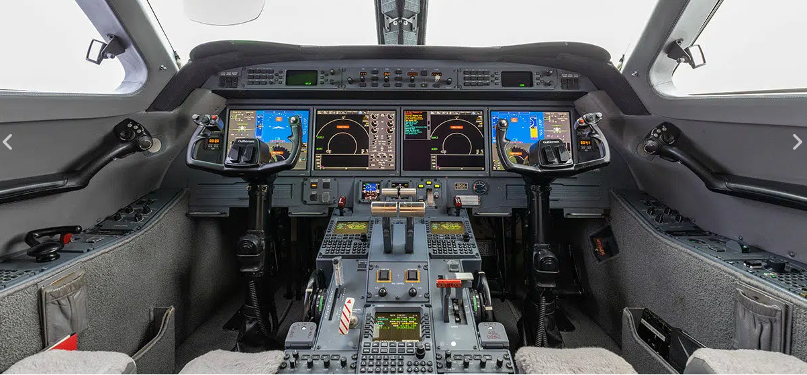
RAIL
Electrical
3053 – CMC UTIL Function Fail
Propose to Close
Initiator: Yibarek Bessey
Owner: David Woodcock
Initiation Date: 05-3-2023
Moved to Top 25:
Original Commit Date: 05-31-2024
Problem Description:
Estimated Completion Date: Dependent on Cert India
    G550 Operators reporting intermittent ‘CMC UTIL FUNCTION FAIL’ maintenance messages (MM# 45452165CMC).
% Completed: 100%
Source:
GCC
Criteria to Close:
    Thought to be a nuisance message, determine if code can be inhibited.
  Find root cause and correct.
Status & Dates:
    Determined the message cannot be inhibited because it’s a function failing where valid maintenance data transmitted from the CMC UTIL that resides on the NIC/PROCs is not being seen by the CMC.
    A past investigations shows root cause was due to an issue in software where under certain instances it was found that CMC calls would never be returned. Upgrading the EPIC FSS software proved to fix this issue. (PR-1524).
    2024 Update: Issue is resolved in G650 Block 3. Keeping on Agenda Follow Up until fix can be confirmed on upcoming G450/G550 certifications.
Affected OEMs:
Gulfstream
Impacted Regions:
APAC, EMEAI, Americas
Honeywell Confidential - ©2024 by Honeywell International Inc. All rights reserved.
Honeywell Internal

Slide 5
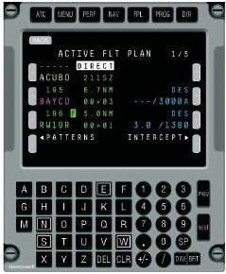
RAIL
Electrical
3054 – CD-830 Plan / Roadmap
Propose to close
Initiator: Chris Christianson
Owner: Troy Holyoak
Initiation Date: 12-07-2023
Moved to Top 25:
Original Commit Date: 05-31-2024
Problem Description:
Estimated Completion Date: 12-31-2024
    The current CD-830 LCD glass is facing obsolescence. What is the plan or roadmap to address this obsolesce? Will a new Control Display Unit (CDU) part number need to be certified on my aircraft.
% Completed: 100%
Source:
GCC
Criteria to Close:
    Communicate the plan / roadmap for the CD-830.
Status & Dates:
    Q1 of 2025 – The new LCD will be MOD F. The CD-830 is expected to continue production into the 2030’s. There is currently enough of the current LCD glass to last 5 years or greater to support repairs of the CD-830. After the run-out date of the current LCD glass the MOD will be chargeable for repairs.
    For HAPP or MSP customers, they will get a new MOD CD-830 for an exchange FOC if there are no more current MOD CD-830s available.
    Article #000045275 published on the portal to communicate status.
    Effective July 1, 2024, TES Parts LLC, will be authorized to distribute these Honeywell products in new condition to BGA aftermarket customers globally, including Honeywell’s Channel Partners and dealers.
    Please add TES Parts to your Authorized Supplier List; Company: TES Parts, LLC
    Address: 600 Railhead, STE 200
    City, State: Fort Worth, Texas
    Postal Code: 76106
    Country: USA
    DUNS Number: 098814843
    Website: www.tesservice.com
CD-830
Affected OEMs:
Bombardier, Dassault, Embraer, Gulfstream
Impacted Regions:
APAC, EMEAI, Americas
Honeywell Confidential - ©2024 by Honeywell International Inc. All rights reserved.
Honeywell Internal

Slide 6
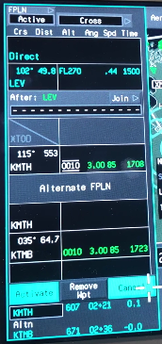
RAIL
Operations
- PC-12 NG Fuel Calculations after amending Flight Plan
5036
propose to close
Initiator: Brent McCasland
Owner: Troy Holyoak
Initiation Date: 10-04-2018
Moved to Top 25: 11-28-2018
Original Commit Date: 4-10-2019
Problem Description:
Estimated Completion Date: 12/31/24
    When amending the Flight Plan route the system makes new Time, Distance & Fuel calculations for the amended route. The time and distance calculations are correct; however, the fuel calculation is incorrect until the route is accepted.
% Completed: 100%
Source:
GCC
Criteria to Close:
    Revise product roadmap for future software updates to include change which corrects the fuel calculation when amending route.
Status & Dates:
    Customer video supplied for engineering review.
    1/28/19: Engineering flight test complete. Problem reproduced on aircraft
    PAR assigned: C_APPS_APEX_PAR_1874.
    The PAR places it in the engineering roadmap to fix in a future build
    Issue has been fixed in Core Apex software. Will be in next available PC-12 & PC-24 load (Per Patty Bass 12/5/2019). Dates TBA by Pilatus
    10/2020: Awaiting certification and delivery on aircraft with new software load for confirmation. Date TBD by Pilatus.
    10/12/2021: Criteria to close RAIL has been met. However, Pilatus has not had a software release for the PC-12 NG and the GCC wanted to keep it open to confirm despite having met closure criteria.
    2024 Status: Confirmed by customer on the PC12NGX and PC24 issue has been corrected. Waiting for future load to confirm on PC12NG. What load?
Affected OEMs:
Pilatus, Viking, Syberjet, HAIG, Antonov
PC12NG ( No scheduled S/W Release ) - PC12NGX (Complete 12.7) - PC24 (Complete B5)
Impacted Regions:
APAC;EMEAI;Americas
Honeywell Confidential - ©2024 by Honeywell International Inc. All rights reserved.
Honeywell Internal

Slide 7
RAIL
Operations
- PC-12 NG Unable to modify flight ID in air
5037
Propose to close
Initiator: Jack Shields
Owner: Troy Holyoak
Initiation Date: 10-04-2018
Moved to Top 25: 11-28-2018
Original Commit Date: 4-10-2019
Problem Description:
Estimated Completion Date: 12/31/24
    If the Flight ID is not changed while on the ground, it cannot be modified once airborne. This causes confusion with ATC because the filed Flight ID doesn’t match what is being output by the transponder.
% Completed: 100%
Source:
GCC
Criteria to Close:
    Revise product roadmap for future software updates to include the ability to change the Flight ID both on the ground and in the air.
Status & Dates:
    Issue reported to engineering for evaluation. FAA guidance suggests that there should be the ability to change Flight ID to match what is filed.
    1/28/2019: Flight Test Completed, works correctly in next load. Release TBA
    1/31/2020: PC-12 NGX deliveries in March 2020 will have fix. Retrofit aircraft date has not been announced by Pilatus
    10/2020: PC-12 NGX software released, and aircraft delivered. Waiting for confirmation of fix on both NGX & NG before closing per GCC.
    10/12/2021: Criteria to close RAIL has been met. However, Pilatus has not had a software release for the PC-12 NG and the GCC wanted to keep it open to confirm despite having met closure criteria.
    2024 Status: Confirmed by customer on the PC12NGX and PC24 issue has been corrected. Waiting for future load to confirm on PC12NG. What load?
Affected OEMs:
Pilatus, Viking, Syberjet, HAIG, Antonov
PC12NG ( No scheduled S/W Release ) - PC12NGX (Complete) - PC24 (Complete)
Impacted Regions:
APAC;EMEAI;Americas
Honeywell Confidential - ©2024 by Honeywell International Inc. All rights reserved.
Honeywell Internal

Slide 8
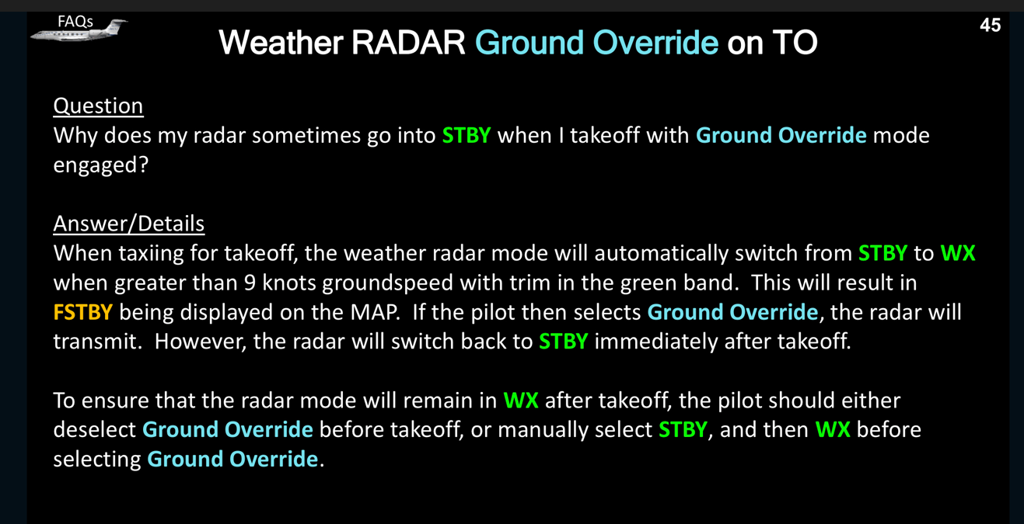
RAIL
Operations
5040 – RDR-4000 Going into STBY after operating in GND Override
Propose to close
Initiator: John Cain
Owner: David Woodcock
Initiation Date: 11-4-2023
Moved to Top 25:
Commit Date: 5/31/2024
Problem Description:
Estimated Completion Date: 11/30/2024
If operator uses Ground Override to activate radar on the ground. After takeoff the radar reverts to Standby mode by itself.
% Completed: 100%
Source:
Criteria to Close:
Confirm operation is not per design, identify fix for implementation in G500/600/700/800.
-5/1/23 - Issue investigated and confirmed with GAC that it is not intended operation.
-7/11/23 - Existing PARs Identified
C_GAC_GVII_PAR_3482
C_CA4_GVIII_PAR_232
-11/5/2024: Issue confirmed to be resolved on G700, and G500/G600 Block 2
Proper operation is verified. If in Ground Override, after radar switches to whichever mode is set in the RADAR MODE selection.
Status & Dates:
Affected OEMs:
Gulfstream
Impacted Regions:
APAC; EMEAI; Americas
Honeywell Confidential - ©2024 by Honeywell International Inc. All rights reserved.
Honeywell Internal

Slide 9
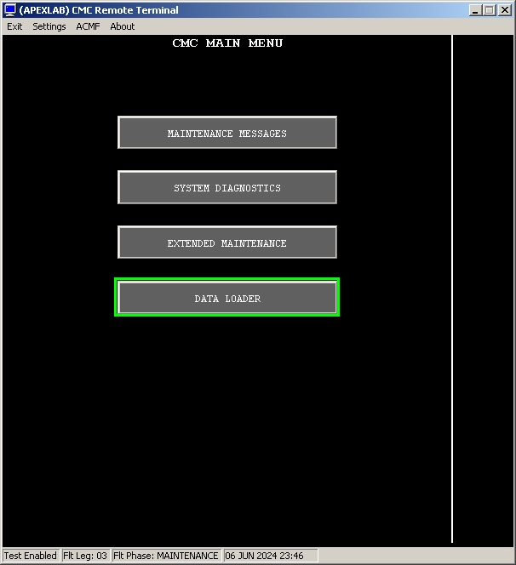
RAIL
Electrical
3055- Create CMC user guide
New
Initiator: Jack Shields
Owner: Troy Holyoak
Initiation Date: 4-10-2024
Moved to Top 25:
Original Commit Date: 12-31-2025
Problem Description:
Estimated Completion Date: 12-31-2025
    Not all CMC features/functionality are defined in the Flight Line Maintenance Manual. It has been requested to define all of the features such as return to service testing.
% Completed: 10%
Source:
GCC
Criteria to Close:
    Communicate the plan / roadmap for creation
Status & Dates:
    Honeywell started collecting data for the document to include CMC functions not included in the FLMM in June. During that process we determined it was a much larger task than originally planned.
    Honeywell is developing the roadmap to create the document or add it to the FLMM.
    Engineering and Tech Pubs teams are working together to capture images and steps for these functions.
CMC
Affected OEMs:
Pilatus
Impacted Regions:
Americas
Honeywell Confidential - ©2024 by Honeywell International Inc. All rights reserved.
Honeywell Internal

Slide 10
Operations
- CMS PN 990-S9101-001-Switch Panel Built Incorrectly
RAIL
3056
Propose to close
Initiator: Rich Van Riper
Owner: Sean Fowler
Initiation Date: 05/13/2024
Moved to Top 25:
Original Commit Date: 09/27/2024
Problem Description:
Estimated Completion Date: 09/27/2024
    Aircraft SN 9090 has two of these switches and one is the correct color, and one is incorrect.
% Completed: 100%
Source:
GCC
Criteria to Close:
    Find correct switch light color and determine root cause.
Status & Dates:
    05/31/2024: Created SR-169419 and Rail from GCC F2F rail Submission.
    06/17/2024: Collected history and background on all 8 GCC Ovation SRs
    06/24/2024: Met internally to discuss GCC Ovation SR disposition
    07/17/2024: Customer telecon to brief on forward plan
    07/18/2024: Request support from Quality and CAR
    08/28/2024: CAR completed and drawing updated
Solution:
Switch drawing was found to have incorrect markings causing confusion on the production line. Drawing was corrected and new revision release to avoid issue in the future.
Affected OEMs:
Duncan Aviation, Bombardier
Impacted Regions:
APAC;EMEAI;Americas
Honeywell Confidential - ©2024 by Honeywell International Inc. All rights reserved.
Honeywell Internal

Slide 11
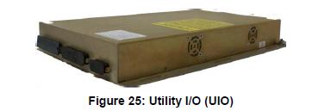
Operations
- CMS/Ovation - UIO P/N 990-E2002-002 cycles internal relays when booting up.
RAIL
3057
Agenda Follow Up
Initiator: Rich Van Riper
Owner: Sean Fowler
Initiation Date: 05/31/2024
Moved to Top 25:
Original Commit Date: 11/14/2024
Problem Description:
Estimated Completion Date: 12/21/2024
    When the UIO PN 990-E2002-002 is first booted up , it goes thru a BITE. When the BITE is occurring, it cycles all the internal relays for the analog interfaces causing uncommented movement of shades, motors, and lights in the cabin.
% Completed: 50%
Source:
GCC
Criteria to Close:
    Find root cause and conduct corrective action.
Status & Dates:
    05/31/2024 Created SR-169753 and Rail from GCC F2F rail Submission.
    06/24/2024: Met internally to discuss GCC Ovation SR disposition
    06/17/2024: Collected history and background on all 8 GCC Ovation SRs
    07/17/2024: Customer telecon to brief on forward plan
    08/12/2024: Internal meeting to restart RCCA from previous investigation SR-164107
    09/05/2024: Internal task meeting conducted to discuss forward plan
    10/22/2024: Investigation continues to verify previously found Root Cause
Affected OEMs:
Duncan Aviation, Bombardier
Impacted Regions:
APAC;EMEAI;Americas
Honeywell Confidential - ©2024 by Honeywell International Inc. All rights reserved.
Honeywell Internal

Slide 12
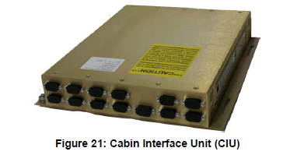
Operations
- CMS/Ovation - CIU DHCP external versus internal - When Ovation is installed.
RAIL
3058
Propose to close
Initiator: Rich Van Riper
Owner: Sean Fowler
Initiation Date: 05/31/2024
Moved to Top 25:
Original Commit Date: 11/14/2024
Problem Description:
Estimated Completion Date: 11/14/2024
    When Ovation is installed; the CIU is the main ETHERNET switch for the system. Depending on the installation; sometimes the CIU is strapped for EXTERNAL DHCP. When this happens and the router fails or loses connection; the cabin becomes INOP.
% Completed: 100%
Source:
GCC
Criteria to Close:
    Find root cause and conduct corrective action.
Status & Dates:
    05/31/2024 Created SR-169755 and Rail from GCC F2F rail Submission.
    06/17/2024: Collected history and background on all 8 GCC Ovation SRs
    06/24/2024: Met internally to discuss GCC Ovation SR disposition
    07/17/2024: Customer telecon to brief on forward plan
    08/28/2024: Potential Root Cause found, SIL planned
Solution:
CIU DHCP faults were determined to be external to the box. A product improvement to handle external DHCP faults may be possible but is not planned at this time.
The CIU’s tested for this issue were found to be performing to specification.
Affected OEMs:
Duncan Aviation, Bombardier
Impacted Regions:
APAC;EMEAI;Americas
Honeywell Confidential - ©2024 by Honeywell International Inc. All rights reserved.
Honeywell Internal

Slide 13
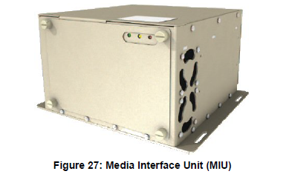
Operations
- CMS/Ovation - MIU and briefer panel ARINC 429 issues.
RAIL
3059
Propose to close
Initiator: Rich Van Riper
Owner: Sean Fowler
Initiation Date: 05/31/2024
Moved to Top 25:
Original Commit Date: 11/14/2024
Problem Description:
Estimated Completion Date: 11/14/2024
    The JETMAP briefer controller can NOT see the FMS flight plan ARINC 429 labels, even when the MIU can.
% Completed: 100%
Source:
GCC
Criteria to Close:
    Find root cause and conduct corrective action.
Status & Dates:
    05/31/2024: Created SR-169756 and Rail from GCC F2F rail Submission.
    06/17/2024: Collected history and background on all 8 GCC Ovation SRs
    06/24/2024: Met internally to discuss GCC Ovation SR disposition
    7/17/2024: Customer telecon to discuss issue and possible fixes - Consensus was to have customer review available SBs for applicability
Solution:
Media Interface Unit Service Information Letter (Doc# D202310004157) details how to move to the updated MIU PN: 990-61051640-01. New PN has a number of fixes rolled in as part of the product improvement program.
Affected OEMs:
Duncan Aviation, Bombardier
Impacted Regions:
APAC;EMEAI;Americas
Honeywell Confidential - ©2024 by Honeywell International Inc. All rights reserved.
Honeywell Internal

Slide 14
Operations
- CMS/Ovation - The MIU info box differs from the FMS.
RAIL
3060
Propose to close
Initiator: Rich Van Riper
Owner: Sean Fowler
Initiation Date: 05/31/2024
Moved to Top 25:
Original Commit Date: 11/14/2024
Problem Description:
Estimated Completion Date: 11/14/2024
    The MIU (990-5164-001) has software issues showing FMS data accurately destination , TTD between the INFO box and the map info versus if the JETMAP briefer controller is used or not as well. The database between the JETMAP controller do NOT match each other based on config when in use.
% Completed: 100%
Source:
GCC
Criteria to Close:
    Find root cause and conduct corrective action.
Status & Dates:
    05/31/2024: Created SR-169756 and Rail from GCC F2F rail Submission.
    06/17/2024: Collected history and background on all 8 GCC Ovation SRs
    06/24/2024: Met internally to discuss GCC Ovation SR disposition
    7/17/2024: Customer telecon to discuss issue and possible fixes - Consensus was to have customer review available SBs for applicability
Solution:
Media Interface Unit Service Information Letter (Doc# D202310004157) details how to move to the updated MIU PN: 990-61051640-01. New PN has a number of fixes rolled in as part of the product improvement program.
Affected OEMs:
Duncan Aviation, Bombardier
Impacted Regions:
APAC;EMEAI;Americas
Honeywell Confidential - ©2024 by Honeywell International Inc. All rights reserved.
Honeywell Internal

Slide 15

Operations
- CMS/Ovation - SCALAR Boot up Issue.
RAIL
3061
Agenda Follow Up
Initiator: Rich Van Riper
Owner: Sean Fowler
Initiation Date: 05/31/2024
Moved to Top 25:
Original Commit Date: 11/14/2024
Problem Description:
Estimated Completion Date: 11/14/2024
    When the SCALAR boots up and does NOT see its ID ; the Ovation thinks it needs software, reloads it ,and then REQUIRES a cabin reboot. This loop sometimes can be asked for 3 times in a row hindering flight ops prior or during principal arrival.
% Completed: 25%
Source:
GCC
Criteria to Close:
    Find root cause and conduct corrective action.
Status & Dates:
    05/31/2024: Created SR-169758 and Rail from GCC F2F rail Submission.
    06/17/2024: Collected history and background on all 8 GCC Ovation SRs
    06/24/2024: Met internally to discuss GCC Ovation SR disposition
    07/17/2024: Customer telecon to discuss issue and forward plan - Customer related that SCALAR issue is #1 priority for them
    9/10/2024: Met with Rosen on resuming previous investigation
    Root cause is an intermittent internal bus fault that interrupts Scalar boot sequence which results in an unrecoverable error. The proposed solution would require a re-spin of the main board of the Scalar, new SW, and document updates. The required re-spin has been determined to be unfeasible when compared against the fielded unit inventory and future demand.
    The Cabin Management Business unit has an initial plan to offer items and services that would compensate affected customers. Details of the plan can be discussed with the business team via telecon.
Affected OEMs:
Duncan Aviation, Bombardier
Impacted Regions:
APAC;EMEAI;Americas
Honeywell Confidential - ©2024 by Honeywell International Inc. All rights reserved.
Honeywell Internal

Slide 16
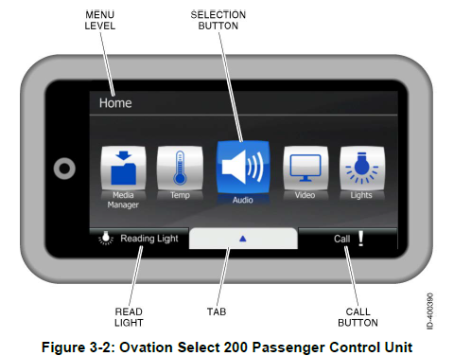
Operations
- CMS/Ovation - PCU-100 brand new has burnt out pixels
RAIL
3062
Propose to close
Initiator: Rich Van Riper
Owner: Sean Fowler
Initiation Date: 05/31/2024
Moved to Top 25:
Original Commit Date: 11/14/2024
Problem Description:
Estimated Completion Date: 11/14/2024
    Customers are complaining that a brand new PCU-100 when first powered up have burnt out pixels. This is unacceptable and gets rejected. Per customer comments ; the SPEX units have better screens than the new ones regarding pixels.
% Completed: 100%
Source:
GCC
Criteria to Close:
    Find root cause and conduct corrective action.
Status & Dates:
    05/31/24 Created SR-169762 and Rail from GCC F2F rail Submission.
    06/17/2024: Collected history and background on all 8 GCC Ovation SRs
    06/24/2024: Met internally to discuss GCC Ovation SR disposition
    07/17/2024: Customer telecon to brief on forward plan
    07/18/2024: Request support from Quality and CAR
    08/22/2024: CAR entered by Quality
    09/14/2024: Suspect screens removed from production; new screens put through additional testing
Solution:
Acceptance Test Procedure (ATP) changed to add two additional tests. The allowable pixel faults were reduced from 5-6 to 1-2 with the production goal being zero.
Affected OEMs:
Duncan Aviation, Bombardier
Impacted Regions:
APAC;EMEAI;Americas
Honeywell Confidential - ©2024 by Honeywell International Inc. All rights reserved.
Honeywell Internal

Slide 17

Operations
3063
RAIL
- Update CPDLC approved list/equipment/CMF version, etc
Agenda Follow Up
Initiator: Rich Van Riper
Owner: David Woodcock
Initiation Date: 05/31/2024
Moved to Top 25:
Original Commit Date: 11/13/2024
Problem Description:
Estimated Completion Date: 03/31/2025
    Now that the A056 rule has been lightened or lifted; the BGA fleet needs an updated list from HON about which aircraft models, avionics combinations of equipment, and what is allowed to participate.
% Completed: 85%
Source:
GCC
Criteria to Close:
    Up-to-Date Domestic Participation List
    Up-to-date Maastricht White/Black List
    Requirements and limitations added to Capabilities SIL (D201802000051)
Status & Dates:
    05/31/2024: Created SR-169766 and Rail from GCC F2F rail Submission.
    07/19/2024: Reviewed FAA Participation List and identified inconsistencies
    08/10/2024: Updated Capabilities SIL for AC90-117 LOA for A056 for latest
    aircraft applicability.
    11/01/2024: Re-evaluated stated limitations in Classic EPIC, APEX, and
    Legacy NZ/APEX software to get official Participation list
    corrected. Matrix also to be added to Capabilities SIL
    (D201802000051)
Affected OEMs:
Solution:
In-Work
Duncan Aviation
Bombardier, Dassault, Embraer, Gulfstream, Pilatus, Textron
Impacted Regions:
APAC;EMEAI;Americas
Honeywell Confidential - ©2024 by Honeywell International Inc. All rights reserved.
Honeywell Internal

Slide 18

Operations
- CMS/Ovation – Ovation post installation support is not to the expected standard.
RAIL
7029
Agenda Follow Up
Initiator: Rich Van Riper
Owner: Sean Fowler
Initiation Date: 05/31/2024
Moved to Top 25:
Original Commit Date: 11/14/2024
Problem Description:
    The CMS group (after the C series transition to OVATION product) is NOT the same. The former BAKER group for the C series had a structure and had POCs for pre and post delivery plus mods support. Honeywell contacts have moved on or been restricted and per aircraft model direct support is no longer offered.
Estimated Completion Date: 11/14/2024
% Completed: 75%
Source:
GCC
Criteria to Close:
    Find root cause and conduct corrective action.
Status & Dates:
    05/31/24 Created SR and Rail from GCC F2F rail Submission.
    06/17/2024: Collected history and background on all 8 GCC Ovation SRs
    06/24/2024: Met internally to discuss GCC Ovation SR disposition
    07/17/2024: Customer telecon to brief on forward plan
    08/02/2024: Met with CMS PAC on improvement actions
    09/16/2024: Presented at CMS PAC on several cases and their specific improvement actions
    10/09/2024: Gather data and propose additions to customer response team
    10/22/2024: Met with CMS PAC to discuss enhanced customer support plan
Proposed Solution:
    Cabin Management structure underwent a number of improvements to enhance customer support.
    CMS staffing levels were increased
    Priority scoring was changed to provide improved post-installation (Aftermarket) support.
    The CMS group was restructured to include a dedicated Quality Engineer.
    A campaign to establish stronger relations with CMS supplies was initiated and now regular meetings occur to cover reported field failures.
Affected OEMs:
Duncan Aviation, Bombardier
Impacted Regions:
APAC;EMEAI;Americas
Honeywell Confidential - ©2024 by Honeywell International Inc. All rights reserved.
Honeywell Internal

